Slide 1
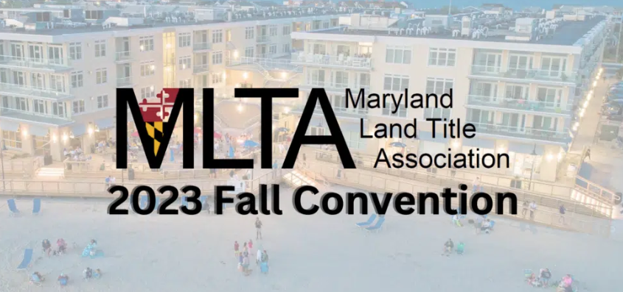

Slide 2
Cannabis in Real Estate – What’s the Latest Eric D. Oberer, Esq., CLTP Maryland State Counsel First American Title Insurance Company

Slide 4
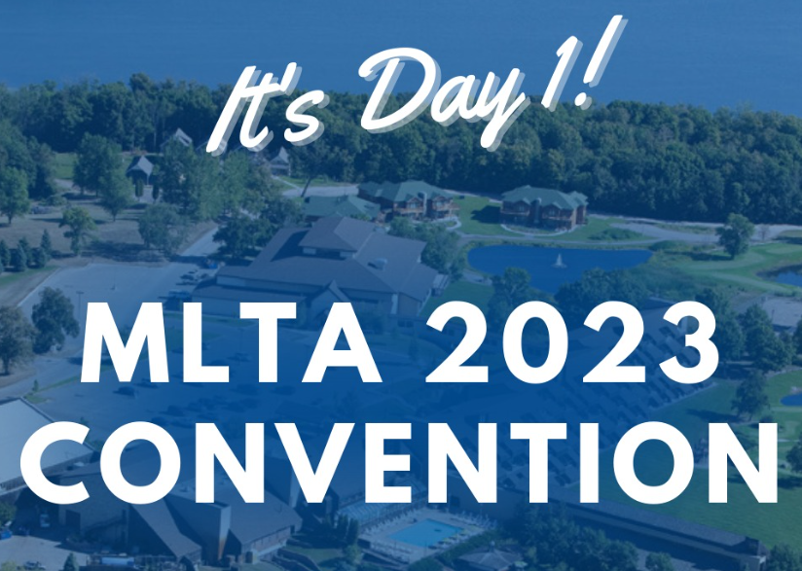

Slide 5
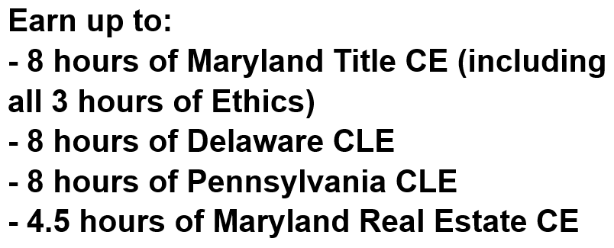

Slide 6
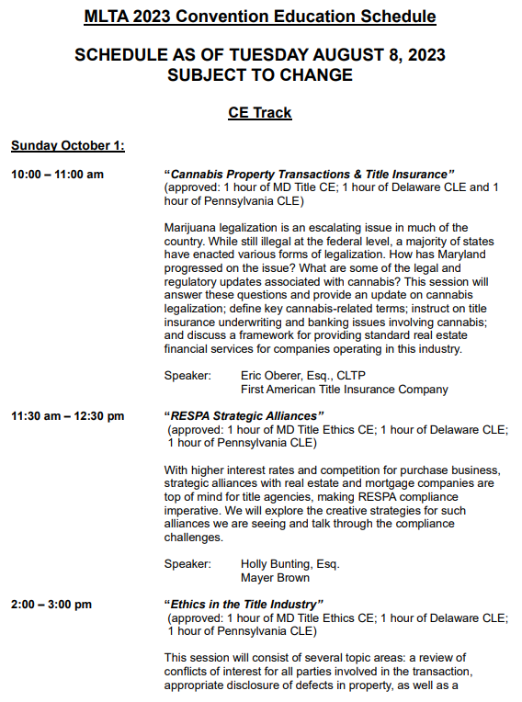

Slide 7
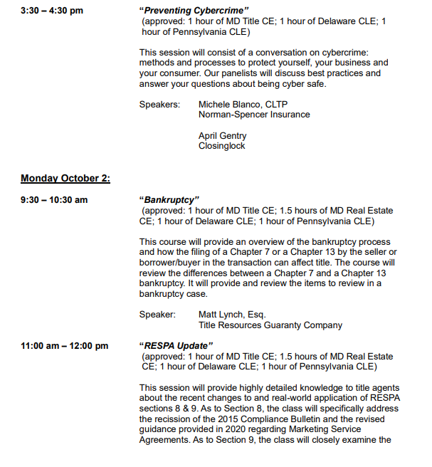

Slide 8
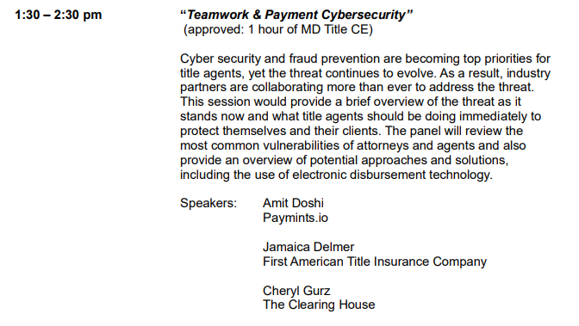
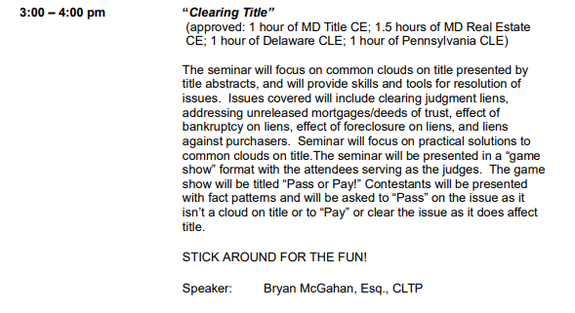

Slide 9
Cannabis in Real Estate – What’s the Latest Eric D. Oberer, Esq., CLTP Maryland State Counsel First American Title Insurance Company

Slide 10
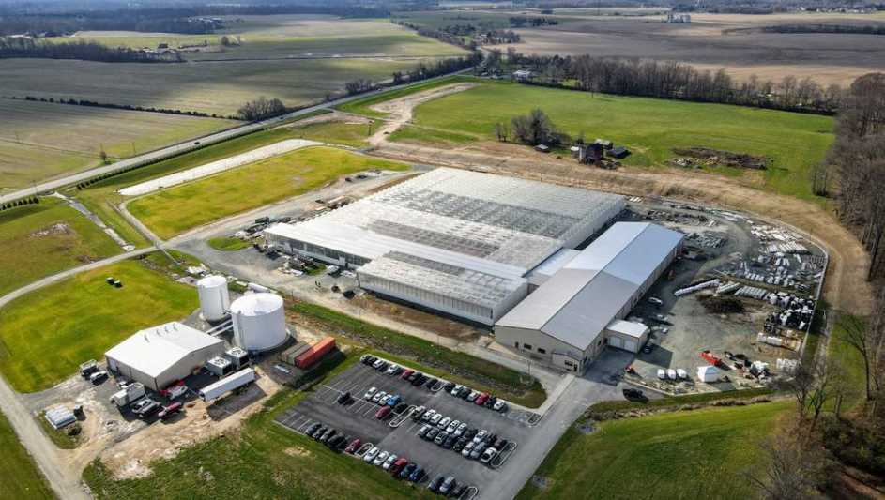
The New Cash Crop
Notes:
•Along a flat road in rural Cecil County stands a long, nondescript building.
•Inside is one of the most important cultivation and processing operations for Maryland’s new cash crop — cannabis.

Slide 11
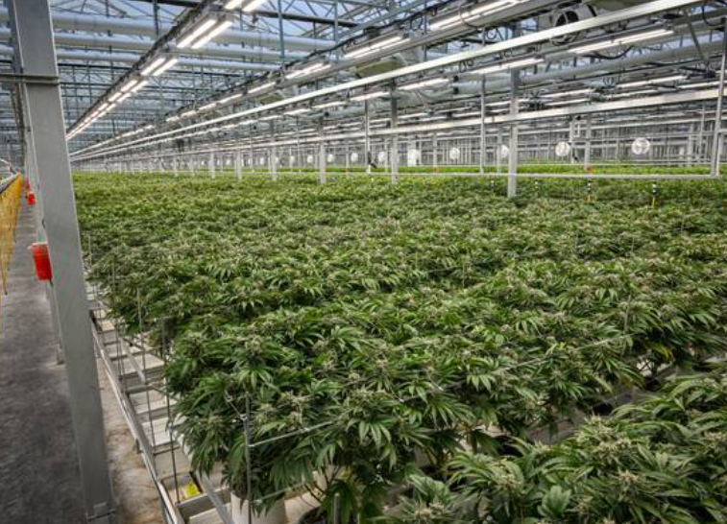
July 1, 2023
Notes:
•As of Saturday, July 1, SunMed Growers, now sells to any individual 21 or older
vapes, gummies, pre-rolled joints, edibles and more.
•There are now about 100 dispensaries statewide paying licensing fees that typically
range between $100,000 and $2 million based on their revenue.

Slide 12
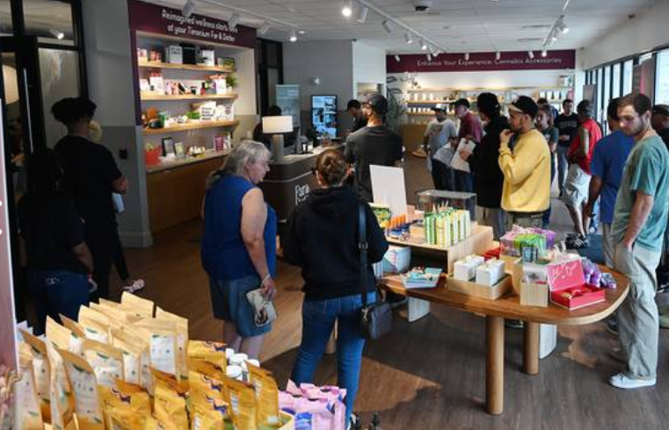
Shifting Public Opinion
Notes:
•Ninety years ago, alcohol was nationally legalized after 14 years of prohibition.
•Maryland is now among 23 states, plus Washington, D.C., to legalize recreational cannabis.
•The majority of Americans now favor its legalization: In 1995, just 25% of Americans supported legalization, while 68% did in 2021.

Slide 13
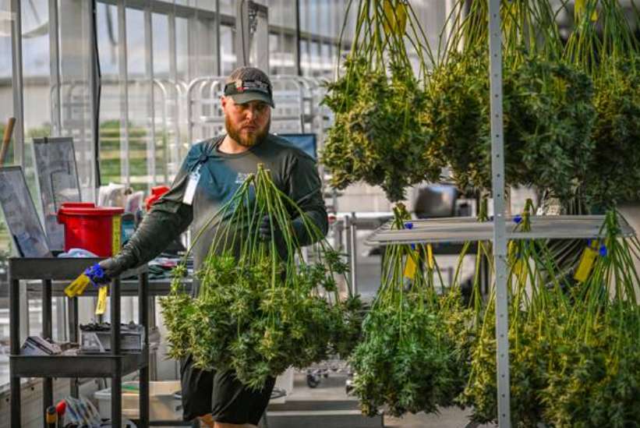
Expansion
Notes:
•Voters approved it in a referendum in November piggybacking on the existing medical cannabis industry,
which was legalized in 2014 but didn’t see its first sales until 2017.
•Maryland already has a substantial medicinal market, with roughly 100 dispensaries open in the state.
Of those, at least 94 have converted their licenses from medical-only to add recreational.

Slide 14
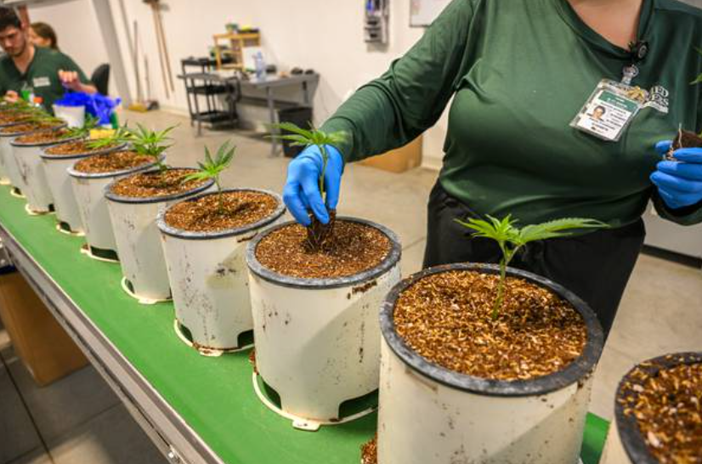
Challenges
Notes:
•The Maryland Cannabis Administration projects $600 million in recreational cannabis revenue in the first year.
•Obtaining funding for cannabis businesses can be difficult because cannabis is illegal under federal law
and most banks won’t lend to cannabis companies due to the requirements to be licensed under federal regulatory rules.

Slide 15
Agenda
Cannabis: What Is It and Why Do We Care?
Cannabis and Federal Law
State Legalization
Understanding the Risk; Underwriting Issues
Insuring Cannabis Property Transactions
Proposed Federal Legalization Bills

Slide 16
The Cannabis Sativa Plant
Many names of cannabis (marijuana, pot, etc.)
Main ingredient: Tetrahydrocannabinol (THC), the psychoactive component from the cannabis plant
One of the over 500 known compounds in the plant, including at least 65 other cannabinoids
Indigenous to Central Asia and Indian subcontinent
Various forms of cannabis and mechanisms for delivery:
Smoking Vaporizing
Edibles Extract
Capsules
High THC Plants = Marijuana
Low THC Plants = Hemp

Slide 17
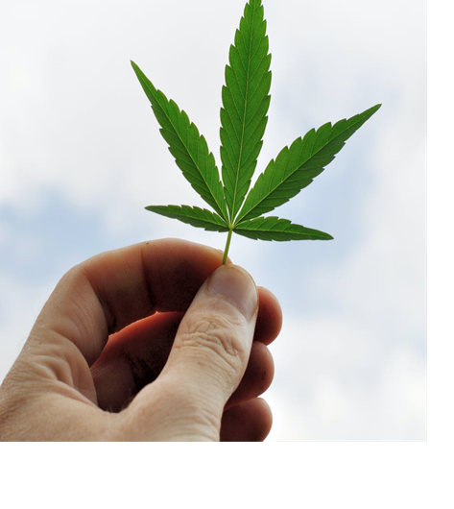
Cannabis, Explained
Effect of Cannabis
Positive effects:
May improve/alleviate symptoms of various debilitating diseases, chronic pain and other health conditions
Reduce nausea and vomiting during chemotherapy
Improve appetite
Achieve relaxation
Heighten mood
Lower blood pressure
Some known side effects:
Impaired short-term memory
Dry mouth
Impaired motor skills
Red eyes
Feelings of paranoia or anxiety
Distortion of time/space
Psychosis
Increased heart rate
Impaired concentration/respiratory problems

Slide 18
Cannabis, Explained
Some dispute about whether cannabis is highly addictive
Reports say use of other drugs and alcohol have decreased in states with some version of cannabis legalization
Still no approval or even formal evaluation by U.S. Food and Drug Administration (FDA)

Slide 19
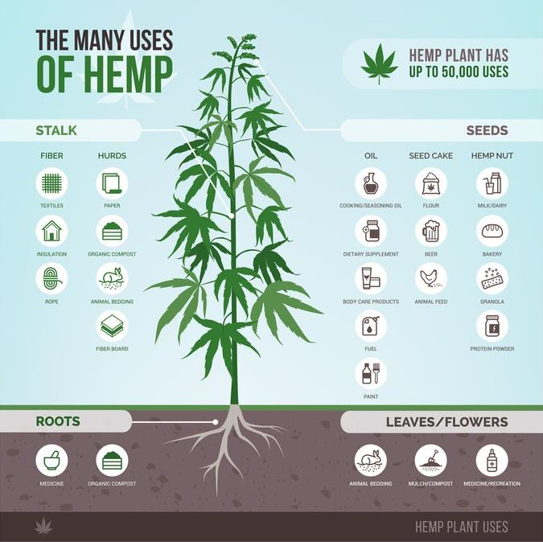
Hemp, Explained
Strain of the Cannabis sativa plant species that is grown specifically for the industrial use of its derived products:
Rope, textiles, clothing, shoes, food, paper, bioplastics, insulation and biofuel
Has a lower concentration of THC than marijuana
Decreases or even eliminates its psychoactive effects

Slide 20
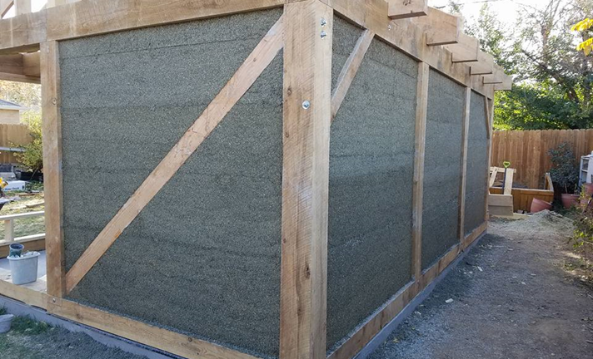
Hemp, Explained
Has been used for centuries, but has experienced negative public perception and confused with marijuana in the United States
Hempcrete structures provide better insulation then standard materials
All formulations of Hemp have been made legal under the 2018 Federal Farm Bill

Slide 21
Why Are We Here Today Talking About Cannabis By Any Name?

Slide 22
INC. Magazine Reports
“The Marijuana Business
Is Really the Real Estate Business”
“Selling weed seems like a cash cow, but the real money these days is in the real estate that represents the most crucial part of the cannabis business.”

Slide 23
In the Beginning …

Slide 24
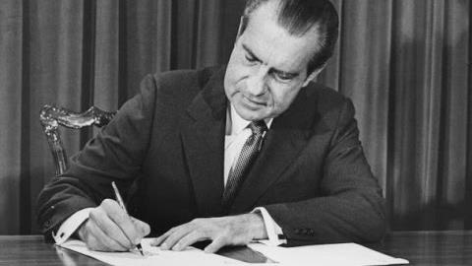
Cannabis and Federal Law
The Controlled Substances Act of 1970 – Title 21 U.S. Code (CSA)
Signed by President Richard Nixon to address concerns about narcotics and dangerous drug problems at the federal level
Combined all existing federal laws into one statute, expanded their scope and increased federal law enforcement pertaining to controlled substances
Notes:
Politics: According to a TAPED VOICE RECORDING made by Nixon in the White House, Nixon saw pot prohibition as a way to destroy the antiwar left. Nixon convened The National Commission on Marijuana and Drug Abuse (what became known as the Shafer Commission) to engineer scientific support for cannabis’s Schedule I placement.

Slide 25
Cannabis and Federal Law
Created 5 “schedules” (classifications) of drugs/substances based on potential for abuse, accepted medical use and safety/potential for addiction

Slide 26
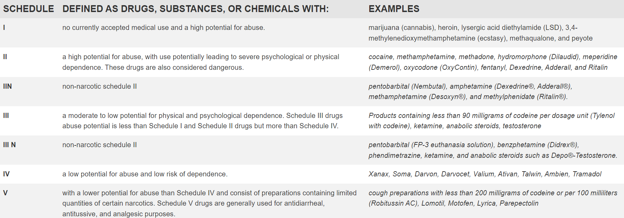
Cannabis and Federal Law

Slide 27
Cannabis and Federal Law
Marijuana/CBD classified as Schedule 1 drug
High potential for abuse
No accepted medical use
Drug is not safe to use, even under medical supervision
Other drugs classified as Schedule 1: Heroin and LSD, just to name a few
Possessing/selling any amount is a felony
Penalty for possession is 1 year in jail and fine up to $5,000
Penalty for selling/intending to sell: 15 years in prison and fine up to $250,000
No such thing as LEGAL medical marijuana under Federal Law

Slide 28
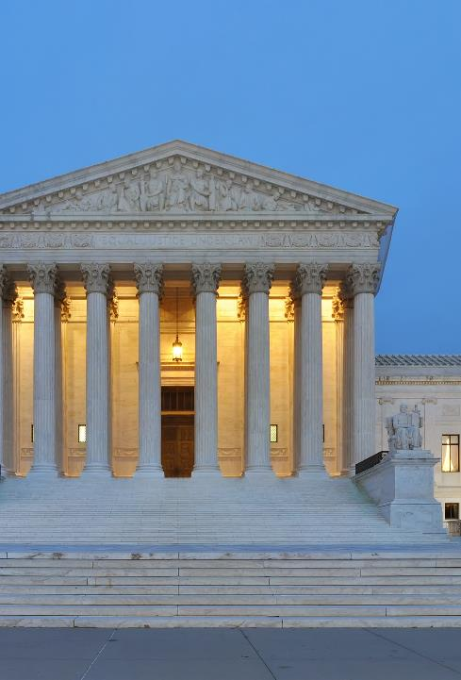
Cannabis and Federal Law
Multiple efforts to reschedule cannabis under the Controlled Substance Act have failed
Supreme Court decisions: Federal government has the right to regulate and criminalize cannabis, even for medical purposes
United States v. Oakland Cannabis Buyers’ Cooperative (2001)
Gonzales v. Reich (2005)

Slide 29
State vs. Federal Law

Slide 30
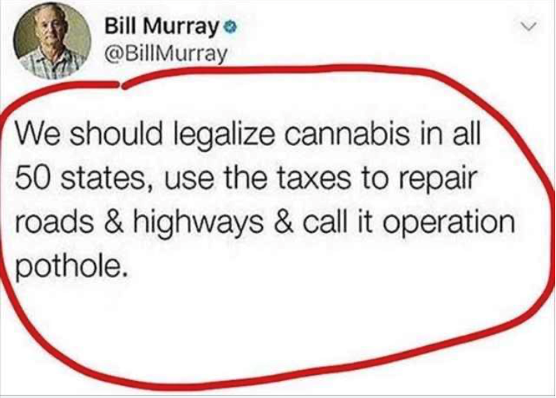
State Legalization

Slide 31
Legalized States
Medical use:
Legal in 37 states; Washington, D.C.; and 4 U.S. territories
Recreational use:
First legalized in CO and WA, 2012
Legal in 23 states; Washington, D.C.; and 2 U.S. territories
Legal in all of Canada for recreational use

Slide 32
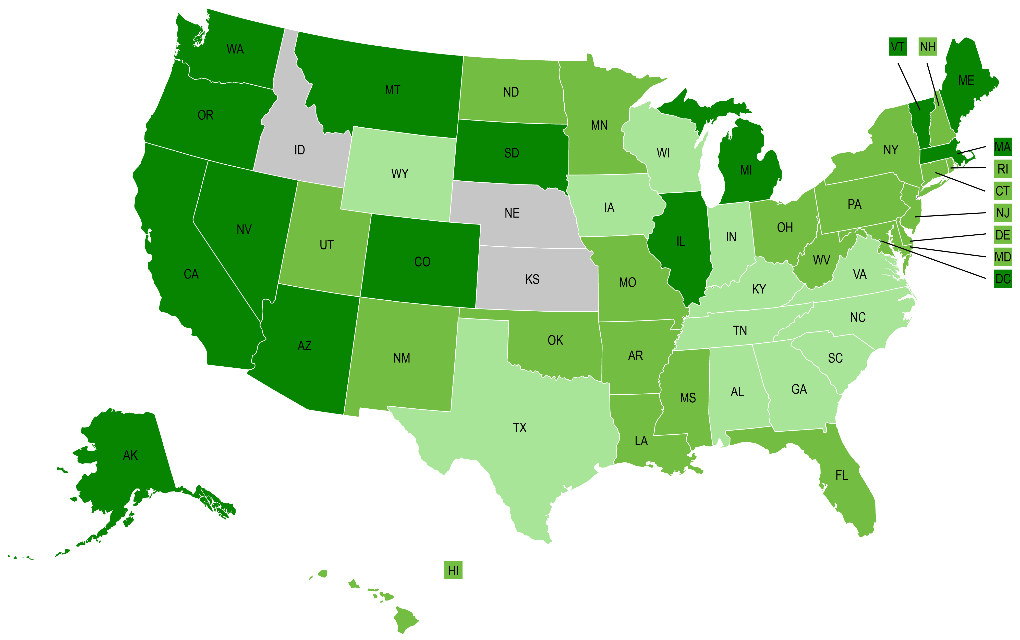
State Cannabis Programs

Slide 33
Maryland Cannabis Timeline
2016 – Decriminalized use possession and use
2017 – Proposal to legalize failed
2019 – Taskforce was created
2021 – Decided a referendum was needed
2022 – Passed referendum ballot in November
2023 – Legalized for recreational purchase – July 1, 2023
Maryland’s law prohibits the smoking of cannabis in public spaces, such as parks, streets, sidewalks, bars and restaurants, public transportation and workplaces. The law also prohibits smoking cannabis in motor vehicles.
Notes:
So, samples would not work right now…

Slide 34
Supremacy Clause of the Constitution
State laws can’t permit what federal laws prohibit
Anyone in any state who possesses, distributes or manufactures marijuana or attempts or conspires to do so can be prosecuted for up to 5 years after the occurrence.
Feds see no difference in distribution of the drug and facilitating the sale of a warehouse to do so. A settlement agent would be an easy target to make an example.
Congress currently restricts the government from spending government funds to prosecute individuals … BUT the winds could change, and they could restore that funding tomorrow.

Slide 35
Cole Memorandum and After
2013 – Deputy AG James M. Cole
Stated that given its limited resources, the DOJ would not enforce federal marijuana prohibition in states that legalized it in some form, with limited exceptions.
2021 – AG Merrick Garland
“It does not seem to me a useful use of the limited resources that we have to be pursuing prosecutions in states that have legalized and that are regulating the use of marijuana, either medically or otherwise.”
2018 – AG Jeff Sessions
“In deciding which marijuana activities to prosecute under these laws with the department’s finite resources, prosecutors should follow the well-established principles that govern all federal prosecutions.”

Slide 36
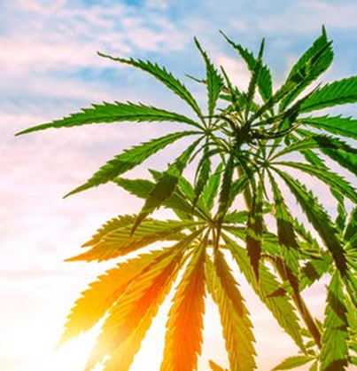
FinCEN and the SEC
2018: FinCEN issued guidance for financial aspects of Marijuanaa Related Businesses
Priorities are federal money laundering and violations of the Controlled Substances Act.
Banks can file “Marijuana Limited” suspicious activities reports.
Notes:
Because federal law prohibits the distribution and sale of marijuana, financial transactions involving a marijuana-related business would generally involve funds derived from illegal activity. Therefore, a financial institution is required to file a report on activity involving a marijuana-related business (including those duly licensed under state law).

Slide 37
FinCEN and the SEC
2018: Securities and Exchange Commission issues investor alert
Risk of prosecution: In addition to the potential for investment schemes associated with marijuana-related stocks, some marijuana-related companies may be at risk of criminal prosecution because of the business they are in.
In January 2018, the U.S. Department of Justice (DOJ) issued a marijuana enforcement memorandum noting: “…Congress’s determination that marijuana is a dangerous drug and that marijuana activity is a serious crime.”
If you are considering investing in a company with operations relating to the marijuana business industry, understand that the company may be criminally prosecuted, and this may impact the value of your investment.

Slide 38
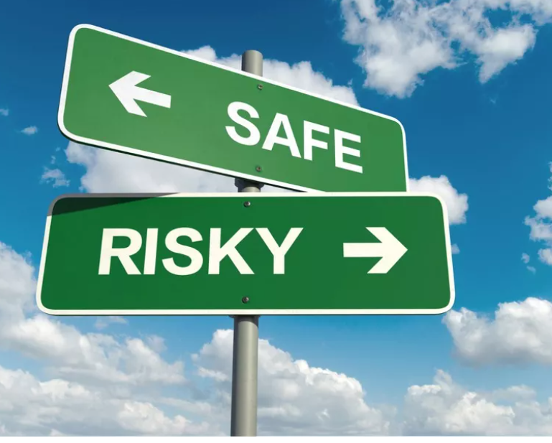
Underwriting Issues
Few title insurance underwriters will insure transactions involving properties involved in the sale, cultivation or manufacturing of cannabis, or marijuana-related businesses
Federal laws conflicts with state/local laws
Even in states where it is legal, individual cities and counties may prohibit use

Slide 39
Underwriting Issues
Insurers cannot insure without risk of criminal prosecution:
Forfeiture risk/total title failure claim on policy
Civil RICO actions
Safe Streets Alliance v. Hickenlooper, 859 F.3d 865, 887-88 (10th Cir. 2017)
Court held in pre-trial order that plaintiffs stated a plausible claim that the RICO violations caused injury because the plaintiff’s property “declined in value due to the recurrent noxious odors emanating from the Marijuana Growers’ facility.”
Money laundering risks
Federal aiding and abetting statute

Slide 40
Why?

Slide 41
Major Players (Projected 2023 Revenue)
Curaleaf
$1.26 billion
Verano
$857 million
Green Thumb Industries $834 million
Trulieve
$810 million
Cresco
$805 million*
Columbia Care $490 million*
Harvest Health & Wellness $378 million
*Acquisition of Columbia Care by Cresco would make Cresco the largest player acquisition valued at $2 billion; Fortune Magazine reports “Legal marijuana sales in the US expected to exceed $52 billion in 2026”.

Slide 42
The Weeds Winds of Change

Slide 43
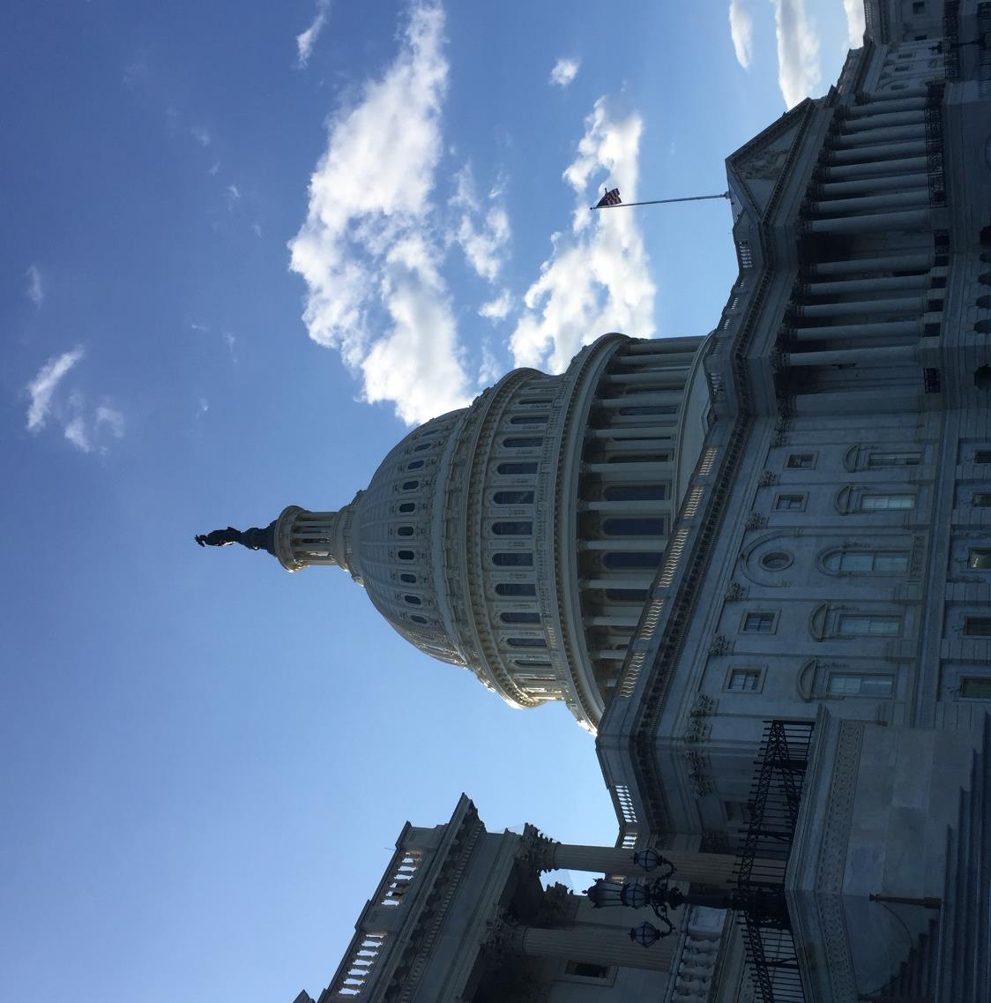
Federal Legalization of Cannabis
Multiple bills proposed
Protection to financial institutions working with cannabis industry
Remove cannabis as a Schedule 1 drug
Social Equity provisions

Slide 44
Federal Legalization of Cannabis
Passed the U.S. House of Representatives on April 19, 2021.
Remove cannabis from Schedule 1 of the CSA
The SAFE Act would allow financial institutions to provide services to cannabis clients without fear of federal penalties
Eliminate related criminal penalties
Equity provisions to benefit the communities affected the most by the prior prosecution of cannabis possession and sales
The MORE Act was re-introduced in the U.S. House of Representatives on May 28, 2021
The Marijuana Opportunity, Reinvestment and Expungement (MORE) Act
Secure and Fair Enforcement (SAFE) Banking Act

Slide 45
Federal Legalization of Cannabis
Remove cannabis from the CSA
Provide access to financial services for the cannabis industry
Expunge past non-violent cannabis crimes
Creates funding with a federal cannabis tax
Funds would be reinvested in the communities most impacted by prior cannabis convictions, while also enabling entrepreneurs in those communities a chance to participate in the growing cannabis business
Requires the Dept of Transportation to research and develop national standard for driving impaired
Restricts marketing to minors
Cannabis Administration and Opportunity Act
Introduced by Chuck Schumer, Senate, Late July 2022

Slide 46
Summary of the Risk
Why is cannabis such a great risk to the title insurance industry?
The potential for enforcement under federal law depending on changing
presidential administrations year to year and prosecutorial discretion.
•Banking Regulations (FinCEN and SEC)
•Money Laundering Risk
•Forfeiture of Real Estate
•Risk of prosecution for facilitating criminal activity
•RICO Enforcement

Slide 47
The Rest of the Convention…

Slide 48
Most Common Investments
Real Estate and Stocks

Slide 49
Necessity of Title Insurance
Stocks vs. Real Estate

Slide 50
Impact on Real Estate
Covenants and restrictions
Easements
Records – chains of title (Land Records)
HOAs
Collateralized Asset
Lien Attaching Asset
Land use
Zoning
Ease of fraud
Non-Fungible Asset vs. Fungible Asset
Legal Actions
– Example: Adverse
Possession
– Example:
foreclosure

Slide 51
Cannabis in Real Estate – What’s the Latest Eric D. Oberer, Esq., CLTP Maryland State Counsel First American Title Insurance Company
Notes:
Munchies and Lunch

