Slide 1
AI: Cause and effect………or dare we say affect?

Slide 2
Who am I?
Michelle – a true entrepreneur – is the innovative and results-oriented founder/owner of Interstate Title & Escrow, LLC. She is an industry influencer who has established herself as one able to do the “hard stuff.” She has been accused of being that kid in the class that volunteers for everything even if she should just say no and let someone else deal with the difficulties of life.
Michelle started in the industry in 1995 as a processor at a local title company and quickly worked her way into a management position. Her entrepreneurial spirit eventually led her to the establish of Interstate Title & Escrow, LLC, in October of 2010.
Michelle is experienced in all aspects of the real estate industry and currently serves on the Maryland Land Title Association Education and CLTP Committees. She is licensed in MD, VA, DC, TN & KY and has offices located in three states.
Michelle is very active in her church, both actively giving and serving. In keeping with her faith, she supports local organizations committed to supporting families in need. Michelle is happy to commit both time and finances to many organizations including The Catherine Foundation Pregnancy Center, Southern Maryland Vacations for Vets and Lions Club. She also supports a variety of local children's recreation groups and the Special Olympics Torch Run.

Slide 3
Let’s Define Affect and Effect first.
Effect
A change that results when something is done or happens
An event, condition, or state of affairs that is produced by a cause
Classic – cause and effect
Computer software is the standard used to perform tasks for us when working towards closing.
Affect
To produce a material influence upon or alteration in
To act upon so as to produce a response
Influence
We are influenced by AI – Goggle and social media tell us the right answer and how to think about something.

Slide 4
What is AI? Machines think and judge like humans Perform human-like tasks Attempts to simulate human intelligence Basically – it is software that does fancy things Marinate on this – does AI influence our decisions? Do we just bump along and let AI make decisions for us? The invention of AI has certainly changed how we do things.

Slide 5
Have you watched the movie M3GAN?
She functioned within her programed perimeters
The doll could not truly reason like she was a human
She did not have real human experiences for good decision making
She lacks free will
The doll was a heavy influence over the little girl; she did not want to part with the doll
The doll “eliminated” a bully, a woman and her dog
AI 100% failed the little girl and the dolls creator.

Slide 6
What does some dumb movie have to do with title insurance?
So. Many. Things.
If we “check out” from a personal involvement in our business and just let AI and automations handle it, could we cause harm to someone?
Can AI determine if someone is under the influence or being influenced by someone in the room?
Is someone acting strange and possibly providing false information at closing?
Does AI have that “sixth sense” or intuition?
What happens when AI fails us? Yes, I said it. AI can 100% fail us.

Slide 7
So I guess I should just give up and use a hammer and chisel?
Not at all. The tools AI gives us should be a help mate to what we do.
AI does not replace us – she is just a helpmate in our daily work.
We have an ethical and moral obligation to use AI properly an in it proper time and place.

Slide 8
Let’s dive a little deeper

Slide 9
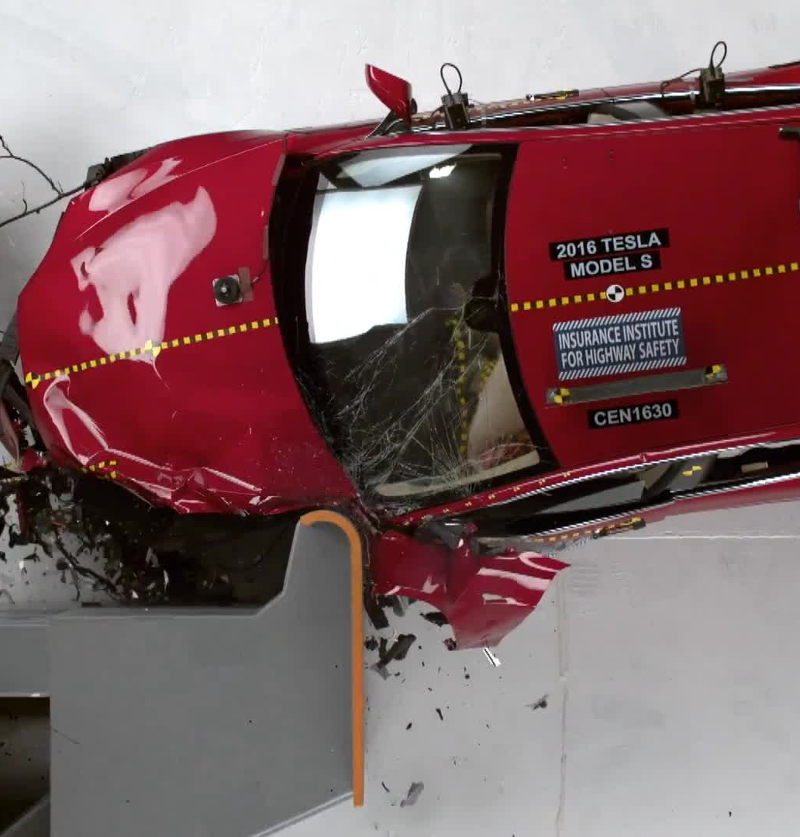
When AI fails us
- First American and FNF 2023 hacks
Loss of premium calculating software
Integration issues
- Power and Internet outages
NPI data breaches
Just try clicking one of those sneaky emails
Firewalls – what exactly are their limitations?
Tesla auto-driving car crashes…….
Connecting to Carplay or Bluetooth!!!!
We expect a lot from various software/hardware

Slide 10
RON – Remote Online Notary
Cons:
MUST have a strong internet/cell connection and maintain it during the entire signing process
MUST have a working camera and mic on your computer/phone
MUST be able to answer security questions
The computer/phone MUST be able to read a valid ID
Changes and additions of documents is limited once the session starts
Pros:
Sellers and purchasers can close with great convenience (time/location)
They can be anywhere in the world
Do not always have to have a hard-set date/time

Slide 11
Marketing – ChatGPT
Cons:
Does not protect sensitive information/NPI
Disclosure: may provide inaccurate information; not intended to give advise
Potential for plagiarism – the result is not your original work
Be careful of bias in the answers/responses
Pros:
Create content with ease
Presents items in a more professional way
Saves time
FREE!!!!!! Well sorta

Slide 12
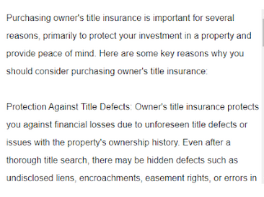
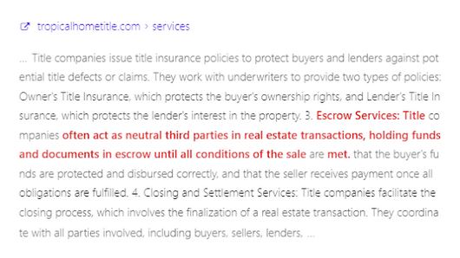
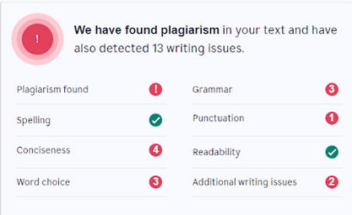

Slide 13
Automation in title services
Title searches
Uploaded directly into the software
Some underwriters have services that will interpret, correct, and approve the results of the search
Some prepare the actual commitment
For a fee they will take on liability for issues not corrected if the underwriter prepares the commitment
Less staff, less overhead, less risk…….
Sound wonderful!! Sign me up!!!

Slide 14
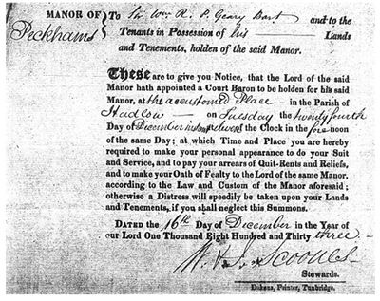
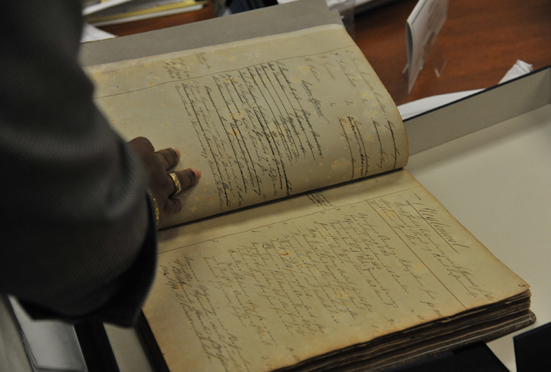
Is there a downside?
Software issues
First American and FNF issue in 2023
Knowledge will retire with the older generation
Ability to understand the abstract
Ability to chase records that make up the chain of title
Ability to resolve title issues
Questions from our realtors do not always start with a title search

Slide 15
How to ethically use AI
ChatGPT – start with your own original work and let AI suggest better wording
Be unique – we all use the same graphics with wires – do something different!
Be wary about what you click in an email – make sure you have an active file with that name/address
Be educated – know how to calculate transfer taxes and title premiums
Have “old school” checks and balances
Double check your work – an algorithm can become corrupt
Learn your craft – understand how title searches and land records work
Keep in mind that AI can only work to the permissions and perimeters its creator gave it. AI does not have the ability to freely think nor have free will.

Slide 16
Thank you
Michelle Woods
Owner/CEO
Interstate Title & Escrow, LLC
Cell: 301-861-7289

