Slide 1


Slide 2

Mary O’Donnell
CEO/President- Westcor Land Title Insurance Company & ALTA President
Modonnell@wltic.com

Slide 3
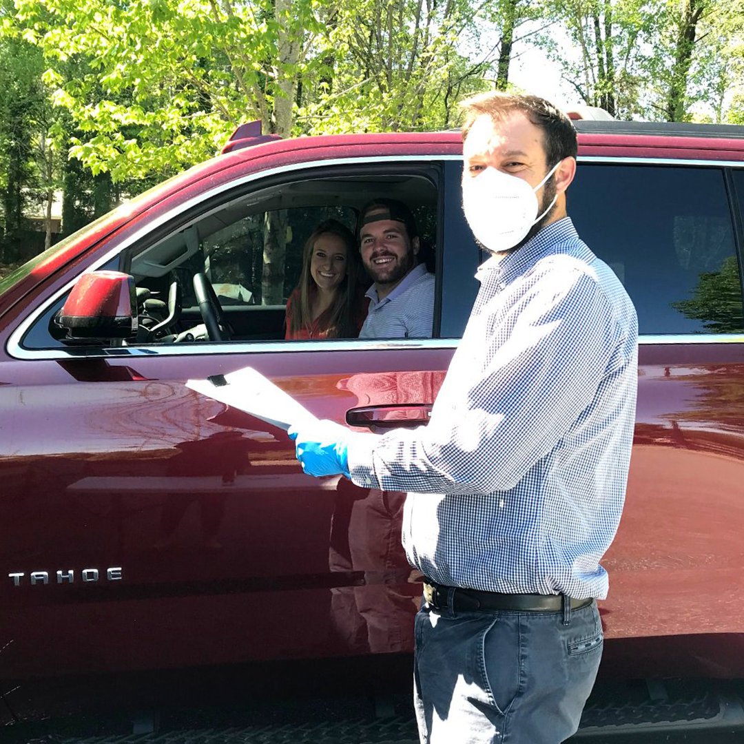
ALTA’S
advocating on behalf of our members’ and the industry’s interests
providing education and information to our members
offering networking opportunities, and
creating and promoting professional industry standards
MISSION
Help our members excel in a changing business and regulatory environment by:

Slide 4
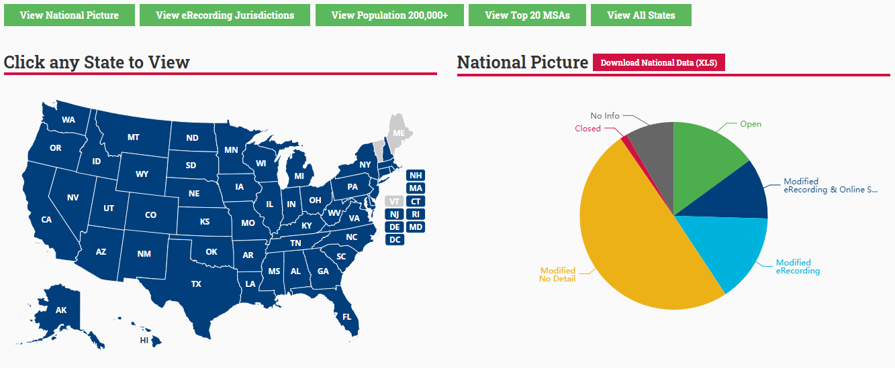
Helping Members During COVID-19
COVID-19 Resources
Operating Status of Recording Jurisdictions
ALTA Insights
Notes:
COVID-19 Resources: ALTA.ORG/CORONAVIRUS
Operating Status of Jurisdictions:
ALTA Insights- sessions offered so far:
What’s in Store for Mortgage Lending? A Conversation With FHFA Director Mark Calabria​
How to Cultivate a High-performing Remote Team During a Crisis​
Conducting Closings in a COVID-19 World​
How GSE Guidance Updates Impact the Title Industry ​
How Your Business Can Access Financial Assistance Due to COVID-19 Pandemic

Slide 5

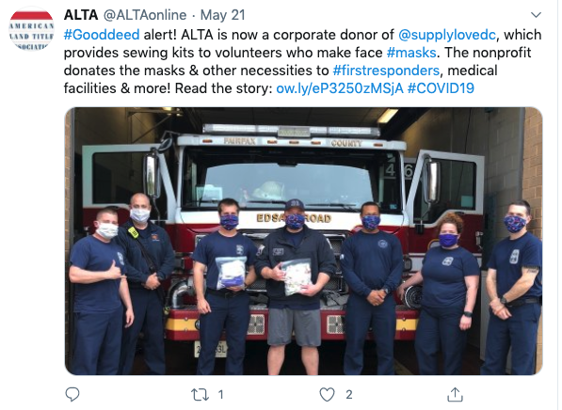
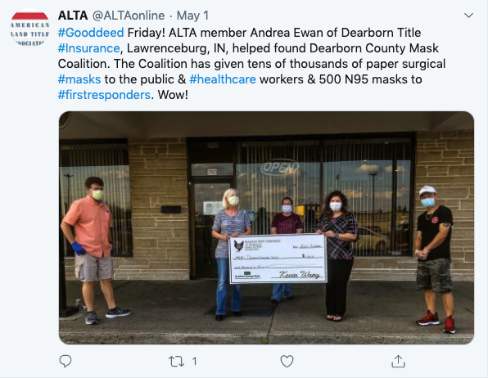
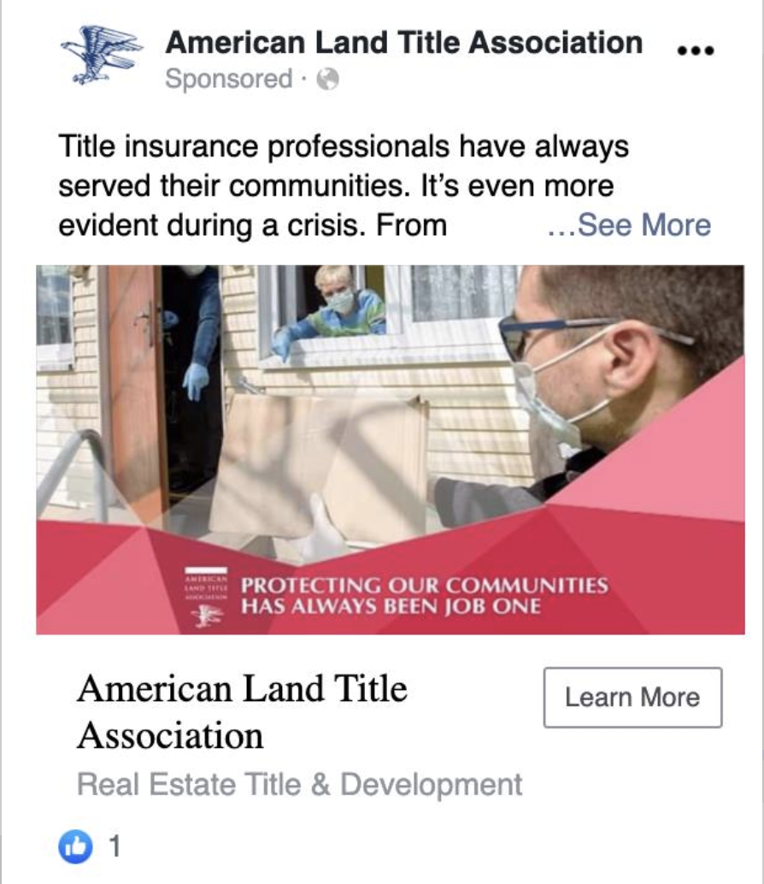
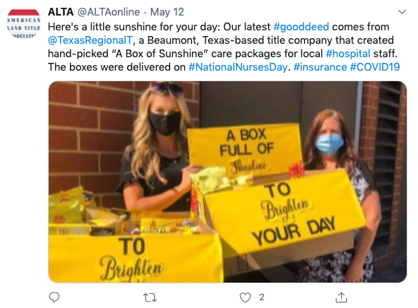
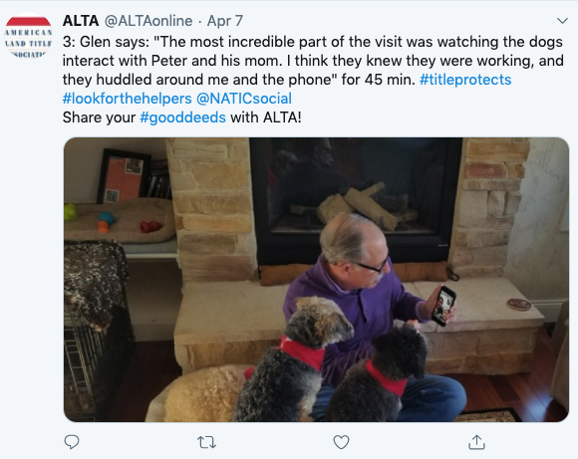
HELPING Customers and Communities During COVID-19
Creative closings
#GoodDeeds Campaign
Notes:
Creative Closings:
In-Person: With accommodations for social distancing
Curbside or Drive-through: Customers remain in their car during closing
Remote: Via the internet with a webcam
#GoodDeeds:
Throughout the pandemic, ALTA members across the country have been delivering for people and organizations in their local communities.
From making masks to donating money to local restaurants and helping the homeless, the response to ALTA’s #GoodDeeds campaign has been inspirational.
Please continue to share your good deeds on ALTA’s blog (blog.alta.org), by emailing your story and pictures to communications@alta.org or by posting on social media with #GoodDeeds and tag @ALTAonline.

Slide 6
Protect Our Customers’ Money
Prepare for Privacy Laws & Regulations
OUR PRIORITIES
Prepare for Digital Closings
Tell Our Story
Engage with Relevant Agencies Focused on Federal
Housing Finance Policy
Develop & Retain Talent
Notes:
Talking points
ALTA remains a forum to help members improve the real estate transaction for businesses and consumers
Each year, ALTA’s Board of Governors establishes strategic priorities to help our members
While the presentation is focused on our 2020 priorities, ALTA has developed many helpful resources and tools aimed at helping title professionals succeed in the market.
Some of these items include the:
ALTA’s Registry
Best Practices
Homeowner Outreach Program
We don’t have time to discuss in detail all these programs and resources, but I’m happy to discuss any of these other important items further with you after the presentation.

Slide 7

PROTECT OUR
CUSTOMERS’ MONEY
My Title:
Educating and promoting awareness of closing scams and wire fraud
Offering resources that inform our members on new threats to their businesses
Providing best practices and public policy that protects funds during real estate transactions
Bodyguard
Notes:
Recommended talking points:
Each year, wire fraud continues to pose a multimillion-dollar threat to members of the title insurance industry as cyber criminals adapt more sophisticated methods for compromising your customer’s transactions. If you conduct business on your cell phone and work in coordination with real estate agents, you are at risk for cyber crimes.
Just consider these stories from homebuyers in Texas, Ohio, Wisconsin and New York:
Texas
In July 2019, a couple was selling their home to build a new one. Planned to sell house and pay cash. Days before the closing, the husband received an email from what he thought was the title company and he wired $471,000 to the fraudulent account. But due to quick work by the homebuyers, the FBI and the local sheriff’s department, the money was recovered from a bank in Florida.
Ohio
In March 2019, a woman in Columbus, Ohio, nearly lost her life savings and her home. She wired $27,000 after receiving an email she believed was from her Realtor. The email instructed her to wire funds to a Wells Fargo account in Minnesota. The money was recovered thanks to the due diligence of the title company and bank.
Wisconsin
In February 2019, a TV executive and his wife were swindled out of more than $260,000 through a wire transfer scam. The couple thought they were communicating with a person with the title company. According to court records, the suspect was attempting to collect on another fraudulent wire transfer in Florida worth $138,000.
New York
In February 2018, a homebuyer received a compromised email from their closing agent during a real estate transaction. They initiated a wire transfer of $50,000 to a fraudulent bank account located in New York.
ALTA has created many resources to help protect your business and educate your customers
ALTA Outgoing Wire Preparation Checklist: Use this checklist as a best practice for verifying outgoing wire information.
ALTA Rapid Response Plan for Wire Fraud Incidents: The standard ALTA Rapid Response Plan for Wire Fraud Incidents has been developed by the ALTA Information Security Committee.
Wire Fraud Video: This 2-minute video provides four tips on how consumers can protect their money and offers advice on what to do if they have been targeted by a scam. Link to this video from your website, include in your email or share on social media.
Wire Fraud Infographic: ALTA has produced this Rack Card explaining Wire Fraud. ALTA Members can brand the infographic with their own information.
Resources can be accessed at alta.org/wirefraud
Coalition to Stop Real Estate Wire Fraud
Last year, ALTA spearheaded the launch of the Coalition to Stop Real Estate Wire Fraud.
Focus is to raise awareness.
Have ran digital advertising campaigns in nine markets favorable to first-time homebuyers across the country
Garnered more than 22 million ad impressions to potential homebuyers in these markets
For more information about the coalition go to stopwirefraud.org
If they ask, these are the markets:
Washington, D.C.
Birmingham, Ala.
Virginia Beach, Va.
Pittsburgh, Pa.
Minneapolis, Minn.
Seattle, Wash.
Nashville, Tenn.
Tampa, Fla.
Houston, Texas

Slide 8



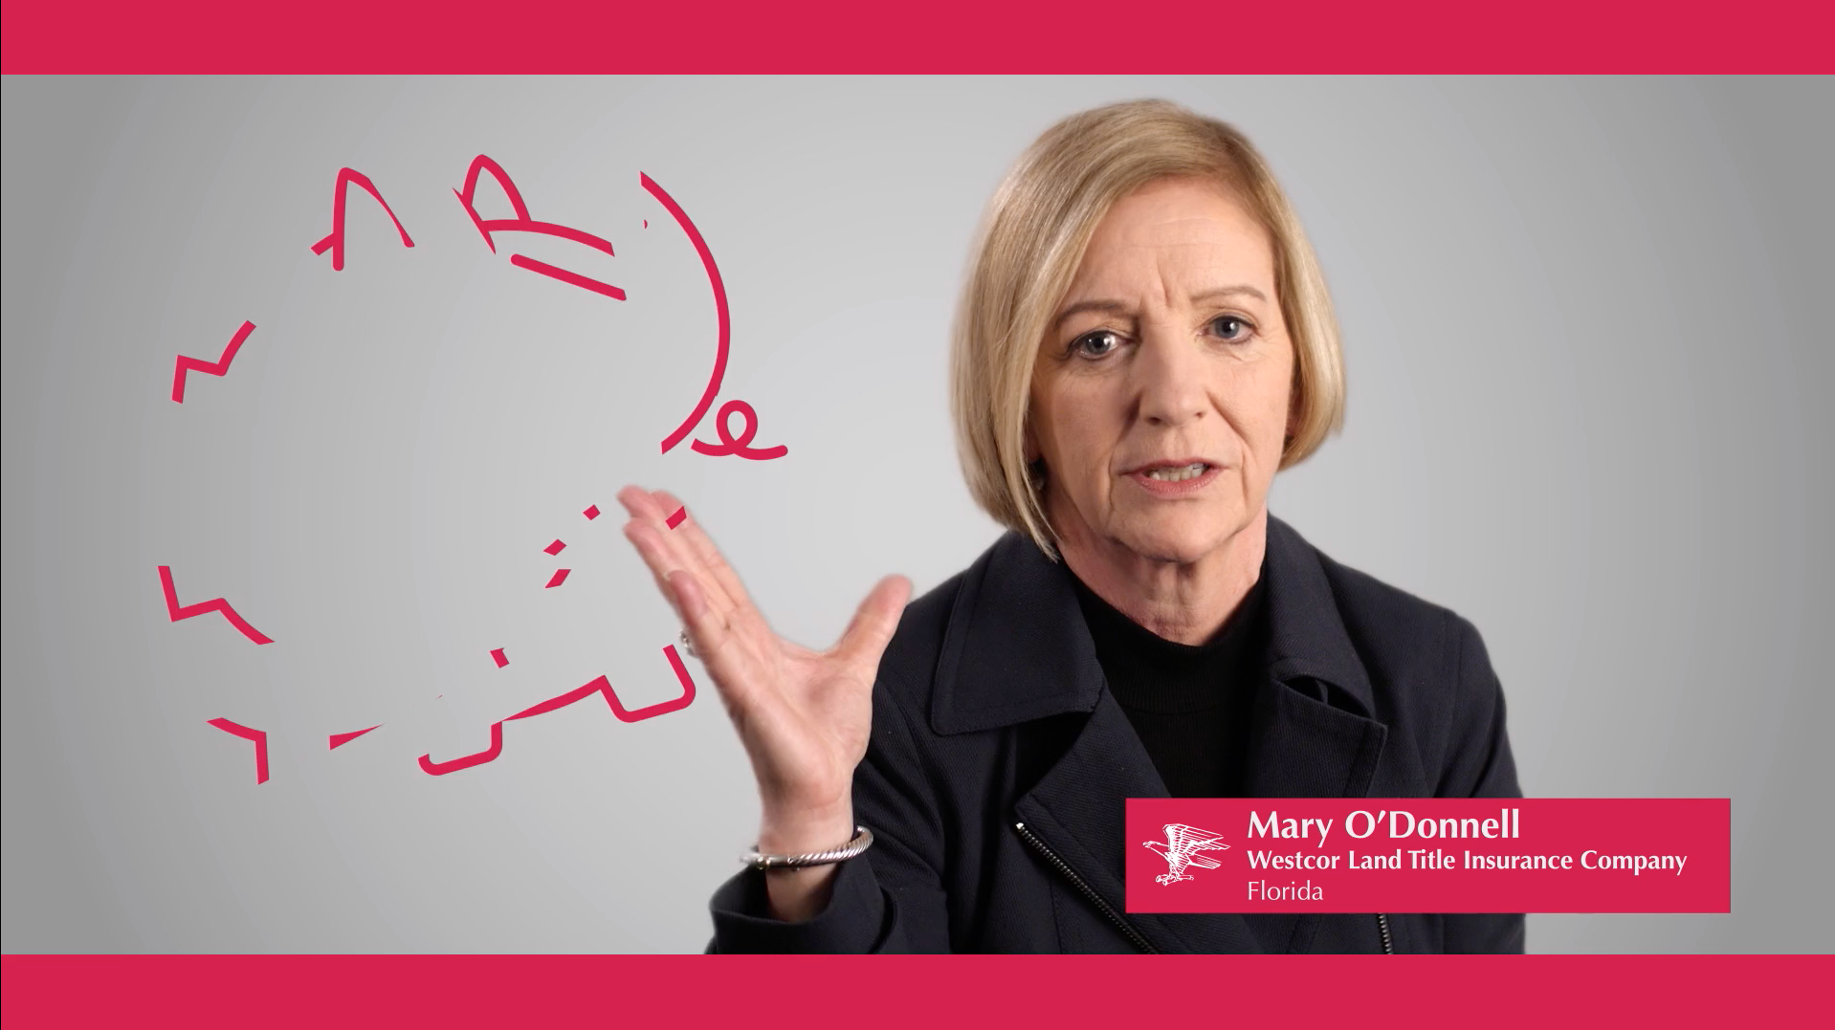




Launching a campaign to stop wire transfer fraud

Slide 9
PREPARE FOR
PRIVACY LAWS &
REGULATIONS
My Title:
GUARDIAN
Helping our members remain compliant with laws that vary state-by-state
Developing industry principles to help you keep up with new regulations and legislation
Advocating on data privacy policy with industry partners
Notes:
The estimated cost for companies with fewer than 25 employees to comply with new comprehensive data privacy law is around $50,000.* *According to a report by the California Department of Justice Office of the Attorney General on the impact of the California Consumer Privacy Act of 2019
http://www.dof.ca.gov/Forecasting/Economics/Major_Regulations/Major_Regulations_Table/documents/CCPA_Regulations-SRIA-DOF.pdf.
Recommended talking points:
Not only are privacy laws and regulations rapidly evolving, there is no uniform federal law that addresses data privacy. States are moving forward with inconsistent laws. Companies are left with a patchwork of rules to follow, which makes compliance a cumbersome task.
While CCPA represents the first comprehensive data privacy law in the United States, it is certainly not going to be the last.
State legislative activity related to comprehensive data privacy is expected in 15-20 states during 2020.
While there is a consensus in the business world that a national data privacy standard is necessary, it is unlikely Congress will act on this issue soon.
The main areas of policy conflicts at the Federal level continue to be federal preemption, private right of action, and carve-outs.
It is difficult to see a path forward for comprehensive federal data privacy legislation before the 2020 election.
In order to support members and address this priority, ALTA offers the following:
ALTA has created a set of Data Privacy Principles. These include:
A GLBA exemption
The need for a national standard
An exemption for publicly available information
Recognition of the necessities of transaction-based data
Considerations for small businesses
Uniform data breach notifications
Exemption of business to business data
Exemption of employee data
Providing a right to cure and a safe harbor
ALTA also has developed suggested data privacy state legislative language
Resources that outline laws and regulations by state. For example, we created the “State Data Privacy Tracker,” which is a database for the latest data privacy legislation introduced or passed in all 50 states (and Washington, D.C.)
We also offer easy-to-reference one-sheets, including “Your Guide to CCPA Privacy Rights” and “What is the CCPA and Why You Should Care”.
We publish webinars and PDF presentations designed to educate our members on emerging legislation
And if you’re on-the-go, you can tune in to our podcast to learn more about critical legislation like the CCPA.
These resources are available at alta.org/dataprivacy

Slide 10
PREPARE FOR
DIGITAL CLOSINGS
My Title:
Developing tools, awareness, and education on the nuances of digital closing
Arming members with information about technological advances, including Remote Online Notary (RON)
Advocating for federal, state, and local regulatory and legislative improvements to meet industry needs for implementation of digital closings
Collaborating with industry stakeholders on digital closing adoption, including MBA, MISMO, and GSEs
innovator
Notes:
A survey showed that 70% of consumers would like a more digital process when closing
44% of title professionals are interested in digital closings
33% of title professionals plan to start offering digital closings in the next year
Recommended talking points:
More than 20 years ago, author William Gibson reportedly said, “The future is already here. It's just not evenly distributed.”
This implies that some things that will eventually exist in our everyday lives already exist for some today.
There’s a lot of wisdom in this thought. It gives us some direction as we ponder the potential changes in our industry. The future is already here.
Self-driving cars, delivery drones and solar roof shingles are all products that are already available—just not commonly used (yet). An example closer to the title industry is remote online notaries. Legislation allowing these types of closings has already passed in a few states.
Remote online notarization is here and some are using the technology, but the practice is not evenly distributed. Remote online notary is not yet part of everyone’s daily work flow. The question is, will it be? If so, how and where? Customer needs will play a large role in how and when title and settlement companies implement digital closing processes into their work flow. Having a culture that is connected to your customers and responsive to their needs is critical to understanding what innovation changes will take hold.
In his annual letter to shareholders last year, Amazon CEO Jeff Bezos described his process for remaining relevant and providing solutions to his customers with what he calls “true customer obsession.” He observes that “customers are always beautifully, wonderfully dissatisfied, even when they report being happy and business is great. Even when they don’t yet know it, customers want something better, and your desire to delight customers will drive you to invent on their behalf.”
“Beautifully, wonderfully dissatisfied”—Think about that.
Just because everyone seems happy doesn’t mean they don’t want something more or different. Recognizing this dissatisfaction can drive you to invent of your customers’ behalf. What can you do to deliver a better closing experience? How can you provide information about the benefits of title insurance earlier in the transaction?
Innovation and technology in the title and settlement space exists. They are just not used everywhere. ALTA is here to be a forum to help. To be a place for members to learn about new market entrants and innovative products. To help members apply their knowledge and business judgement, and plan for the future marketplace.
A survey showed that 70% of consumers would like a more digital process when closing and 44% of title professionals are interested in digital closings. And 33% of title professionals plan to start offering digital closings in the next year.
During 2020, there will be legislative and regulatory activity on the state legislative level related to both IPEN and RON.
Legislation impacting Digital Closings is expected in 10-12 states.
On the federal level, efforts to modernize the Electronic Signatures in Global and National Commerce Act (ESIGN Act) are being discussed in the United States Senate. However, no action is anticipated in the short term.
Although there are many benefits, there are risks associated with digital closings and RON. ALTA is committed to ensuring our members have resources and solutions to the latest innovations:
We’ve produced videos for members and customers that describe digital closings, offer tips for acronyms associated with the process, and a tutorial on RON
We provide a map of states with active RON legislation
We feature articles covering the latest news on digital closing
We’ve built a database of resources, including a Digital Closing Readiness Checklist, RON checklist, RON workflow, suggested talking points, FAQs, letters to state legislators, and more
Resources are available at alta.org/digitalclosings
ALTA REGISTRY
As we move to a more digital transaction, lenders need a mechanism to help improve accuracy and precision when it comes to working with title and settlement agents.
ALTA’s Registry provides this resource at no cost to you.
More than 8,000 title and settlement company locations are already confirmed in the Registry.
Last year, lenders performed 12,000 searches in the Registry.
Lenders typically search for a company using their ALTA ID or by your company name. Some of these searches may have been for you.
In 2019, ALTA IDs were added to Encompass to make placing orders with title agents easier
Just because you’re an ALTA member or Policy Forms License holder does not mean your company is confirmed in the Registry.
Make sure you get your free Registry listing at alta.org/registry.

Slide 11
TELL OUR STORY
My Title:
Educating the public and target audiences -- both inside and outside our industry -- on who we are and the value we bring
Providing PR materials to help describe who we are as an industry
Utilizing resources to better connect our entire membership to power grassroots support for our advocacy efforts
STORYTELLER
Notes:
Recommended talking points:
Title insurance agents are important members of their communities and we want the public and policymakers to know the value we provide to our industry
Members of the title insurance industry share traits of superheroes -- they have an identity that is a bit of a secret, not many people know who they are, the role they play in safeguarding the home buying experience, or that they live in the communities they service.
ALTA plans to roll out a public awareness campaign to help support members and address this priority:
We want to tell the story of the important work you do each day. We are partnering with members like you to introduce you to your communities so that homebuyers know who you are and how you may help them
We’ll offer marketing materials for our members to help explain our role in the homebuying experience and make it easy for homeowners to understand the importance of title insurance

Slide 12



What’s Your Title?

Slide 13
ENGAGE WITH
RELEVANT AGENCIES FOCUSED ON FEDERAL HOUSING FINANCE POLICY
My Title:
Engaging with relevant agencies focused on federal housing finance policy, including Government Sponsored Enterprises (GSEs)
Working with private market investors and their regulators who utilize title insurance to responsibly manage risk and provide value to customers
Collaborating to improve the flow of data sharing within the real estate transfer process
advocate
Notes:
Recommended talking points:
Fannie Mae and Freddie Mac are the title insurance industry’s LARGEST CUSTOMERS.
Homeownership helps families build connections to their communities, offers retirement security, funds post-secondary education, and supplies capital for entrepreneurs to start their new businesses. This is only possible with access to affordable and efficient mortgage finance system
GSEs such as Fannie Mae and Freddie Mac received taxpayer bailouts of more than $187 billion
Despite the overwhelming benefits to our homeowners, Congress has yet to enact comprehensive legislation to restructure our nation’s housing finance system to prevent taxpayer-funded bailouts and establish a sustainable market for housing credit
The title industry strongly urges the Congress and the Administration to preserve the uniform standards currently provided by the GSEs, including title insurance, in a newly developed housing finance system.
Because the title insurance industry’s impact on the community remains unknown, garnering support for advocacy efforts may fall on deaf ears.
ALTA plans to address this priority by:
Continuing to work with Congress as it considers crucial efforts to reform our nation’s housing finance system
Engaging GSEs to help advance standardization efforts and work with private market investors who use title insurance to responsibly manage risk
Expanding our advocacy efforts for housing finance reform
Streamlining the flow of data within the real estate transfer process
ALTA’s Key Advocacy Points for Housing Finance Reform
Protect and strengthen uniform national standards for title protection. Fannie Mae and Freddie Mac’s current seller/servicing guides standardize the process for underwriting real property. This includes a requirement that originators warrant all loans sold to the Government Sponsored Entities (GSEs) are in first-lien priority position and protected by title insurance. First-lien position minimizes credit risk for mortgage investors. Title insurance is the market standard method to determine this priority. It provides the strongest protection to investors for safeguarding their collateral.
Promote transparency in the pilot program process. A strong process should promote transparency and ensure that if a pilot is successful, all providers can compete to provide the same product or service if they choose. Before approving a pilot or risk/guide variance, the GSEs should outline clear testing parameters, timelines, and metrics for determining success or failure. These items, along with the results of the pilot, should be made public.
Provide affordable access to credit. High home prices, low housing inventory, and depressed rates of new construction make homebuying difficult for first-time and low- and moderate-income homebuyers. Maintaining strong affordability requirements is critical for supporting home ownership. Additionally, federal law should make conversion of manufactured homes to real property easier, allowing consumers to qualify for better interest rates. Support should also be provided for other low-cost housing options like condominiums.

Slide 14
Develop & Retain Talent
My Title:
Promoting the title and real estate settlement profession to job seekers
Educating the public on the benefits of working in the title insurance industry, attract talent, and engage future leaders
Offering resources for developing workforce skills, knowledge, and expertise
COACH
Notes:
Recommended talking points:​
​
ALTA is deeply invested in the growth of our members. Professional development, paths for advancement, attracting new talent, and retaining talent are essential to securing the future of our industry.
The title insurance industry has a lot to offer those looking for a place to take root -- and if we raise awareness around our core values and how we support our communities, we will attract leaders who can help propel our industry forward ​
ALTA has many professional development resources
Series of online courses, including Title 101 and the recently released Nuts and Bolts of the Title Industry (which is available to ALTA members for free)
Title Agent continuing education credit for online courses and at our conferences
Monthly webinars on timely topics
National Title Professional Designation Program (recognize NTPs in the audience)
ALTA has many HR resources for business owners, hiring managers, and HR professionals
HR Sample Library with ample online resources, including job descriptions and ads, interview questions, employee engagement surveys, etc.
The Compensation Index, which allows participating companies the opportunity to compare salaries and benefits packages against other organizations
In 2020 we are looking to
Create networking groups dedicated to women in the industry and young title professionals
Provide clear paths for career advancement, reskilling, and professional development
Demonstrate the overwhelming benefits of working in the title industry, including opportunities to develop valued skill sets without the need of a college degree, with the creation of a prospective candidate website
Resources are available at alta.org/human-resources

Slide 15

Notes:
Closing Remarks

Slide 16
Q & A

