Slide 2
Ethics & Well-Being
Relating Legal Definitions of Ethical Requirements to Employee Engagement and Loss Avoidance

Slide 3
Ethics & Well-Being
Nicole Timpanaro
CEO
Fortune Title Agency, Inc.
nicole.timpanaro@fortunetitle.com
Paula Zwiren, JD, MBA, CTP
CEO
Zwiren Title Agency, Inc.
paula@zwirentitle.com

Slide 4
Agenda
Well-Being Defined
Competency
Communication
Safekeeping Property
Recommendations

Slide 5
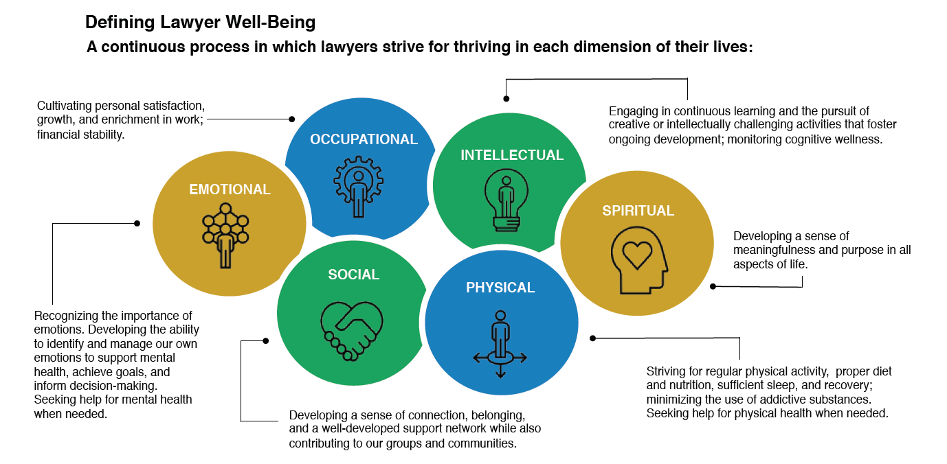

Slide 6
15 Law Schools and 3,300 Law Students participated in surveys
12,825 licensed, employed attorneys were surveyed
Primarily authored and edited by the National Task Force of Lawyer Well-Being

Slide 7
Commonalities of Lawyers and Title Professionals
Licensed Professionals
Fiduciary Roles
Protection of private information and documents
Management and control of trust funds
Standard of professional conduct

Slide 8
“Self-care is not selfish. You cannot serve from an empty vessel.”
- Eleanor Brown

Slide 9
Competency –
Model Rule 1.1
A lawyer shall provide competent representation to a client. Competent representation requires the legal knowledge, skill, thoroughness and preparation reasonably necessary for the representation.
Title professionals may not represent the client but are required to have proper levels of competency on both the individual and corporate level.
Task Force Recommendation to add a component mentioning “mental, emotional, and physical ability reasonably necessary.”

Slide 10
Bereavement
Divorce
Injury
Long-Term/Severe Illness
Anxiety
Depression
Addiction
Suicide Ideation
Family Matters

Slide 11
Best practices pillar four
Adopt standard real estate Settlement policies and procedures that help ensure compliance with: (i) federal and state consumer financial protection laws and regulations, and (ii) contractual obligations as applicable to the Settlement process.
Prepare and execute documents accurately

Slide 12
expectations
Have the confidence to ask for help
Assess the risks of the transaction and ethical boundaries
Review instructions, contracts, commitments and requirements in detail
Responsive to directions provided through documentation, email, or verbally

Slide 13
risks
Depression
Avoid interaction with supervisor or underwriter counsel
Addiction
Lack of concentration and/or focus
Anxiety
Skewed risk assessment and/or hesitancy to take action

Slide 14
Competency –
Wellness/Recovery Resources
Lawyers Assistance Programs
Support Groups (outside & inside the industry)
Individual/Group Therapy
Psychiatric Care
Nutritionist
Wellness Coach
Meditation

Slide 15
Competency –
Corporate Strategies
Establish Organizational Infrastructure to Promote Well-Being
Form a Lawyer Well-Being Committee
Assess Lawyer’s Well-Being
Establish Policies and Practices to Support Lawyer Well-Being
Monitor For Signs of Work Addiction and Poor Self-Care
Actively Combat Social Isolation and Encourage Interconnectivity

Slide 16
Competency –
Corporate Strategies
Provide Training and Education on Well-Being, Including During new Lawyer Orientation
Emphasize A Service-Centered Mission
Create Standards, Align Incentives, and Give Feedback

Slide 17
“None of us got where we are solely by pulling ourselves up by our bootstraps. We got there because somebody bent down and helped us pick up our boots.”
- Thurgood Marshall

Slide 18
Communication – Model Rule 1.4
A lawyer shall:
promptly inform the client of any decision or circumstance with respect to which the client's informed consent, as defined in Rule 1.0(e), is required by these Rules;
reasonably consult with the client about the means by which the client's objectives are to be accomplished;
keep the client reasonably informed about the status of the matter;
promptly comply with reasonable requests for information; and
consult with the client about any relevant limitation on the lawyer's conduct when the lawyer knows that the client expects assistance not permitted by the Rules of Professional Conduct or other law.
A lawyer shall explain a matter to the extent reasonably necessary to permit the client to make informed decisions regarding the representation.
Notes:
NOTE: includes several reference to reasonableness as a standard; promotes keeping customers in the loop regarding status, responding promptly, explaining circumstances and permitting customers to make informed decisions

Slide 19
Communication –
Proper Communication Standards
Meeting Deadlines
Attention to Detail
Timely Response to Client Communications
Thorough Responses vs. Piecemeal
Professional Communication
Listening Attentively

Slide 20
Communication –
Self-help deterrents
Failure to recognize symptoms
Not knowing how to identify/access treatment
Negative attitude about mental illness
Fear of adverse reactions
Feeling ashamed
Viewing help-seeking as weakness
Fear if career repercussions
Concerns about confidentiality
Uncertainty about the quality of treatment
Lack of time in busy schedules

Slide 21
Best practices Pillar 7
Adopt and maintain written procedures for resolving Consumer complaints.
Consumer complaint intake, documentation, tracking, and resolution.

Slide 22
expectations
Customer complaint received
Complaint intake form completed
Completed complaint intake form copy provided to management
Customer contacted and provided acknowledgment of the complaint
Customer provided status 1st status update and estimated time for resolution and follow up status contacts
Follow up status contacts default timeframe if other timeframe not determined
Complaint resolved default date if other timeframe not determined
Complaint closed and stored properly in designated location

Slide 23
risks
Complaint taken in without gathering all relevant information or by a person who does not have the knowledge or experience to take the complaint in thoroughly
Complaint not provided to management for corporate response
Customer complaint not acknowledged timely
Customer complaint not resolved
Customer complaint not documented properly or stored

Slide 24
Communication –
Removing the barriers
Direct contact with someone with personal experience
Re-frame help-seeking as a sign of strength
Education on mental health
Provide resources for treatment
Company policy supporting mental health treatment and confidentiality
Additional employee control over scheduling and time-off
Notes:
Direct contact with someone with personal experience (most effective)

Slide 25
Communication –
Corporate Tools
Mentor and Sponsorship Programs
Management Techniques
Training Programs
How to approach a colleague who may be in trouble
Self-assessment of mental health or substance use
Stress management
How, why, and where to seek help at first signs of difficulty
Notes:
Direct contact with someone with personal experience (most effective)

Slide 26
“Discipline does not make an ill lawyer well.”
- National Task Force on Well-Being

Slide 27
Safekeeping property –
Model Rule 1.15
A lawyer shall hold property of clients or third persons that is in a lawyer's possession in connection with a representation separate from the lawyer's own property. Funds shall be kept in a separate account maintained in the state where the lawyer's office is situated, or elsewhere with the consent of the client or third person. Other property shall be identified as such and appropriately safeguarded. Complete records of such account funds and other property shall be kept by the lawyer and shall be preserved for a period of [five years] after termination of the representation.
A lawyer may deposit the lawyer's own funds in a client trust account for the sole purpose of paying bank service charges on that account, but only in an amount necessary for that purpose.
Notes:
NOTE: includes obligations to keep trust funds separate, to safeguard the funds, to maintain complete records and accounting, to promptly communicate regarding funds and deliver funds, to maintain a neutral position when there is a conflict between beneficiaries of the funds.

Slide 28
Safekeeping property –
Model Rule 1.15
A lawyer shall deposit into a client trust account legal fees and expenses that have been paid in advance, to be withdrawn by the lawyer only as fees are earned or expenses incurred.
Upon receiving funds or other property in which a client or third person has an interest, a lawyer shall promptly notify the client or third person. Except as stated in this rule or otherwise permitted by law or by agreement with the client, a lawyer shall promptly deliver to the client or third person any funds or other property that the client or third person is entitled to receive and, upon request by the client or third person, shall promptly render a full accounting regarding such property.
Notes:
NOTE: includes obligations to keep trust funds separate, to safeguard the funds, to maintain complete records and accounting, to promptly communicate regarding funds and deliver funds, to maintain a neutral position when there is a conflict between beneficiaries of the funds.

Slide 29
Safekeeping property –
Model Rule 1.15
When in the course of representation a lawyer is in possession of property in which two or more persons (one of whom may be the lawyer) claim interests, the property shall be kept separate by the lawyer until the dispute is resolved. The lawyer shall promptly distribute all portions of the property as to which the interests are not in dispute.
Notes:
NOTE: includes obligations to keep trust funds separate, to safeguard the funds, to maintain complete records and accounting, to promptly communicate regarding funds and deliver funds, to maintain a neutral position when there is a conflict between beneficiaries of the funds.

Slide 30
Safekeeping Property –
Precipitating events to violations
Substance Abuse
Financial Strain
Gambling Loss
Depression
Notes:
60% of malpractice claims and 85% of all trust violation cases involve substance abuse.

Slide 31
Best practice pillar 2
Adopt and maintain appropriate written procedures and controls for Escrow Trust Accounts allowing for electronic verification of reconciliation
Follow state good funds laws and Title Insurer requirements/guidelines for Escrow Trust Account individual transaction disbursements.

Slide 32
expectation
Compliance to good funds laws
Properly secure funds
Proper management of funds in the escrow account
Follow RESPA guidelines

Slide 33
risks
Substance abuse, financial strain, and/or gambling losses can make a person more willing to bend/break the rules
Accept personal checks
Wire out on funds that have not cleared
Fraudulently take funds from the escrow account
Pay for business

Slide 34
Safekeeping Property –
PREVENTION recommendations
Well-Being education as an accreditation requirement for law schools.
Well-Being related questions to the multistate professional responsibility exam.
Mandatory CLE programming on prevention, detection, and treatment of mental health and substance use disorders.

Slide 35
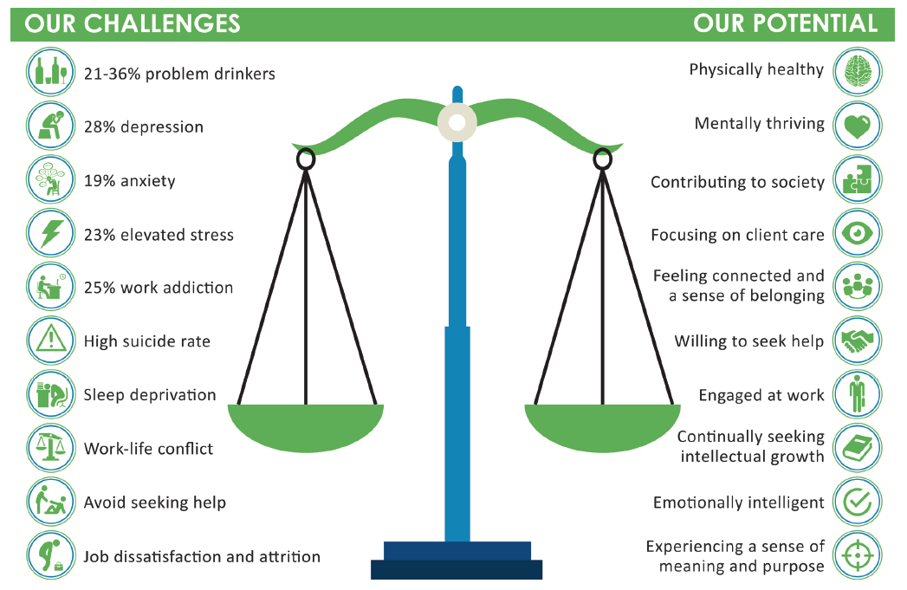
Notes:
40 to 70 percent of disciplinary proceedings and malpractice claims against lawyers involve substance use or depression, and often both
For alcohol abuse, the majority of abusers (up to 80 percent) experience mild to severe cognitive impairment
Research has found that 30-40 percent of licensed physicians, 49 percent of medical students, and 60 percent of new residents meet the definition of burnout, which is associated with an increased risk of depression,
substance use, and suicidal thinking.176 Burnout also undermines professionalism and quality of patient care by eroding honesty, integrity, altruism, and self-regulation.
Sleep deprivation has been linked to a multitude of health problems that decay the mind and body, including depression, cognitive impairment, decreased concentration, and burnout.
People who average four hours of sleep per night for four or five days develop the same cognitive impairment as if they had been awake for 24 hours—which is the equivalent of being legally drunk
Subordinates’ immediate leader drives almost 70 percent of their perceptions of the workplace

Slide 36
Title industry well-being
Title Insurance Professional Assistance Program
Emphasize Confidentiality
Develop High-Quality Well-Being Programming
Volunteers trained in crisis intervention and assistance
Referrals to professionals and treatment facilities
Helpline for individuals with concern about themselves or others

Slide 37
well-being tips for individuals
Meditation
Exercise
Body Scan
Emotional Scan
Social activities without substances
Rest
Self-compassion

Slide 38
well-being tips for companies
Incorporate well-being support into corporate policies
Provide space for employees to rest, meditate, etc…
Mandatory time-off with detachment from work
Implement well-being assessments
Incorporate well-being into mentoring and coaching
Company events centered on well-being (exercise, meditation, etc…)

Slide 39
“It always seems impossible until it’s done.”
- Nelson Mandela

