Slide 1
Preventing Elder Financial Exploitation:
Trends, Tips & Tools
CFPB Office for Older Americans

Slide 2
Disclaimer
This presentation is being made by a Consumer Financial Protection Bureau representative on behalf of the Bureau. It does not constitute legal interpretation, guidance or advice of the Consumer Financial Protection Bureau. Any opinions or views stated by the presenter are the presenter’s own and may not represent the Bureau’s views.

Slide 3
The Bureau’s Mission and Vision
MISSION
To regulate the offering and provision of consumer financial products or services under the Federal consumer financial laws and to educate and empower consumers to make better informed financial decisions.
Free, innovative, competitive, and transparent consumer finance markets where the rights of all parties are protected by the rule of law and where consumers are free to choose the products and services that best fit their individual needs.
VISION

Slide 4
Office for Older Americans
The Office for Older Americans (OA) develops initiatives, tools, and resources to:
Help protect older consumers from financial harm
Help older consumers make sound financial decisions as they age

Slide 5
What is elder financial exploitation?
Fraudulent or otherwise illegal, unauthorized, or improper act or process of an individual that uses the resources of an older person for personal benefit, profit or gain
Actions that result in depriving an older person of rightful access to, or use of benefits, resources, belongings, or assets

Slide 6




Examples of financial exploitation
Investment fraud and scams
Exploitation by an agent under a POA or person in another fiduciary relationship
Theft of money or property by family members, caregivers, or
in-home helpers
Lottery and sweepstakes scams

Slide 7




Examples of financial exploitation (cont.)
Grandparent/
Imposter scams
Tax and debt collection scams
Charity scams
Telemarketer, mail offer or salesperson scams

Slide 8




Examples of financial exploitation (cont.)
Telephone, computer, and internet scams
Identity theft
Reverse mortgage fraud
Contractor fraud and home improvement scams

Slide 9
Who is at risk?
Anyone can be the victim of financial exploitation
Elder financial exploitation crosses all social, educational, and economic boundaries

Slide 10
Why are some older adults at risk?
Some older adults may:
Have regular income and accumulated assets
Experience social isolation
Be vulnerable due to grief from a loss
Be reluctant to report exploitation by a family member, caregiver, or someone they depend on
Be trusting and polite

Slide 11
Who could be the abuser or exploiter?
Someone known to the older person
  Family members and caregivers
  Friends, neighbors, or acquaintances
  Agents under a power of attorney
  Financial professionals
Strangers
  Scammers of all types

Slide 12
Why don’t some older adults report financial exploitation or abuse?
Shame and embarrassment
Loyalty to family member or caregiver
Fear of retaliation or not being believed
Dependence on the abuser
Denial or self-blame
Lack of awareness

Slide 13
How to spot potential financial abuse
Look out for these common signs:
The person says money or property is missing
The person is afraid or seems afraid of a relative, caregiver, or friend
The person is reluctant to have visitors or take phone calls
You notice sudden changes in the person’s spending or savings

Slide 14
What you can do to help
Adult Protective Services
For elder abuse, contact Adult Protective Services.
Find contact information at eldercare.acl.gov or call 1-800-677-1116.

Slide 15
What you can do to help
Local Police - 911
If someone is in danger or a crime has been committed, call the police.
Your State Attorney General
Visit naag.org to find yours.

Slide 16
What you can do to help
Scams
Submit scams to the FTC at ftc.gov/complaint
Mail Fraud
Report mail fraud to the U.S. Postal Inspection Service at usps.gov

Slide 17
What you can do to help
Problems with financial products and services
  Credit cards
  Checking accounts
  Mortgages
Submit a complaint to CFPB Consumerfinance.gov/complaint
  Student loans
  Payday loans
  Auto loans or leases

Slide 18
Advisory & Recommendations and report to financial institutions on preventing and responding to elder financial exploitation (2016)
Office for Older Americans identified best practices to enable financial institutions to prevent elder financial abuse and intervene effectively when it occurs
Financial institutions can consider the recommendations as they assess their own current practices
Advisory does not impose any responsibilities or duties on financial institutions
Emphasizes importance of compliance with appropriate federal and state laws, but not intended to interpret federal consumer financial law or any other statute or rule

Slide 19
Update to Advisory for Financial Institutions on Preventing and Responding to Elder Financial Exploitation (2019)
Released July 2019
Focuses on reporting of suspected Elder Financial Exploitation (EFE) by banks and credit unions to appropriate local, state, or federal first responders
Provides new information on reporting based on federal and state legislative changes, including statutory charts
Highlights findings from the CFPB’s 2019 analysis of EFE SARs

Slide 20
Suspicious Activity Reports (SARs)
Bank Secrecy Act mandates that financial institutions report suspicious activity that might indicate criminal activities to FinCEN
SAR filers include banks, credit unions, money services businesses (MSBs), broker/dealers, others
Access to SARs and knowledge of existence generally limited to law enforcement and financial regulators
Law enforcement can use SAR information to trigger investigations, support ongoing investigations, identify subjects

Slide 21
Elder financial exploitation (EFE) SARs
2011: FinCEN Advisory noted that SARs are valuable avenue for financial institutions to report elder financial exploitation (EFE)
  Includes transactional red flags signaling EFE, e.g. frequent large withdrawals, uncharacteristic attempts to wire large sums
  Includes behavioral red flags, e.g. elder shows fear or submissiveness toward caregiver, financial institution is unable to speak directly with elder
2013: FinCEN introduced electronic SAR filing, including designated category for EFE
  “Clear, complete and concise” description of activity to be included in narrative field

Slide 22
Suspicious Activity Reports on Elder Financial Exploitation: Issues and Trends
consumerfinance.gov/data-research/research-reports/suspicious-activity-reports-elder-financial-exploitation-issues-and-trends/

Slide 23
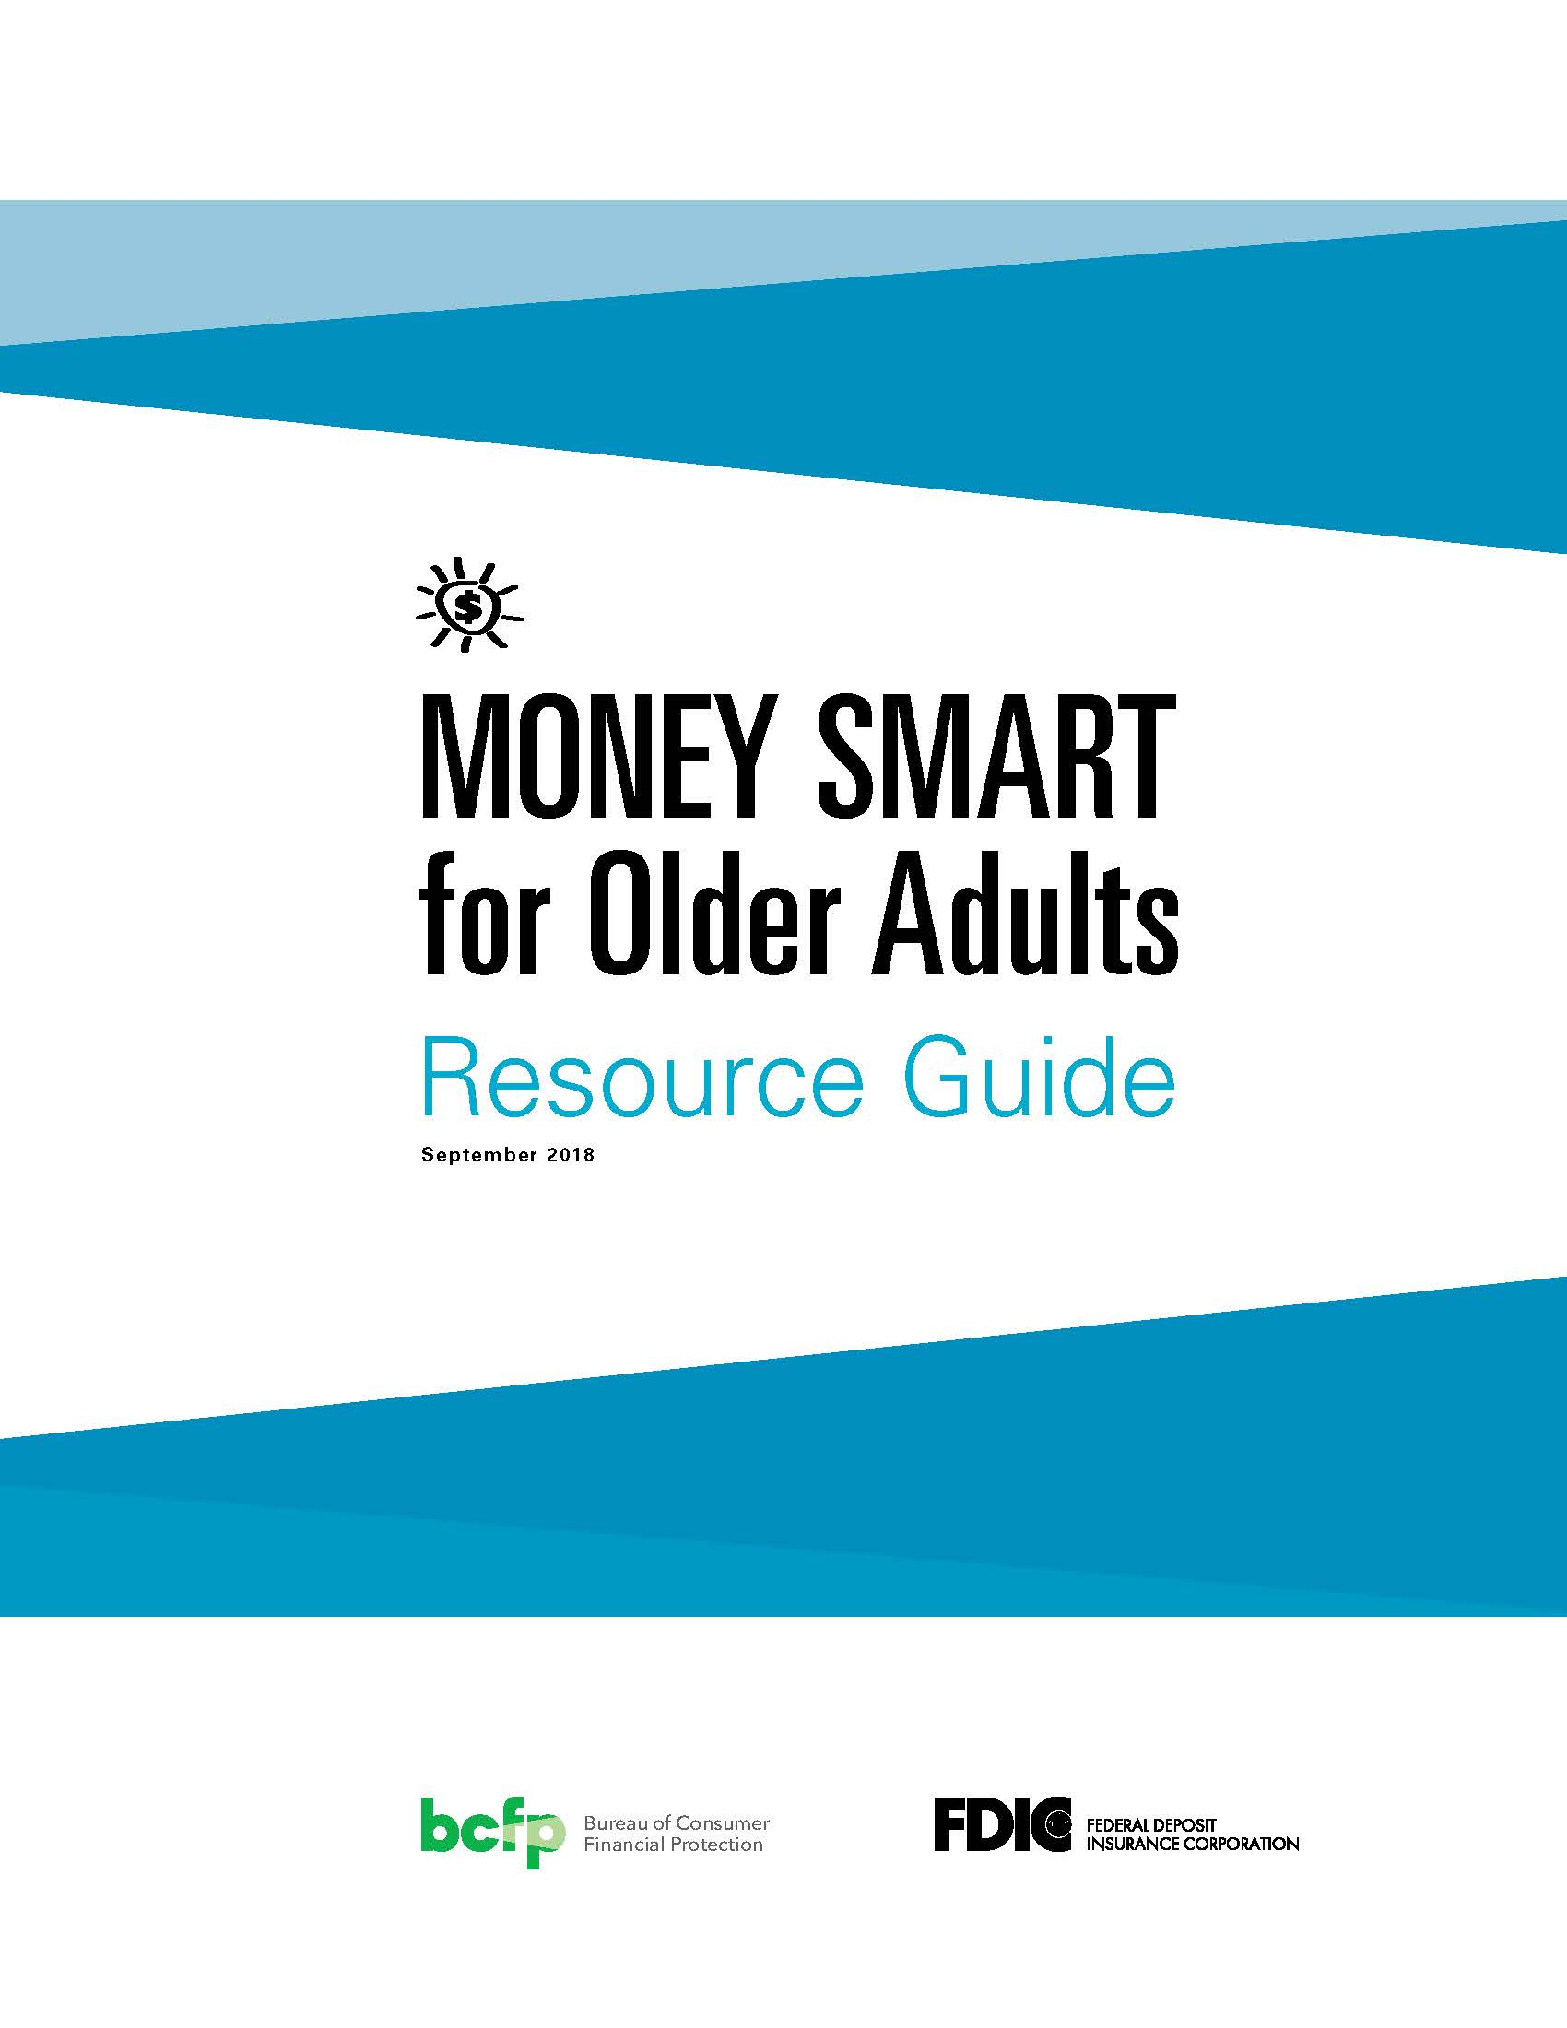
Money Smart for Older Adults
An awareness program developed in collaboration with the FDIC
Identify scams, fraud and other forms of exploitation
Instructor guides available for download
Resource guide available in bulk at no charge
Available in English and Spanish
https://www.consumerfinance.gov/practitioner-resources/resources-for-older-adults/protecting-against-fraud/

Slide 24
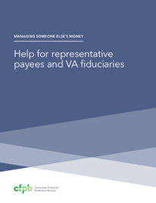



Managing Someone Else’s Money
Help for financial caregivers handling the finances for a family member or friend who is incapacitated
Guides for four common types of financial caregivers:
  Agents under a Power of attorney
  Guardians and conservators
  Trustees
  Social Security and Department of Veterans Affairs (VA) representatives
Includes tips on protecting assets from fraud and scams.
Available in English and Spanish
https://www.consumerfinance.gov/consumer-tools/managing-someone-elses-money/

Slide 25
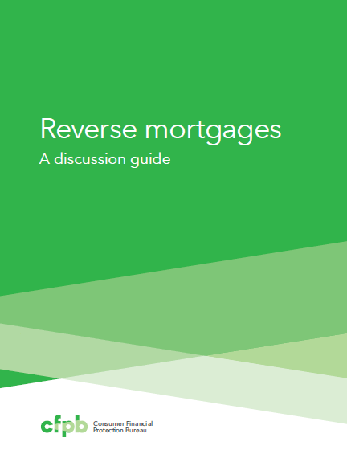
Reverse Mortgages Discussion Guide
An in-depth guide for consumers considering a reverse mortgage.
A tool that housing counselors, attorneys, financial counselors, or other intermediaries can use to walk consumers through the reverse mortgage product.
https://www.consumerfinance.gov/consumer-tools/reverse-mortgages/

Slide 26
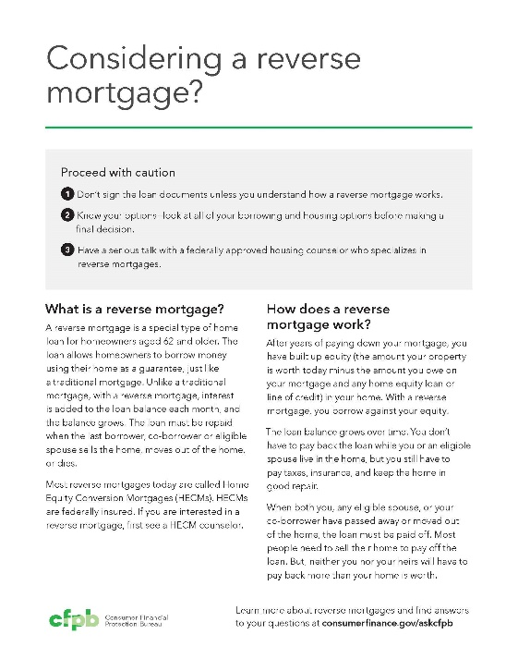
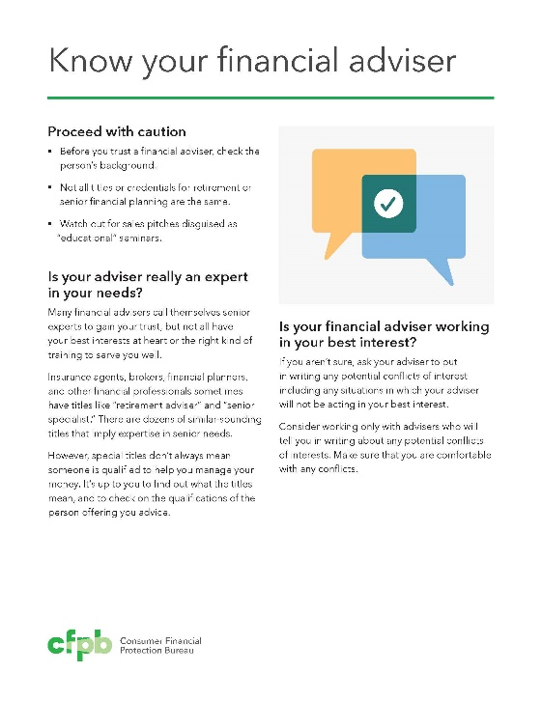
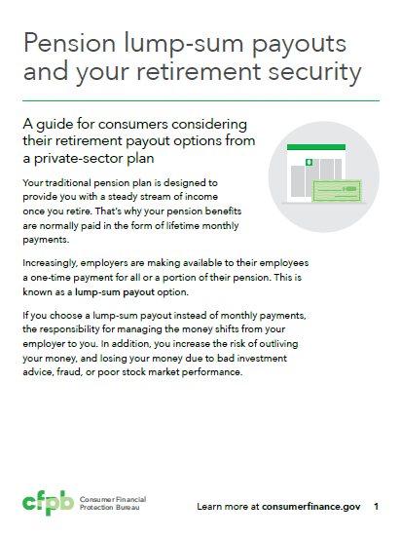
Guides to help consumers make informed decisions
The guides cover topics such as:
  Reverse mortgages
  Financial advisers
  Pension lump-sum offers
The guides list important questions to ask and where to go for help.

Slide 27

Tips and advice for older consumers
Consumer advisories:
Preparing your spouse to manage family finances
Asset recovery scams
Co-signing student loans
Taking a pension advance
Dealing with medical debt
Planning for diminished capacity
Recognizing misleading claims in reverse mortgage advertising
Responding to debt collectors’ threats of garnishing Social Security benefits

Slide 28
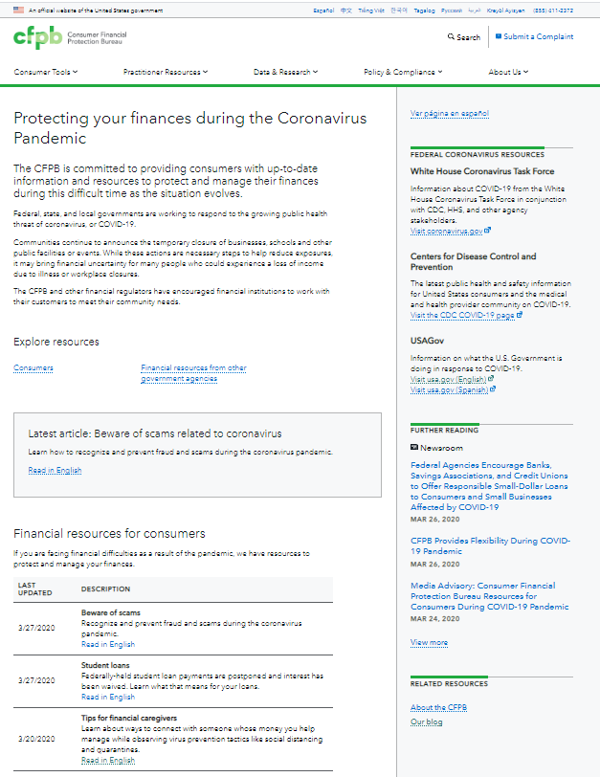
consumerfinance.gov/coronavirus
Hub for critical content
Central hub on consumerfinance.gov
Resources in English and Spanish
Check back for updates

Slide 29
Content topics and themes
Protect yourself financially
Submit a complaint if you are having a problem with a financial product or service
Protecting your credit
  Tips for financial caregivers
  Dealing with debt: Tips to help ease the impact
  Student loan repayment
Be aware of scams
Mortgage relief options
A guide to COVID-19 economic stimulus relief
For a full list of topics visit: consumerfinance.gov/coronavirus

Slide 30
Contact Us
Consumer Financial Protection Bureau
Office for Older Americans
Website: consumerfinance.gov/olderamericans
Email: olderamericans@cfpb.gov
Kate Kramer
Katelyn.Kramer@cfpb.gov

