Slide 1
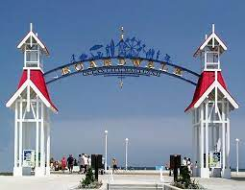
mlTA FALL SEMINAR
SEPTEMBER 11, 2022
TITLE IMPLICATIONS OF FORECLOSURE PROCEDURES
IN Maryland and D.C.
David H. Cox, Presenter
Ryan A. Patino, Presenter

Slide 2
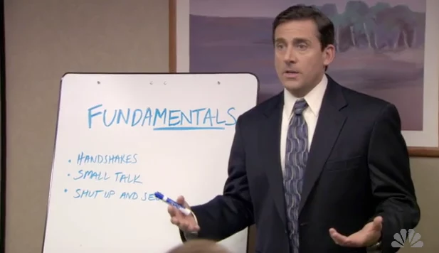
Summary of Presentation
1) Maryland Residential Foreclosure Steps and Timeline
2) Maryland Commercial Foreclosure Overview
3) Maryland Foreclosure Checklist to Avoid Pitfalls
4) DC Residential Foreclosure Timeline
5) DC Foreclosure Checklist to Avoid Pitfalls
6) Maryland Foreclosure Case Law Update
7) DC Foreclosure Moratorium Update

Slide 3
A lender is looking to foreclose on a home in Maryland, what is the process?
Review the Mortgage Agreement- There may be grace periods allowed under the mortgage agreement that a lender would have to respect before sending a notice of intent to foreclose.
If the Homeowner is in default, Lender can send a Notice of Intent to Foreclose .
Usually sent 45 days after default and with a loss mitigation application
A property is “residential” if it is 4 units or less, and it is “owner-occupied” if it is the owner’s primary residence.
Notice must include several pieces of information including a summary of the default and who the servicer and investor are on the mortgage.

Slide 4
The Beginning of the Judicial Foreclosure Process in Maryland
After the notice of foreclosure is sent, the Lender must file an Order to Docket 90 days after default (45 days after Notice to Foreclose sent)
The lender must file several documents and affidavits with the Order to Docket proving it has the right to foreclose, including:
The lender must file, under oath, a statement of debt
itemizes the entire amount the lender claims is due under the loan.
That property owner is not a member of the military service, commonly known as the Servicemember’s Relief Act.
Preliminary Loss Mitigation Affidavit or Final Loss Mitigation Affidavit*

Slide 5
Once the lender begins this process, what are the homeowner’s options?
Homeowner must file a mediation request and send a payment of $50, within 25 days of:
The Order to Docket if final loss mitigation affidavit served at same time
Receipt of final loss mitigation affidavit filed after the Order to Docket is filed
If homeowner does not request mediation, the sale can occur:
45 days after the homeowner has been served with the Order to Docket if it has a final loss mitigation affidavit filed with it; or
30 days after the final loss mitigation affidavit is served if it is filed after the Order to Docket is filed

Slide 6
Homeowner’s Initial Remedies- Cont.
If the homeowner requests mediation, within 5 days of receiving a mediation request the Circuit Court will forward the request to Office of Administrative Hearings (OAH)
If there is no agreement in mediation, the lender schedules the home for foreclosure sale. The lender can schedule the sale as soon as 15 days after the mediation has occurred
If Mediation does not work, what are the homeowner's options?
Homeowners may file a motion to stay or dismiss under Maryland Rule 14-211 if they have a valid defense to why the lender does not have the right to foreclosure on their home.

Slide 7
Is the homeowner provided an opportunity to cure under Maryland law?
The Homeowner has the right to cure the default by paying all past due payments, penalties, and fees and reinstate the loan at any time up to 1 business day before the foreclosure sale occurs.
If the homeowner does not cure, do they have any other options through the Circuit Court?
If a homeowner wishes to file exceptions to sale, those exceptions must be filed with the Court within 30 days after the clerk’s notice. The Circuit Court ratifies the sale after the time for exceptions has past or exceptions have been overruled.

Slide 8
What must a lender do in Maryland once the foreclosure sale has occurred?
Once the foreclosure sale has occurred, the lender must file a report of sale with the Circuit Court within 30 days of the sale.
After the foreclosure sale occurs and the purchaser from the foreclosure sale completes settlement, the court-appointed auditor will file the Auditor's Report with the Court.
The Homeowner and any junior lienholder are entitled to receive a copy of the Auditor's Report.
Once the Sale is ratified, what does a Purchaser have to do to remove the past homeowner (if they are still residing in the house)?
The purchaser from the foreclosure sale can file a Motion for Entry of Judgment Awarding Possession with the Landlord and Tenant Court.

Slide 9
Maryland Commercial Foreclosure Overview
Lenders typically foreclose loans secured by commercial property in Maryland using either:
Power of sale foreclosure. This form of foreclosure is authorized under a power of sale clause contained in the subject lien instrument (MD Rules, Rule 14-202(m)). Power of sale foreclosure is the preferred form of commercial foreclosure in Maryland.
Assent to decree foreclosure. This form of foreclosure is authorized by a provision in the lien instrument in which the borrower agrees to the entry of a court order for the sale of the property after a specified default (MD Rules, Rule 14-202(a)).
A lender cannot conduct a power of sale foreclosure unless both:
The deed of trust or mortgage:
contains a power of sale clause; and
is recorded in the county where the subject property is located. (Md. Code Ann., Real Prop. §§ 1-101(c), 3-101(a), and 3-103.

Slide 10
A Few MD Residential Foreclosure Tips to Help Avoid Pitfalls
1) Do not start the foreclosure until the last of:
______120 days after the loan becomes delinquent if the lender is subject to Consumer Financial Protection Bureau (CFPB);
______90 days after the default under the lien instrument; or
______45 days after the lender sends a notice of intent to foreclose (notice of intent) in the required form and manner.
_____ Perform a loss mitigation (workout) analysis if the property is owner-occupied.
2) Serve the Initial Foreclosure Documents
______Provide the complaint to foreclose with all filed exhibits (initial foreclosure documents) to the borrower and the property's record owner.
______Include a notice of foreclosure action in the prescribed form
______Mail a notice of action in the statutory form to the property's occupants
______File affidavits of service with the details required by court rule

Slide 11
Maryland Tips Cont.
3) Schedule a foreclosure sale of the property after receiving a decree for sale from the court and waiting:
______if the property is owner-occupied and the borrower requests post-filing mediation, at least 15 days after either the date of the mediation session or, if no mediation is held, the date that the OAH files its report with the court;
______if the property is owner-occupied and the borrower does not request post- filing mediation, either 45 days after service of the initial foreclosure documents (if the plaintiff files the final loss mitigation affidavit with the complaint to foreclose) or 30 days after the plaintiff separately mails the final loss mitigation affidavit; or
_____if the property is not owner-occupied, 45 days after service of the initial foreclosure documents.
4) Conduct the Foreclosure Sale
______Ensure the foreclosure sale takes place as a public auction at the time and place specified in the notice of sale. Confirm the sale occurs:
________in the county where either the property is located or, if the property is in more than one county, the foreclosure action is pending; and
________outside the courthouse or at the subject property (unless the court orders otherwise).
______Confirm the auctioneer (if any) files an affidavit within 15 days after the sale containing the information required by court rule.

Slide 12
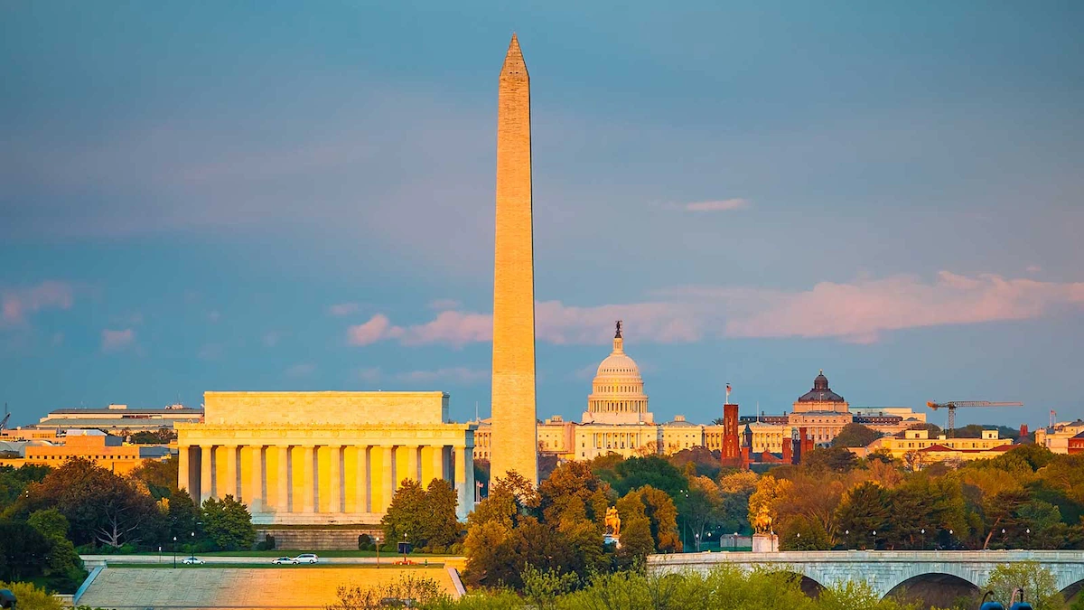
How does a Lender foreclose on a property in DC?
Judicial Foreclosure allows the court to:
set the terms for the sale of property;
set the track on which the judicial foreclosure case will precede;
appoint officers to conduct the sale; and
provide guidelines for advertising and post-sale procedures.
Non-Judicial Foreclosure (by issuing a Notice of Default and offering mediation through the D.C. Department of Insurance, Securities, and Banking (DISB))
Non-judicial foreclosure procedures are governed by D.C. Code Section 42-815.
Non-judicial foreclosures are now less common than judicial foreclosures in D.C. because:
a party to a non-judicial foreclosure can convert the case to a judicial foreclosure;
there is a risk of relitigating the non-judicial foreclosure because non-judicial foreclosure does not require a final court order.

Slide 13
How does a lender start the judicial foreclosure process.
The foreclosing party must:
File the complaint and with the Superior Court by naming all necessary Defendants. (Prepare a summons for each defendant)
Attach all necessary exhibits to the Foreclosure Complaint
Mediation is not required in judicial foreclosures; however, the court typically orders that residential lenders and borrowers engage in two successive rounds of mediation.
Once the Court renders judgment, what are the next steps?
The court renders a judgment of foreclosure in judicial foreclosures by a decree of sale. The decree of sale sets out the steps for conducting public sales of real property in judicial foreclosures.
Notice of Public Sale
The court generally orders the plaintiff-lender to send notice to all junior lienholders, owners of record, and occupants.

Slide 14
D.C. Residential Judicial Foreclosure Checklist
D.C. Residential Judicial Foreclosure Checklist to Avoid Pitfalls (4-5 min)
Before Commencing a Residential Foreclosure
• ______Review the terms of the note and deed of trust or mortgage for any contractually required notice requirements.
• ______Send a written notice of default to the defaulting borrower before beginning a non-judicial foreclosure
• ______Determine if the 120-day delinquency period required by the Consumer Financial Protection Bureau has run before beginning the foreclosure process.
• ______Ensure compliance with the statute of limitations by:
• reviewing the loan documents to determine requirements for the borrower's default; and
• declaring the loan in default.
Commence a Judicial Foreclosure
• ______Consider requesting that the court appoint the attorney handling the judicial foreclosure as substitute trustee.
• _______Record the court order appointing a substitute trustee in the land records of the Office of the Recorder of Deeds.

Slide 15
MARYLAND FORECLOSURE CASE LAW UPDATE
1) Daughtry v. Nadel, 248 Md. App. 594, 601 (2020).
In 2007, Wanda and Nathaniel Daughtry borrowed $918,900 from Liberty Mortgage Corporation to refinance the mortgage on their home. The Daughtrys defaulted in their loan payments in 2012, and the Daughtry’s loan was eventually sold to MTGLQ Investors. In 2018, MTGLQ sent the Daughtrys a “notice of intent to foreclose” informing them that their loan payments were 6 ½ years in arrears and notifying them that foreclosure proceedings would be instituted if the default was not cured. In 2019, MTGLQ appointed foreclosure trustees who initiated proceedings to foreclose on the Daughtrys’ home. The Daughtrys moved to dismiss the case. They asserted that foreclosure cases are now subject to Maryland’s general three-year statute of limitations due to a series of changes in the law since 1947, and seven years elapsed between their default and the filing of the case.
The Court of Special Appeals disagreed. The Court noted that Section 5-101, the statute of limitations argument, applies only to actions “at law.” Foreclosure proceedings, the Court said, are not actions at law because they are “equitable in nature.” Moreover, the Court noted that in exempting instruments secured by owner-occupied residential real property from Section 5-102, the General Assembly substituted a time limit on “any cause of action to collect the unpaid balance due . . . at the time the property was transferred” of three years after ratification of the auditor’s report in a foreclosure case The highlighted language, the Court said, “unambiguously refers to post-transfer causes of action—i.e., post-foreclosure actions—not foreclosure actions themselves.”

Slide 16
MARYLAND FORECLOSURE CASE LAW UPDATE
Huertas v. Ward, 248 Md. App. 187, 211-12, 241 A.3d 1, 15 (2020).
Even when a challenge is raised to the right to foreclose, based upon an allegation that the secured lender may not be the holder or otherwise be entitled to enforce a promissory note, there still does not exist a legal requirement for the original “wet ink” promissory note to be presented to the court. In Huertas, the Court of Special Appeals noted, “[a]s a second potential defense, [[borrower] appears to argue that the substitute trustees had no right to foreclose unless they produced ‘original documents in wet ink[.]’ The relevant rules governing foreclosure under a power of sale include no such requirement.
The Court also noted, that when such a challenge is raised, it is best practice to request that the lender have the original promissory note sent to the trustees' office, so it is available for inspection by either the borrower or the circuit court judge.

Slide 17
MARYLAND FORECLOSURE CASE LAW UPDATE
Mitchell v. Yacko, 232 Md. App. 624, 161 A.3d 14 (2020).
In Yacko v. Mitchell, the Court noted that the Maryland Rules mandate that trial courts slow the foreclosure action to protect the homeowner and to ensure that the instruments are valid.
At issue in Yacko was whether an underlying deed of trust was a forgery. The homeowner alleged that she contracted for a fixed-rate loan but, at closing, she was presented with an adjustable-rate loan. The homeowner alleged that upon recognizing the nature of the documents, she halted the closing and had “void” stamped on the documents. The lender then sent correspondence to the homeowner stating that the loan was to be treated as a fixed-rate loan. The homeowner later defaulted on the fixed-rate payments. The substitute trustees initiated a foreclosure proceeding in Prince George’s County by filing an order to docket and attaching copies of the adjustable-rate note and deed of trust, neither of which contained any void or cancellation marks.
The Mitchell court considered whether the discrepancy between the actual loan documents and those filed within the order to docket presented a defense to the foreclosure pursuant to the clean hands’ doctrine, under which “courts of equity will not lend their aid to anyone seeking their active interposition who has been guilty of fraudulent, illegal, or inequitable conduct in the matter with relation to which he seeks assistance.” The Mitchell court held that an argument that the foreclosure may have been instituted under forged documents would present a valid defense pursuant to the clean hands doctrine.

Slide 18
DC FORECLOSURE MORATORIUM UPDATE
The D.C. foreclosure moratorium has been in effect since March 2020. The moratorium has been extended multiple times. On January 14, 2022, Councilmember Lewis George introduced the “Foreclosure Moratorium Extension Emergency Amendment Act of 2022”. The DC Council approved the legislation on January 18, 2022, and the Mayor signed it into law shortly thereafter.
The continued moratorium applies to any: Residential foreclosure that may be initiated or conducted under section 539; 2) Sales that may be initiated or conducted under section 313(c) of the Condominium Act of 1976; and a 3) Judgment foreclosing the right of redemption shall be entered under D.C. Official Code§ 47-1378.
The moratorium is further extended for residential foreclosures through September 30, 2022, if the “homeowner or their representative applies for financial assistance to cure a debt or default with funds from the Department of Housing and Community Development. Homeowner Assistance Fund (“Homeowner Assistance Funds”) or a similar government fund established to assist homeowners impacted by the COVID-19 public”. In order to gain this additional time, the homeowner must show certain proof and do so no later than 60 calendar days after July 1, 2022.

Slide 19
DC FORECLOSURE MORATORIUM EXCEPTIONS
First, the moratorium does not apply to buildings with more than five units.
Second, the moratorium does not apply to borrowers that are entities (as opposed to individuals). But there is one important exception to this exception: if the underlying mortgage is guaranteed by an individual, the moratorium does apply.
Third, the moratorium does not apply to non-resident borrowers. “This section shall not apply to a residential property at which neither a record owner nor a person with an interest in the property as heir or beneficiary of a record owner, if deceased, has resided for at least 275 total calendar days during the 12 months period immediately preceding October 1, 2021.”

Slide 20
THANK YOU FOR YOUR TIME!
Acknowledgments and Recourses:
Maryland State Bar Association-Foreclosure Proceedings
www.peoples-law.org/foreclosure
Westlaw Practice Note, Residential Foreclosure in Maryland
First American Title Insurance Company, District of Columbia Judicial Foreclosure
Westlaw Residential Foreclosure (D.C.), Practical Law
Daughtry v. Nadel, 248 Md. App. 594, 601 (2020).
Huertas v. Ward, 248 Md. App. 187, 211-12, 241 A.3d 1, 15 (2020).
Mitchell v. Yacko, 232 Md. App. 624, 161 A.3d 14 (2020).
https://www.jackscamp.com/blog/
David H. Cox, Esq. Ryan Patino, Esq. www.JacksCamp.com
Phone: 202.457.1634 Phone: 202. 457.1656 www.linkedin.com/company/jackson-&-campbell-p-c-/
DCox@JacksCamp.com RPatino@JacksCamp.com Twitter: @jackscampDC
Any Questions?

