Slide 1
AMERICA @ 250: LOOKING BACK AT RESTRICTIVE COVENANTS AND THE UNITED STATES SUPREME COURT’S DECISION IN SHELLEY v. KRAEMER

Slide 2
Introduction
Why Shelley v. Kraemer matters.
  A rare convergence of Constitutional and Real Estate Law.
    Real estate practitioners rarely confront constitutional questions.
  Shelley reshaped where, how, and with whom Americans could live.
  It shows the Court's power to drive social change, and how far the country has come.

Slide 3
I.
Setting the Stage for the Court’s Decision:
Racial Separation & Housing in America
1910- 1940

Slide 4
The Changing Demographics of America: 1910 - 1940
The Great Migration
  First Wave (1910–1940): ~1.6 million African Americans moved North, Midwest, and West.
  Second Wave (1940–1970): ~5 million more migrated from the South.
  Together, the waves drove a major demographic shift, sharply increasing Black populations in major cities.

Slide 5
Factors Behind The Great Migration
Racism and Segregation in the South.
Economic Hardship.
Agricultural Problems.
Industrial jobs in the North (War Production).
Higher Wages in the North.
Greater Social Freedoms than the South.
Top Destinations:
  New York, Chicago, Philadelphia, Detroit.

Slide 6
Increase in African American Population in American Cities 1910-40
CITY | 1910 | 1920 | 1930 | 1940
NEW YORK | 91,709 | 152,467 | 327,706 | 458,444
CHICAGO | 44,103 | 109,448 | 233,033 | 277,131
PHILADELPHIA | 84,459 | 134,229 | 219,589 | 250,880
DETROIT | 5,741 | 40,038 | 120,066 | 149,119
BALTIMORE | 85,098 | 108,696 | 142,750 | 166,395
WASHINGTON DC | 94,446 | 109,966 | 132,068 | 187,000

Slide 7
Arrival in the North: Housing
Escaping the South, African Americans still faced discriminatory housing policies nationwide.
Sub-standard, segregated housing.
Black and white residents were kept in separate neighborhoods.
  Real estate agents and landlords routinely blocked Black renters from other areas.
  From 1910, state and municipal laws barred housing integration.

Slide 8
The Situation in Baltimore
  Baltimore was already largely segregated by the early 20th century.
  Summer 1910: W. Ashbie Hawkins, an African American attorney, bought a home at 1834 McCulloh Street in an all-white neighborhood.
  He rented it to his law partner, George McMechen, also an African American attorney.
  Hawkins’ family was harassed and threatened after moving in.
  White homeowners lobbied officials to stop the “Negro Invasion.”

Slide 9
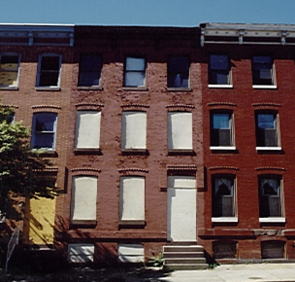
1834 McCulloh Street, Baltimore

Slide 10
Baltimore Segregation Ordinance of 1910
  In December 1910, Baltimore enacted the Segregation Ordinance of 1910.
  It made it illegal for African Americans to “take up residence” on majority-white blocks, and vice versa.
  New construction had to be designated for a specific race.
  Stated purpose: preserve public order, stability, and property values.
  Criminal penalties for violating the ordinance.
  The first racial zoning law in the United States.

Slide 11
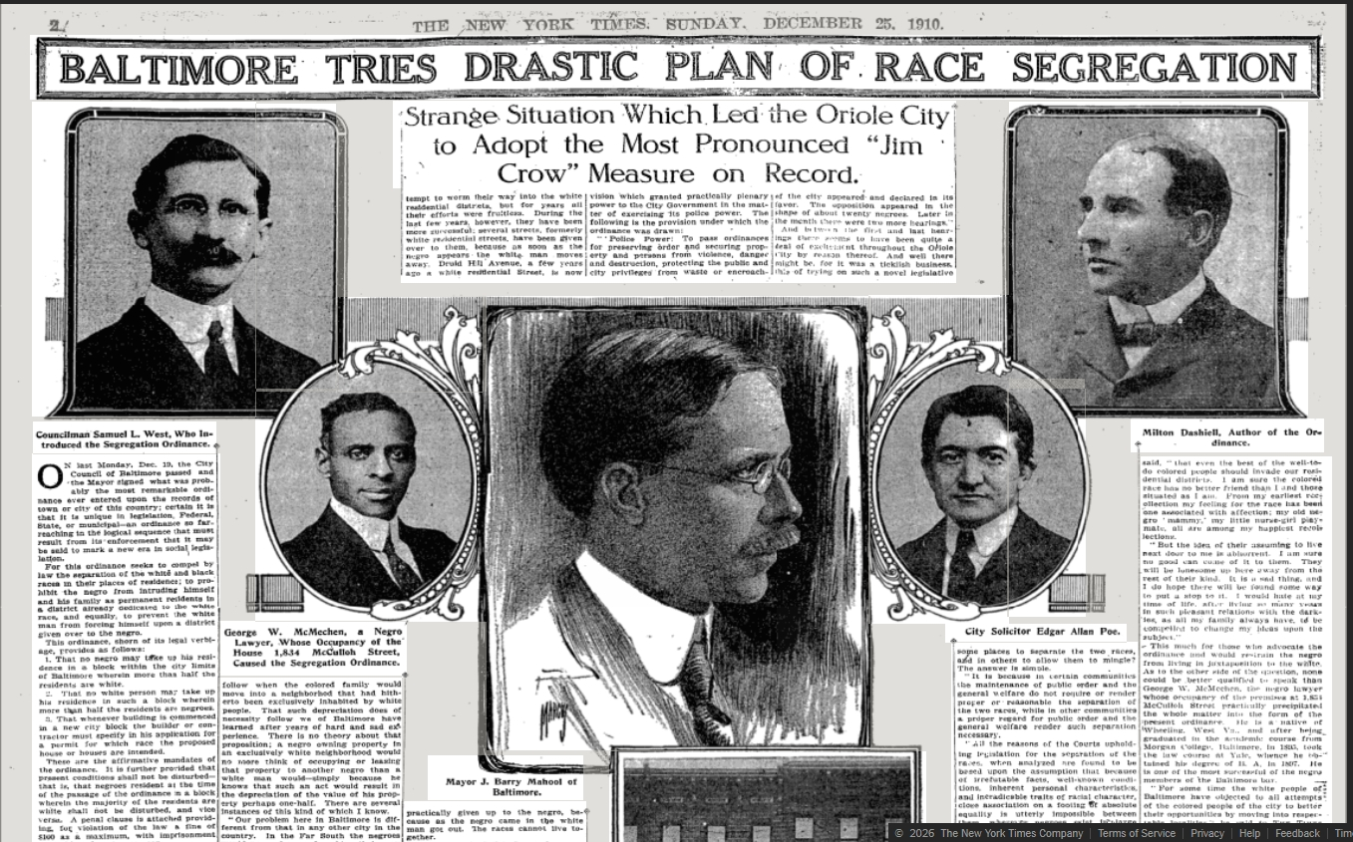
NEW YORK TIMES, DECEMBER 25, 1910

Slide 12
After Baltimore, Zoning Laws to Enforce Segregation Spread
Similar ordinances followed in Richmond, Atlanta, Louisville, New Orleans, and other Southern cities.
Promoted by white homeowners’ associations and city officials, ostensibly to stabilize property values and preserve public order.

Slide 13
Challenges to Baltimore’s Segregation Ordinances
Baltimore’s Segregation Ordinances faced numerous legal challenges.
Baltimore City Council enacted 4 different ordinances.
Two of the three failed judicial review; the Council repealed and replaced the other.
In 1915, a lawsuit challenged Thomas Jackson’s conviction under the City’s 4th ordinance: Jackson v. State, not decided until 1918 — after the Supreme Court’s ruling in Buchanan v. Warley.

Slide 14
Challenge to Louisville Segregation Act
Louisville adopted a Baltimore-style segregation ordinance.
It barred Black residents from majority-white blocks, and vice versa.
William Warley, NAACP Louisville chapter president, contracted to buy a corner lot from white realtor Charles Buchanan — a collaborative test case.
Warley’s contract excused him from performing unless he could occupy the property as a residence.
Buchanan sued for specific performance; Warley argued state and city law barred him from performing.
State courts upheld Louisville’s ordinance and Buchanan lost.
The twist: a white realtor challenging the ordinance’s constitutionality. Case went to the U.S. Supreme Court.

Slide 15
Buchanan v. Warley, 245 U.S. 60 (1917)
In a unanimous decision, the Court held Louisville’s ordinance unconstitutional for infringing the right to acquire, enjoy, and dispose of property.
The Court rejected the argument that the ordinance was a legitimate police-power measure to maintain public peace or racial purity.
Ordinance violated the “fundamental law” of the 14th Amendment “preventing state interference with property rights except by due process of law.”
The Supreme Court held states cannot restrict the right to buy property based solely on color.

Slide 16
Impact of Buchanan v. Warley
State segregation zoning laws were now unconstitutional and “completely invalidated.”
After ruling, MD COA held the Baltimore ordinance was unconstitutional in Jackson v. State (1918). “It is thus definitely settled, . . .that the right of the individual citizen to acquire or use property can not be validly restricted, by State or municipality, on the ground of his color.”
BUT, it applied only to state action — leaving private contracts and restrictive covenants untouched, an important limit on the ruling.

Slide 17
Aftermath: The Rise of Racially Restrictive Covenants
After Buchanan v. Warley, racially restrictive covenants became the “primary legal means of enforcing segregation.”
What is a racially restrictive covenant?
  “Agreements entered into by a group of property owners, sub-division developers, or real estate operators in a given neighborhood, binding them not to sell, lease, rent or otherwise convey their property to specified groups because of race, creed or color for a definite period unless all agree to the transaction.”
      - Seattle Civic Unity Committee (1946)

Slide 18
Racially Restrictive Covenants
Covenants restricted (a) sale or ownership, (b) use or occupancy, or (c) both, by members of an excluded group.
Some covenants were limited in duration, others were perpetual.
Some restrictions were included in deeds; others in recorded covenants running with the land.
Their purpose: enforce segregation privately, since governments no longer could.

Slide 19
Effect of Restrictive Covenants
Enforced housing segregation.
This led to increased overcrowding, squalor and home prices in areas where African Americans were forced to live.
African Americans and other “non-Caucasians” and “colored persons” were shut out of large swaths of residential areas across the country.
Essentially, the covenants were private zoning laws that could be judicially enforced.

Slide 20
Examples of Restrictive Covenants (MD)
Bradley Hills Grove, Block B, Montgomery County (1942)
  The above-described property shall never be sold, leased, or conveyed to, or occupied by, any person of the negro race.
Wyngate, Blocks H-M, Montgomery County (1948)
  No persons of any race other than the white race shall use or occupy any building or any lot, except that this covenant shall not prevent occupancy by domestic servants of a different race domiciled with an owner or tenant.

Slide 21
Examples of Covenant Language(cont.)
Woodside Park, Section 1, Montgomery County (1923)
  For the purposes of sanitation and health, neither the said party of the second part, nor his heirs or assigns, shall or will sell or lease the said land to any one of a race whose death rate is at a higher percentage than the white race.
Glazenwood Manor (Resub.), Prince George’s County
    No person of any race other than the Caucasian race shall use or occupy any building on any lot, except that this Covenant shall not prevent occupancy by domestic servants of a different race domiciled with an owner or tenant.

Slide 22
Examples of Covenant Language(cont.)
Locust Hill Estates, Blocks 4-6, Montgomery County (1945)
  None of the said properties, and no part of any of them, shall, at any time, be used or occupied, by, or sold, demised, transferred, conveyed unto or in trust for, leased, rented, or given to, negroes, or any person or persons in whole or in part of negro blood, extraction, origin or descent, or by or to any person or persons of the Semitic Race, blood, or origin, which racial description shall be deemed to include Armenians, Jews, Hebrews, Persians and Syrians; except that this paragraph shall not be held to exclude partial occupancy of any of said properties by such persons if they are domestic servants of the respective owners or tenants residing thereon.

Slide 23
Corrigan v. Buckley, 271 U.S. 323 (1926)
A restrictive covenant signed in 1921 by 30 white DC homeowners barred selling or renting on S Street, N.W. to African Americans, for a 21-year term.
In 1922, signatory Irene Corrigan sold her property to Helen Curtis, an African American. Corrigan’s neighbor, John Buckley, sued to enforce the Agreement and enjoin the sale.
DC Courts held Agreement was enforceable.
Before the Supreme Court, Corrigan and Curtis argued the covenant denied them due process and equal protection under the 5th, 13th and 14th amendments, and violated public policy.

Slide 24
Corrigan Court’s Decision
The Supreme Court unanimously held the constitutional claims were insubstantial and without merit.
Because covenants were private agreements with no state action, no constitutional violation occurred.
Judicial enforcement of private agreements did not, in the Court’s view, amount to state action.
Case dismissed for lack of jurisdiction.

Slide 25
Aftermath of Corrigan Decision
Courts treated covenants as legal, enforceable private contracts.
Courts enjoined sales and awarded damages for covenant violations.
Continued segregation throughout the country.

Slide 26
Expanded Use of Restrictive Covenants
Following Corrigan, use of covenants expanded nationally.
  Chicago (“home of the most intense covenant activity”).
  Los Angeles (a “veritable wave of covenantry”).
  Queens (NY) and suburbs (“effectively closed to Negro occupancy”).
  Washington, D.C. (most “new building sites and many older areas are now covenanted”).
  Private covenants continued the segregation that had been spreading before Buchanan v. Warley decision.

Slide 27
Covenants – Existing and New Homes
Covenants applied to existing homes (e.g., Corrigan) and new developments alike.
Racial restrictions were often used as a selling point by developers.
Helped drive “white flight” to new suburban developments.

Slide 28
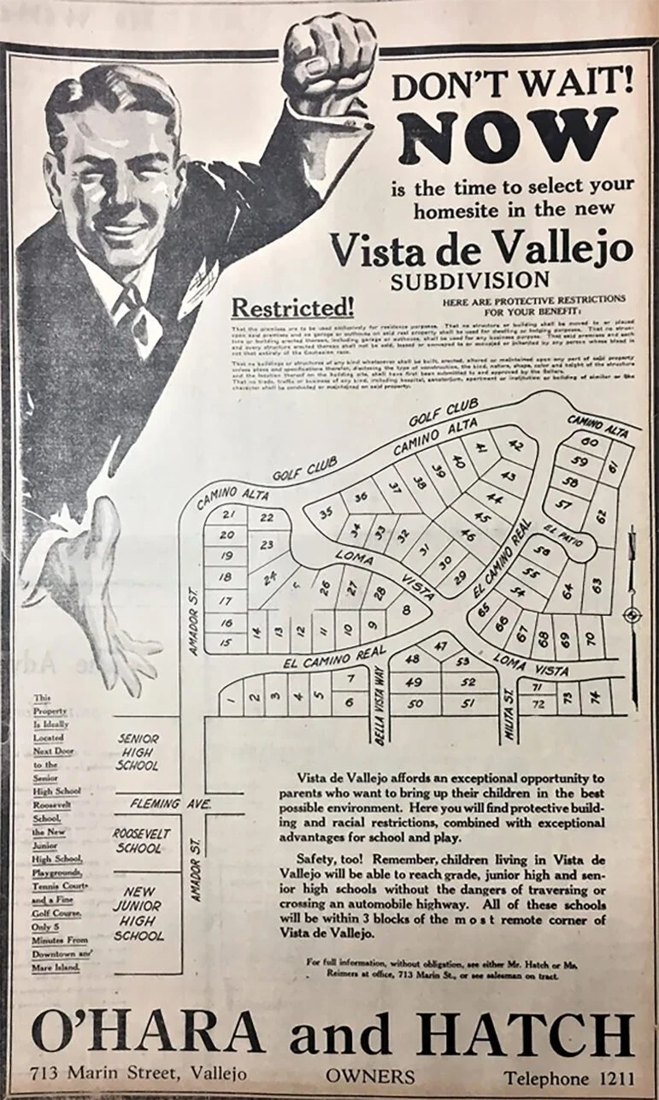
Advertisement
For Segregated
Real Estate
Vallejo, California
(1930s)
(Restricted
Development)

Slide 29
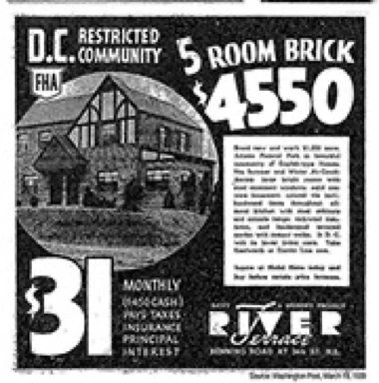
Advertisement
For Segregated
Real Estate
Washington, D.C.
(Washington Post,
March 19, 1939)
(Restricted
Development)

Slide 30
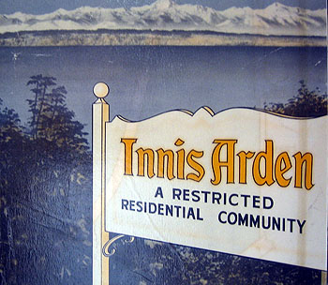
Entrance Sign to
a Racially
Restricted
Development in
Seattle (1940s)

Slide 31
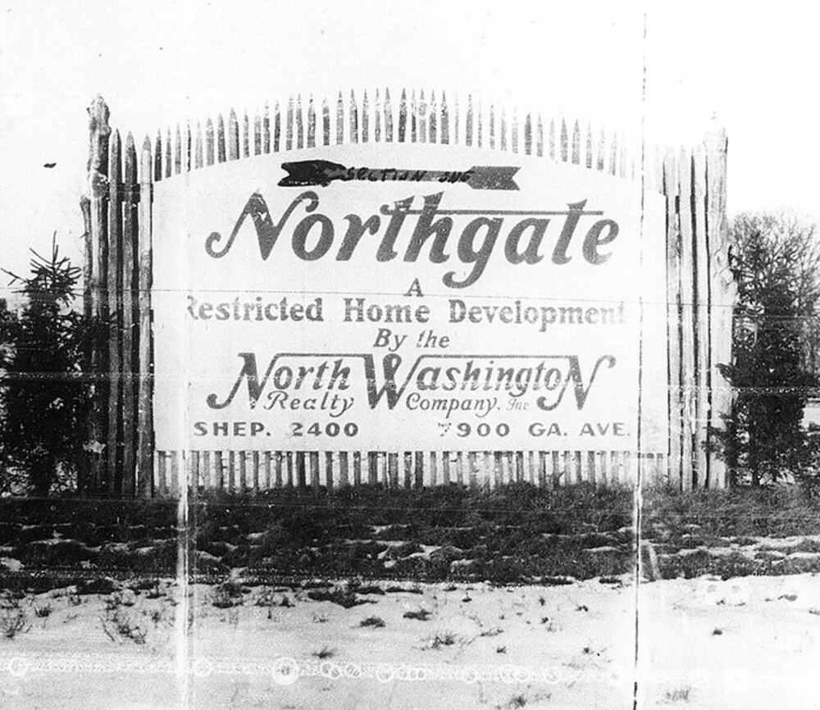
Washington, DC
(1940s)

Slide 32
II.
Shelley v. Kraemer

Slide 33
Consolidated Cases
Shelley v. Kraemer was a consolidated case addressing the constitutionality of racially restrictive covenants.
The first underlying case, Shelley v. Kraemer, came from the Missouri Supreme Court, which had upheld a covenant in St. Louis.
The second case, Sipes v. McGhee, came from the Michigan Supreme Court, which had also upheld one.

Slide 34
Underlying Facts – Shelley v. Kraemer
J.D. and Ethel Shelley bought a St. Louis house subject to a covenant barring “people of the Negro or Mongolian Race” from occupying it.
Purchased through a white “straw purchaser.”
A white neighbor, Louis Kraemer, sued to keep the Shelleys from living there.
The trial court refused to enforce the covenant, in part because not all district owners had signed — 30 of 39 signed; 5 Black property owners had not.

Slide 35
Missouri Supreme Court Decision
The Missouri Supreme Court reversed, upholding the covenant. Kraemer v. Shelley, 355 Mo. 814 (1946).
  The court held not all district residents needed to sign; the covenant bound only those who did.
  Not contrary to public policy; restrictive covenants consistently upheld by courts.
  Citing Corrigan, held covenants did not violate the Constitution: a private agreement, no state action.
Case appealed to the U.S. Supreme Court.

Slide 36
Underlying Facts –Sipes v. McGhee
White plaintiffs sued their African American neighbors to enforce a recorded covenant: “This property shall not be used or occupied by any person or persons except those of the Caucasian race.”
The trial court upheld the covenant: it was properly executed, the defendants were not Caucasian, and it violated neither due process, equal protection, nor public policy.

Slide 37
Michigan Supreme Court Decision
Michigan Supreme Court upheld lower court decision.
  No court had invalidated such a covenant on equal protection grounds; the agreement was legally enforceable.
  Without prior legislative action or a federal mandate, setting aside a private contract would be improper.
  The court’s role was to follow the law, not decide what was just; determining public rights belongs to the State, not the judiciary — enforcement was not state action.

Slide 38
Shelley v. Kraemer – U.S. Supreme Ct.
Consolidated Cases, Shelley v. Kraemer lead case.
High profile attorneys involved in the case.
  Thurgood Marshall argued the case for the Shelleys.
  United States filed an Amicus Brief (first time in a civil rights case).
  Alger Hiss helped write an amicus brief arguing U.S. racial discrimination harmed foreign policy and aided the Soviets.
Chief Justice Fred Vinson presided.
  3 of 9 Justices recused themselves.
DC companion cases, with slightly different issues since DC is not a state: Hurd v. Hodge and Urciolo v. Hodge.
Notes:
Alger Hiss American Assn. for the UN arguing that racial discrimination in the US had an adverse effect on US foreign policy and aided Soviet propaganda.

Slide 39
Issues before the Supreme Court
Does judicial enforcement of racially restrictive covenants constitute “state action” sufficient to trigger constitutional review under the 14th Amendment?
If yes, does judicial enforcement of a racially restrictive covenant violate the Constitution?

Slide 40
Decision by the Supreme Court
The Court first recognized the insidious nature of racially restrictive covenants: “[t]he civil rights intended to be protected from discriminatory state action by the Fourteenth Amendment are the rights to acquire, own and dispose of property. . . [p]roperty rights [were] regarded by the framers of that Amendment as an essential pre-condition to the realization of other basic civil rights and liberties which the Amendment was intended to guarantee.”

Slide 41
Decision by the Supreme Court (cont.)
The Court recognized the 14th Amendment requires “state action” and held that “standing alone” restrictive agreements violate no rights under the Fourteenth Amendment.
The Fourteenth Amendment “erects no shield against private conduct, no matter how discriminatory or wrongful.”

Slide 42
Decision by the Supreme Court (cont.)
The Fourteenth Amendment’s protections require “state action” — and in Shelley the Court found it.
Long-settled law: judicial action “is to be regarded as action of the State” under the Fourteenth Amendment.
“We have no doubt that there has been state action in these cases in the full and complete sense of the phrase.”
Without judicial intervention, the petitioners would have been free to occupy their properties without restraint.

Slide 43
Decision by the Supreme Court (cont.)
“State action . . . refers to exertions of state power in all forms. And when the effect of that action is to deny rights subject to the protection of the Fourteenth Amendment, it is the obligation of this Court to enforce the constitutional commands.”
“The historical context in which the Fourteenth Amendment became a part of the Constitution should not be forgotten. . . [I]t is clear that the matter of primary concern was the establishment of equality in the enjoyment of basic civil and political rights and the preservation of those rights from discriminatory action on the part of the States based on considerations of race or color.”

Slide 44
Decision by the Supreme Court (cont.)
“[I]n granting judicial enforcement of the restrictive agreements in these cases, the States have denied petitioners the equal protection of the laws and . . ., therefore, the action of the state courts cannot stand.”

Slide 45
Analysis of Shelley Decision
Appellants framed it as a civil rights case; respondents framed it as a private contract dispute over a common covenant.
Decision redefined “state action.”
Broadened the reach of the Fourteenth Amendment.
Expanded on Buchanan v. Warley and closed the loophole Buchanan had created.
Signaled federal judicial opposition to segregation.
Laid framework for Brown v. Board of Education.
Purely private discrimination remained constitutionally permissible.

Slide 46
Goetz v. Smith, 191 Md. 707 (1948)
A restrictive covenant recorded in Anne Arundel County barred transfer to “any negro, Chinaman, Japanese, or person of negro, Chinese or Japanese descent.”
MD COA ruled covenant unenforceable.
Shelley v. Kraemer controls. Shelley determines that the equal protection clause of the [Fourteenth] Amendment inhibits judicial enforcement by state courts of restrictive covenants based on race or color.”
After both decisions, MD courts could no longer enforce racially restrictive covenants.

Slide 47
Fair Housing Act of 1968
Federal law prohibiting housing discrimination.
Addressed housing discrimination that persisted after Shelley v. Kraemer.
Bars discriminatory sale, rental, terms, advertising, steering, and redlining.
Applies to sellers, landlords, realtors, lenders, and homeowners’ associations.
Protects individuals based upon race, color, religion, national origin, sex, disability, familial status.
Enforceable through civil lawsuits and other mechanisms.

Slide 48
Legacy of Shelley v. Kraemer
One of the Supreme Court’s most important real estate decisions.
Changed the housing landscape in America.
Neutralized a key legal enforcement mechanism of segregation.
Federal rejection of state policies that enabled segregation.
Broadened “state action,” expanding civil rights nationally.
Paved the way for the Fair Housing Act, which outlawed private discrimination.
But the work isn’t done — segregation’s legacy continues.

Slide 49
Restrictive Covenants: A Settled Issue?

Slide 50
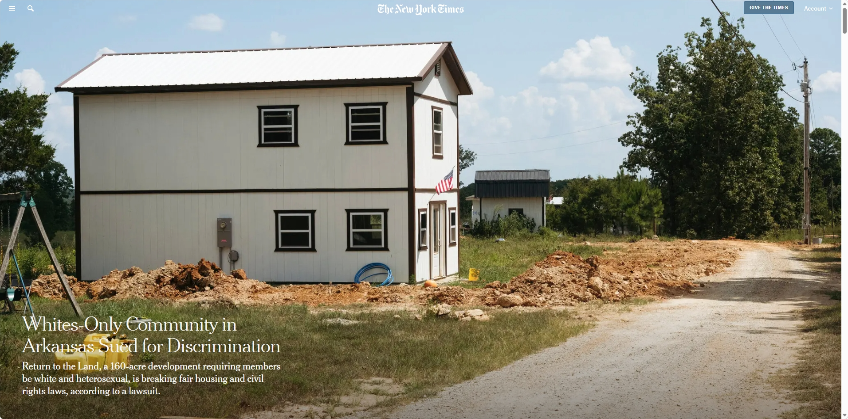

Slide 51
Return to the Land, Ravenden, Arkansas
A community founded by white nationalists, intended for whites only: “Jews, Black people, homosexuals and anyone with heritage that isn’t white and European are banned.” (NYT, 5/20/2026.)
The property is owned by an LLC; members get three acres to build on for a $6,600 membership interest.
A white realtor with a Black husband and biracial children was denied membership and sued in Arkansas Federal Court, alleging FHA and Civil Rights Act violations.
Walker v. Return to Land, 3:26CV151-DPM, E.D. Arkansas.

Slide 52
Bruce L. Stern, Esq.
9801 Washingtonian Boulevard
Suite 600
Gaithersburg, Maryland 20878
(301) 664-4803
bruce@cardinaltitlegroup.com

