Slide 1
Navigating
the Digital Closing Landscape
Presented to: Maryland Land Title Association
Thursday, September 19, 2024

Slide 2
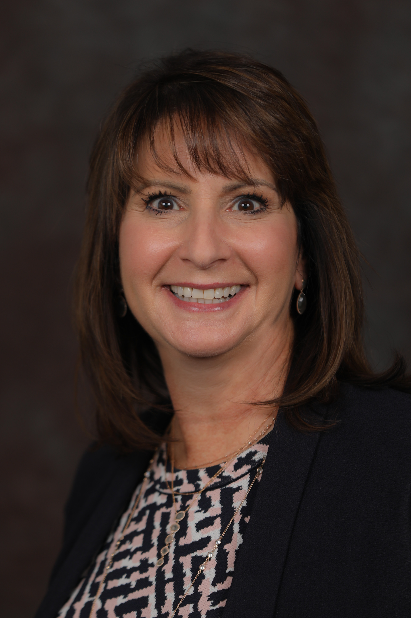
Suzanne Singer
More than 30 years of experience in mortgage and financial services
Current Director of Sales and Marketing at NotaryCam
Most recently served as senior vice president of capital markets sales at Solidifi
Also held executive-level positions at New Diligence Advisors, Clayton Holdings, Auction.com and GMAC-RFC

Slide 3
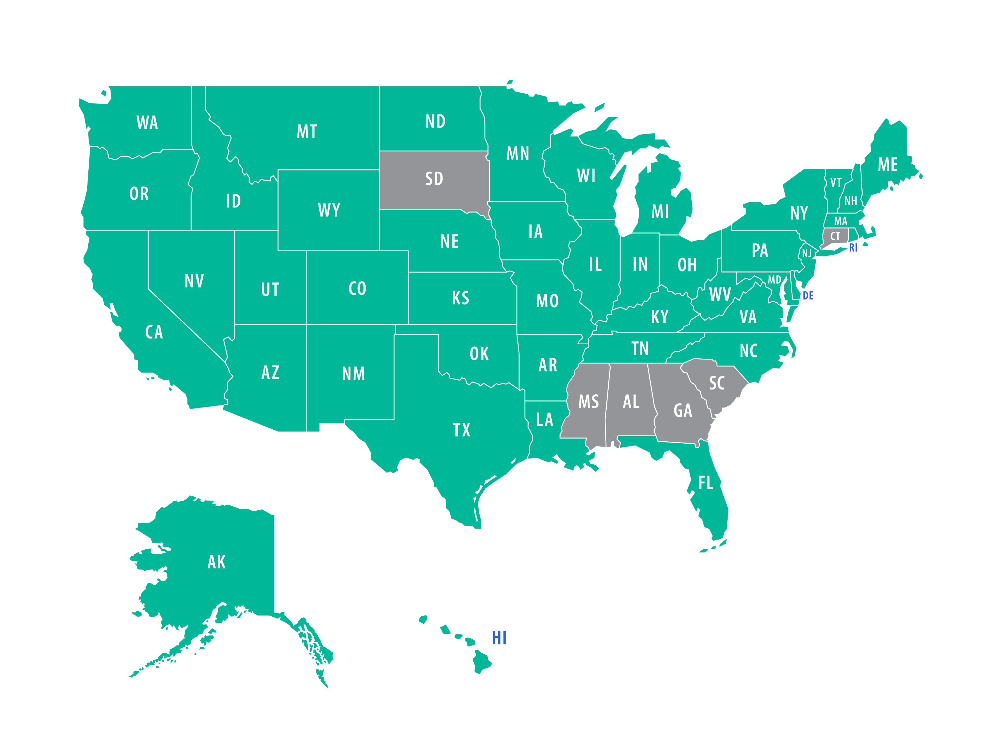
Where has RON legislation passed?
Green = Yes
Grey = No
Source: ALTA & CA Secretary of State
Notes:
44 states in total, California being the most recent
Phase 1 of CA bill recognizes RON transactions performed by out-of-state notaries
Additional phases will allow CA-commissioned notaries to perform RON transactions and approve RON tech vendors for use by CA notaries
Vermont has been operating under temporary legislation but is now working to make that legislation permanent

Slide 4
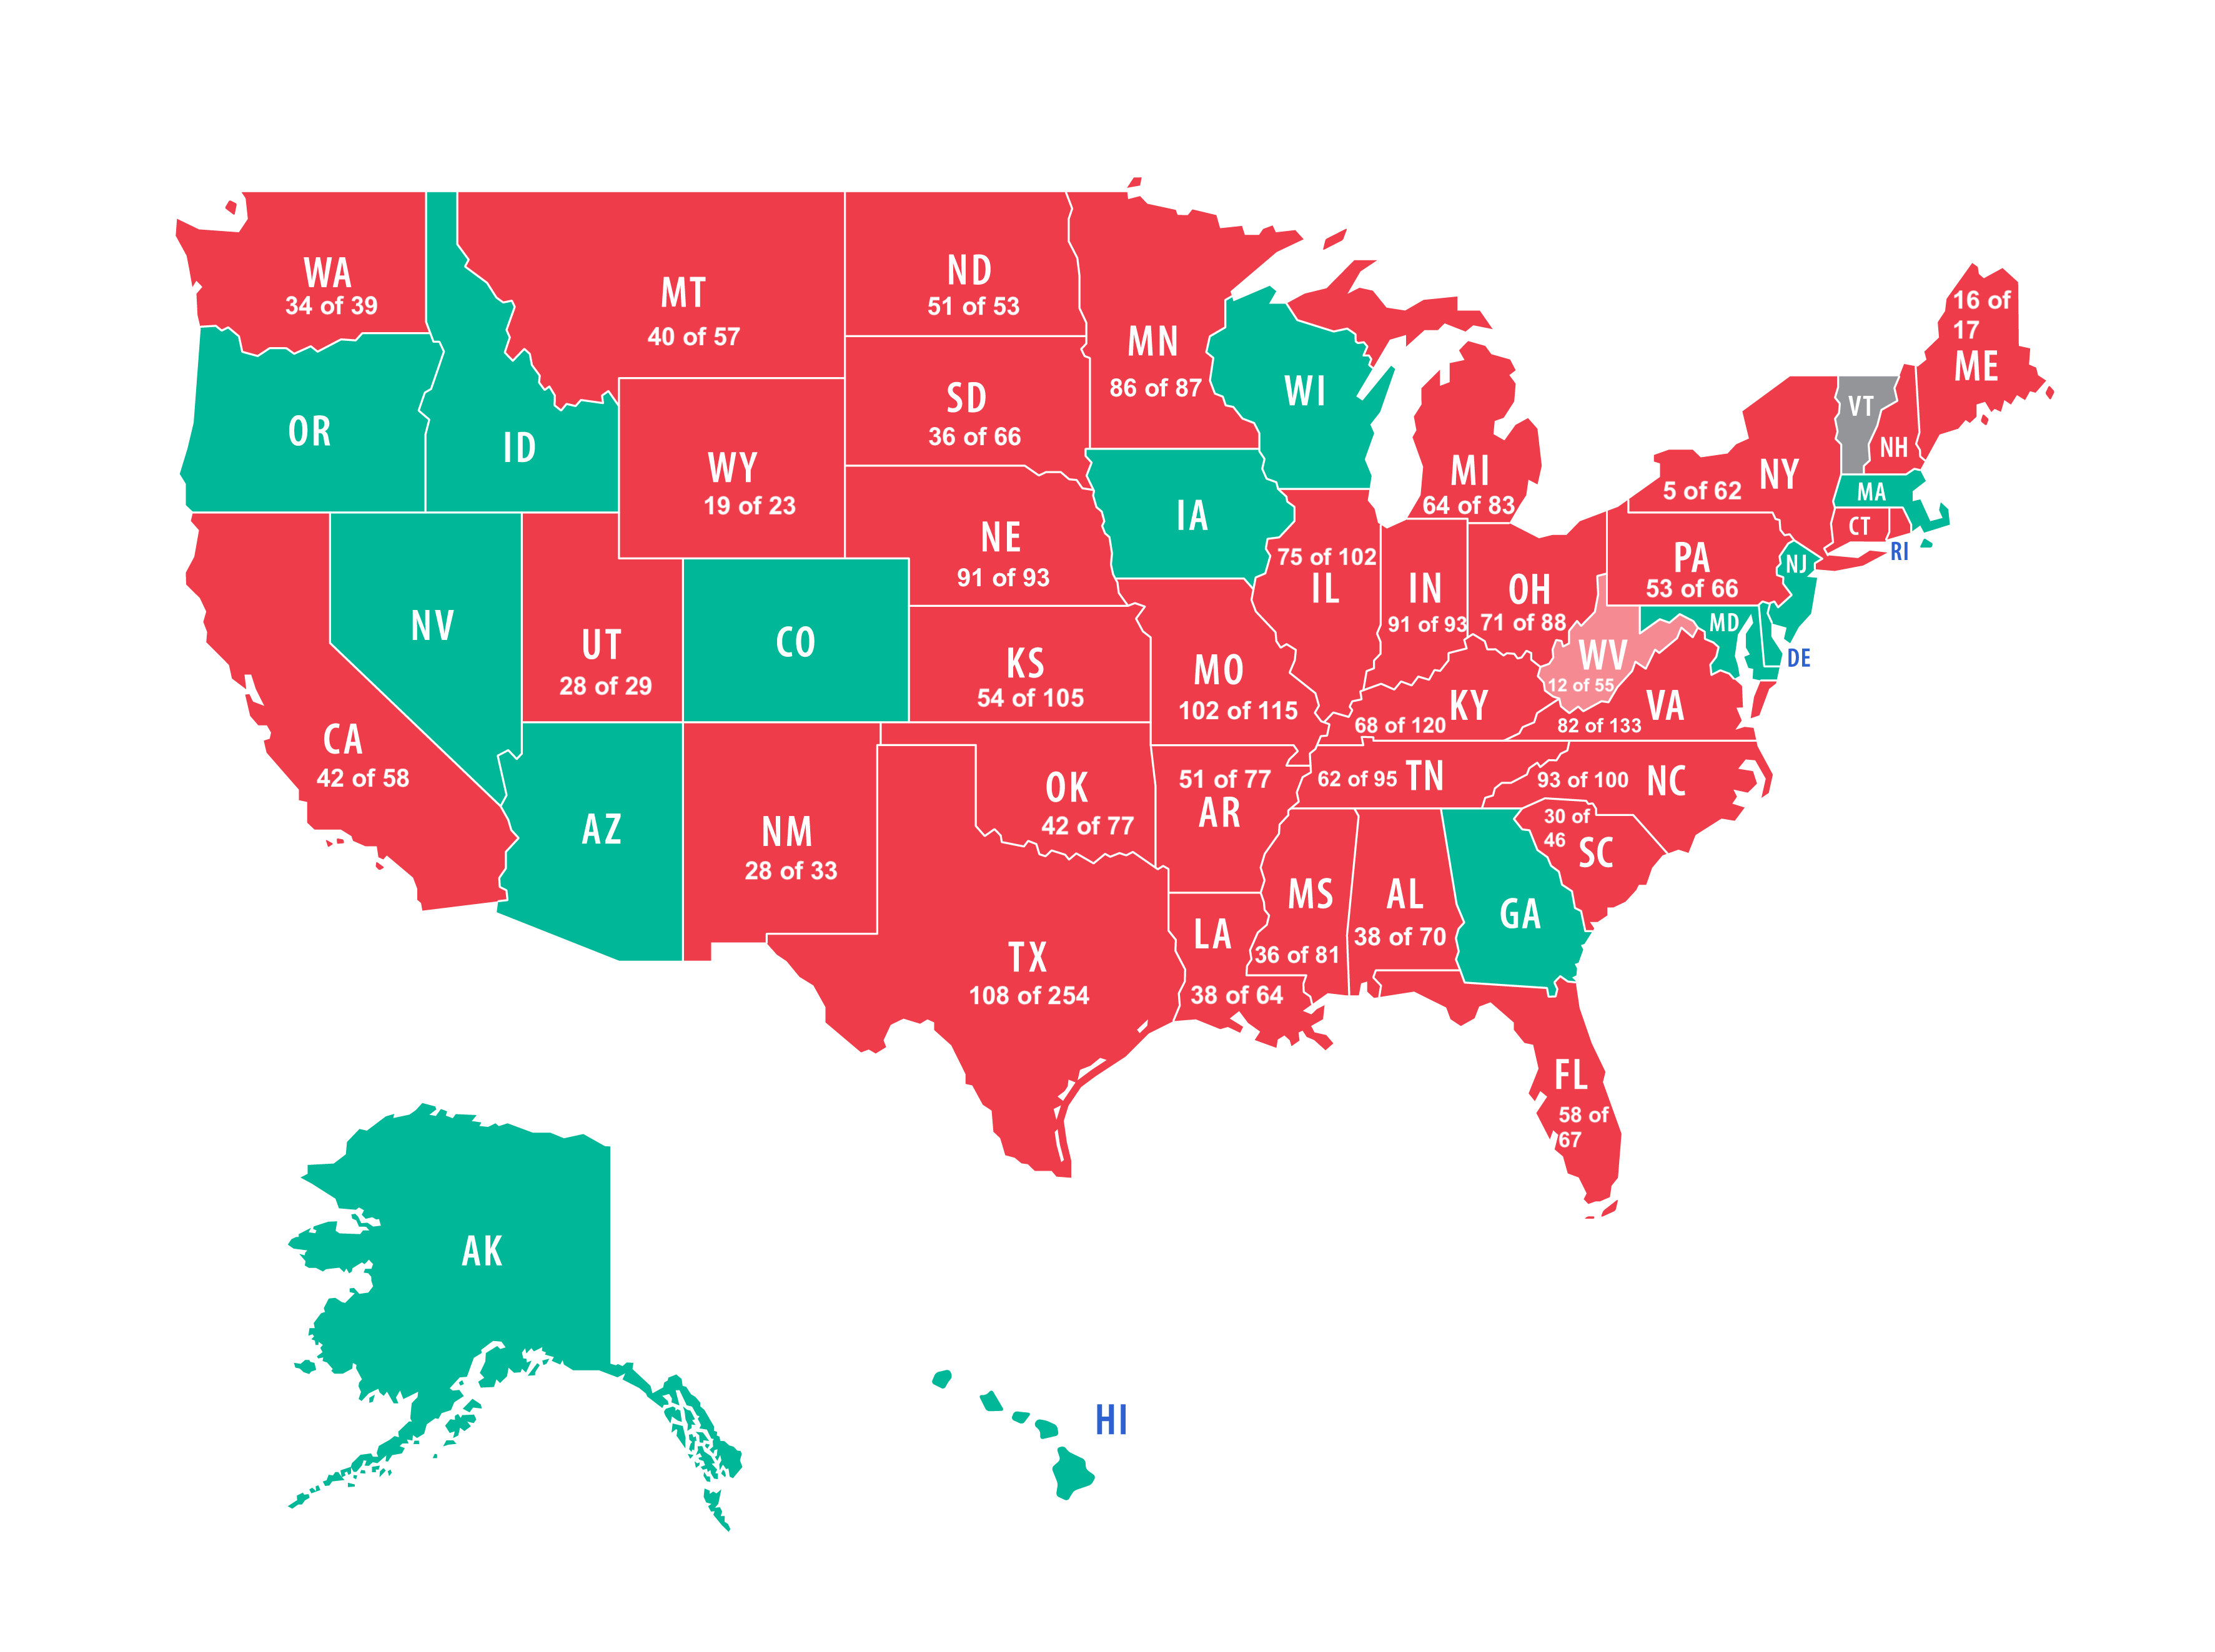
eRecording Jurisdictional Coverage
9 of 10
17 of 39
85 of 173
Green = 100%
Grey = 0%
Source: PRIA

Slide 5

eRecording Population Coverage
97.7%
61.5%
61.4%
Green = 100%
Grey = 0%
Source: PRIA

Slide 6
Title Insurer Acceptance
Top Title Insurers | eNotarization Acceptance?
First American Title | YES
Old Republic National Title | YES
Fidelity National Financial (includes Chicago Title, Commonwealth Land Title & Fidelity National Title) | YES
Stewart Title Guaranty | YES (owns NotaryCam ☺)
Westcor Land Title | YES
WFG National Title | YES
NATIC (now Doma) | YES

Slide 7
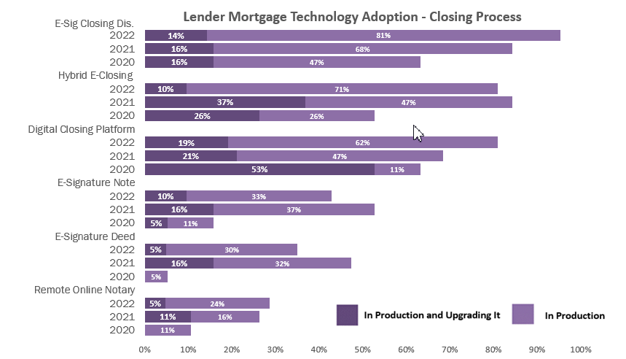
Lender Adoption is Growing!
250 registered originators on the MERS® eRegistry
100% of lenders surveyed indicated that digital tech adoption is inevitable
76% predict total industry-wide adoption will happen in less than 5 years
SOURCE: MBA’s 2022 Technology Profile Survey

Slide 8
Mortgage Investor/
Agency Acceptance
Fannie Mae Dec. 13, 2023 updates to Selling Guide outline policies and procedural requirements for delivering eMortgages eClosings & eMortgages resource page includes: eMortgage Readiness Checklist Index of Selling Guide sections related to eMortgage eClosing Scenarios overview FAQ | Freddie Mac Released 2021 study in on impact of digital offerings to loan production costs eMortgages resource page includes: eClosing implementation road map & checklist eMortgage fact sheet eMortgage case studies eMortgage ROI calculator
Ginnie Mae Launched Digital Collateral program as pilot in October 2019 First eNote securitized in January 2021 Securitized 123,870 eNotes in 2023, a 129% YOY increase | MERS® Over 2 million eNotes have been registered with MERS MERS ® eRegistry participants include: 42 Warehouse Lenders 34 Investors 9 FHLBs + Ginnie Mae

Slide 9

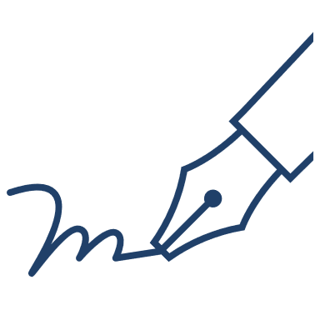


Overview of eClosing Scenarios
IN PERSON
In Office Title company closer Paper-based Wet signed | Mobile/Mail Away Mobile notary Paper-based Wet signed
IN PERSON |  | REMOTE
Hybrid Title company closer/ Mobile notary Mostly eSigned Certain documents wet signed Desktop/Tablet | Full Title company closer/ Mobile notary Completely eSigned Desktop/Tablet eNotarization required eRecording required | Online Title company closer/ Online eEnabled notary Completely eSigned Desktop/Tablet with webcam eNotarization required eRecording required
SOURCE: Stewart – “A Title Agency’s Guide to eClosing”
Notes:
Hybrid eClosing – All parties appear in person at the closing table, but some documents are signed electronically, while others are wet signed. Collateral, notarized and witnessed loan documents are typically among those that are wet signed. For documents that are electronically signed, generally one electronic signature is applied across all documents. Hybrid eClosings are the most popular and most widely used type of eClosing.
Full eClosing – All parties appear in person either at the settlement agent’s office or in the presence of a mobile notary, and all documents are both signed and notarized electronically. Very few closings are full eClosings because a large percentage of lenders are not ready to have the note electronically signed.
This is the most highly regulated type of eClosing, and special certifications are required to electronically notarize documents. Remote online eClosings are very popular and useful for the seller side of the transaction since, in most cases, there are no loan documents involved for the seller.

Slide 10
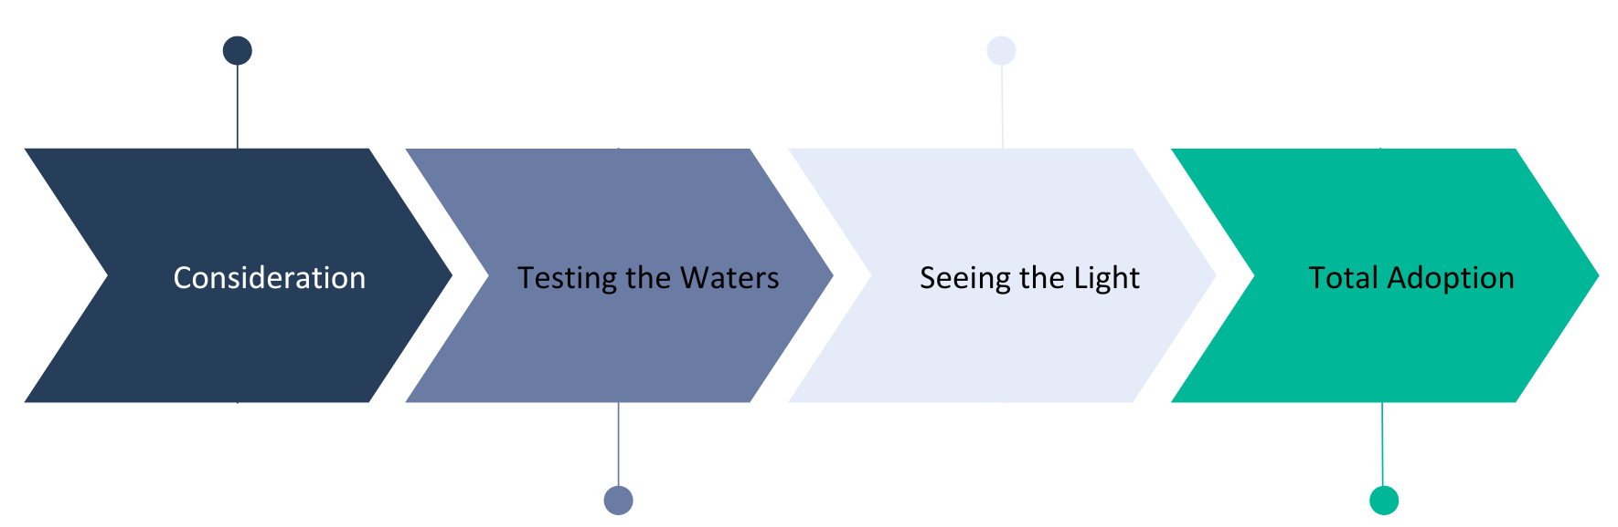
The Journey to eClosing
Aware, but hesitant
In “research & education” mode
12-18 months out from implementation
Broad, but not total, adoption
Full eClose is “default” closing mode
Working on refining digital strategy
Implementation in early stages
Some processes digital, but not all
Building momentum internally & externally
100% integration across the org
Full eClose is THE closing mode
Executing eNotes

Slide 11
IPEN v. RIN v. RON
IPEN = In-Person Electronic Notarization
Notary and signer still physically meet face-to-face but use eSign & electronic seal to sign and notarize an electronic document (a.k.a. electronic record) Signer presents physical proof of identity
RIN = Remote Ink-Signed Notarization
Signer wet-signs a paper document while communicating live with an online notary Identity proofing requirements vary by state – examples include: Notary’s personal knowledge of signer Remote presentment of ID Oath/affirmation of credible witness
RON = Remote Online Notarization
Notary and signer meet remotely using A/V communication technology and use eSign & electronic seal to sign and notarize an electronic document/record Requires combination of at least 2 ID verification methods, such as: Knowledge-based authentication (KBA) Credential analysis Remote presentment of ID Biometrics Public key certificate
SOURCE: National Notary Association
Notes:
RIN popularized during COVID -- 7 states now have permanent RIN legislation
Some states allow paper documents to be signed and notarized using RON

Slide 12
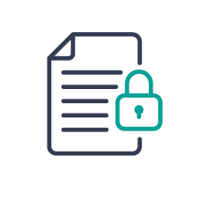



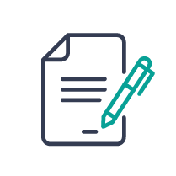


Steps to a Secure Remote Online Notarization
Upload
Meet
eSign
Complete
Signer and notary meet in secure online session
Documents are signed electronically
Documents are available for download
Via order form or API
Schedule
Verify ID
eNotorize
Our team schedules signing
Credential analysis
& KBA completed
Notary applies digital seal, locks document & applies tamper-proof seal

Slide 13
Benefits of RON
for Mortgage Closings
Exceptional Borrower Experience: Borrower can execute from anywhere at anytime. Never have to leave home or office and not limited to traditional office hours. Fast, convenient and secure.
Bank-Level “Know Your Customer” Verification: More rigorous ID analysis, including sophisticated algorithms to verify the security elements and information on the ID presented by the signer during remote ID presentation and knowledge-based authentication based on information pulled from public records that only signer is likely
to know.
Reduced Costs: No printing of documents multiple times, no shipping costs, can immediately eRecord completed transaction all contributing to cost savings.
Fraud Prevention: Higher level of customer verification due to two-way audio/visual recording and multi-factor authentication.
Risk Management: Complete notary journal and audit trail for each transaction.
Record Storage: 10-year cloud storage and access to video recordings.

Slide 14
When Can I Do a…?
Full eClosing
Hybrid eClosing
Remote Online eClosing
Jurisdiction allows eRecording
Investor/ warehouse bank both accept eNotes
Jurisdiction does not allow eRecording
AND/OR
Investor/ warehouse bank does not accept eNotes
Jurisdiction allows RON & eRecording
Investor/ warehouse bank both accept eSignatures

Slide 15

Barriers to Adoption:
Myth v. Reality
Huge IT/workflow change
  FALSE! Modern API integrations make getting started with RON easy.
RON eClosings are less secure
  FALSE! RON statues require at least 2 forms of ID verification, such as KBA
Has to be all or nothing
  FALSE! Hybrid eClosings still provide a tremendous lift and can help build ”muscle memory” in preparation for moving to full/RON eClosings
Can’t execute at scale
  FALSE! RON is legal in 44 states, and over 90% of the U.S. population lives in a jurisdiction that allows eRecording.

Slide 16
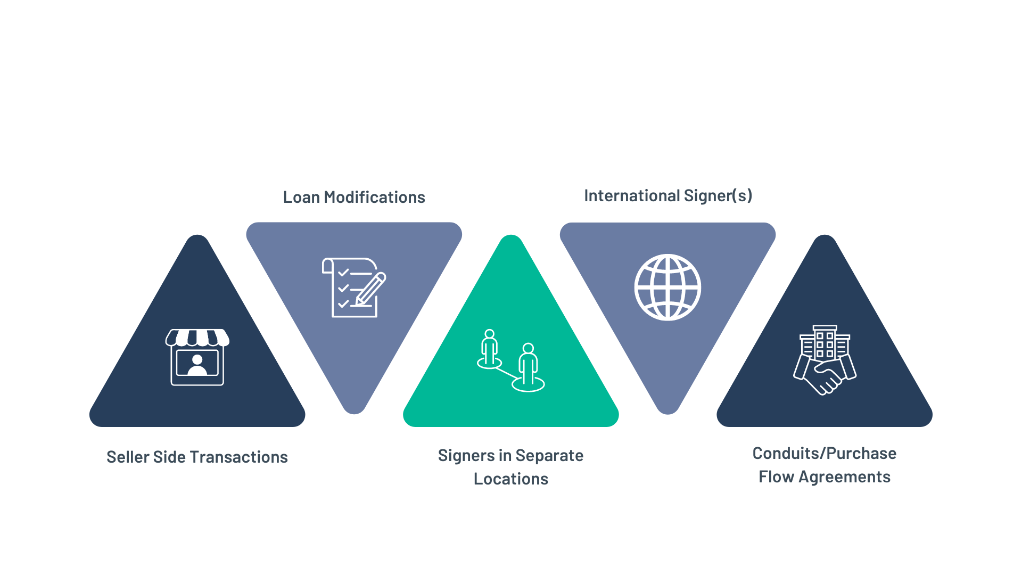
RON Use Cases

Slide 17
The Proof is in the Pudding
“
”
I have had…clients who were not able to attend the in-person closings at our office. Rather than stress about ensuring the mobile notary would be able to accommodate a mail away closing, we scheduled an online closing…Now, whenever we get the chance, I always try to do an online closing because I enjoyed it so much.
Michael Salazar, real estate broker
I thought this would only be popular among younger clients. However, to my surprise, even older clients have been able to successfully complete the closings…and I have only heard positive feedback from the real estate agents and clients that I work with. We continue to push all of our clients to close digitally as it makes the process easier for everyone.
Jordan Lulich, closing attorney
“
”
“
”
Remote online closings are something that our consumers need and want right now. We view them as necessary. Not only does the video recording component make the transaction more secure, but the fact that we're able to engage with the consumer face-to-face provides a better overall experience.
Josip Rupena, mortgage lender
“
”
  We were stationed in Lakewood, WA and were being re-stationed to Fort Stewart near Savannah, GA…As we were closing on the sale of our house in Washington, my husband was winding down his duties there, and I was spending a couple of weeks with my mom in Illinois. My mother-in-law, who with my late father-in-law was a co-signer on the Washington house, was in Missouri. We were all connected and looking at each other from four separate states, coast-to-coast, on a split screen…it was easy and took just about 30 minutes. From our perspective, what could have been a day full of confusion and anxiety turned out to be a pleasant surprise.
Dana Jackson, U.S. military spouse

Slide 18
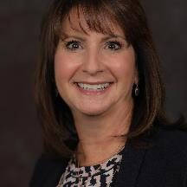
Suzanne Singer
Director Sales & Marketing
301.529.8254
Suzanne.singer@notarycam.com
NotaryCam.com

