Slide 1

The Ethical Dilemma Surrounding Reverse Mortgages

Slide 2
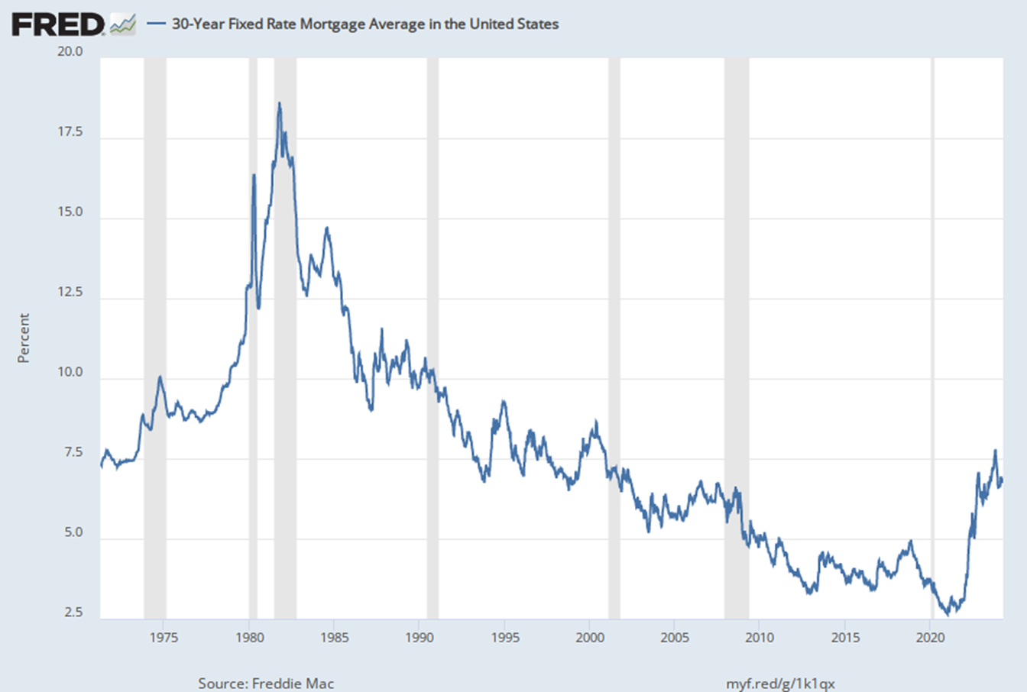
Is There Rate Relief In Sight?
Interest Rates on the Rise
Back to November ‘23 Highs
Federal Reserve is on a Wait & See Viewpoint
Inflation is not Cooling Off
Recession is Around the Corner

Slide 3

Future Horizon
Its not that Bad – Remember 1984
Times Will Change
Presidential Election Pressures
Bank Struggles
Recession
Unemployment Impact on the Fed’s Decisions
Don’t Stress over things you can’t change.

Slide 4

Senior Headlines
“ Millions of Americans are retiring with no savings” – Moneywise
Americans are delaying retirement – GAO Study 2023
Medicare will be drained of benefits by 2036 & the Social Security Fund will be depleted by 2035 – CNBC
Millions of Seniors struggle to afford Housing - NPR

Slide 5

Equity Quandary
American Baby Boomers are sitting on a mountain of real estate wealth – Is it safe to count towards retirement savings? – Moneywise
Boomers Claim 42% of the Total Real Estate Wealth – Federal Reserve 4th Quarter 2023
Are Boomers overlooking the Equity they have locked in for the long haul?

Slide 6
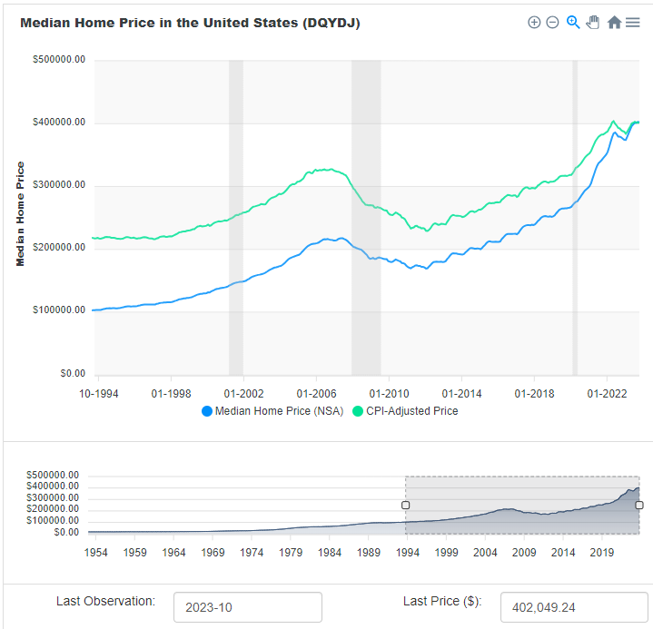
Experienced Strong RE Returns
Up 400% over the last 30 Years
Continue to Climb with no End in Sight
Severe Shortage Limited Listings

Slide 7
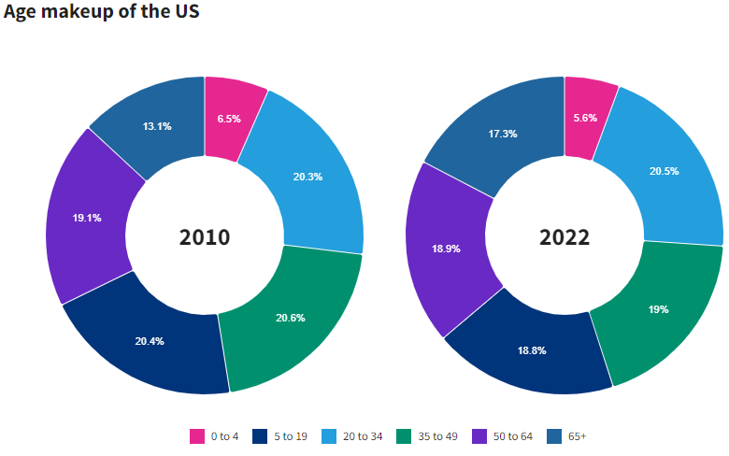
Senior Growth Rate
According to USA Facts – the 65+ Age Group was the fastest growing sector between 2010 and 2022, increasing 42.8%
Projected to have 80.8 Million Americans Aged 65 & Older by 2040

Slide 8

Senior’s Major Fears
Afford Day by Day Basic Needs
Being Homeless
Rising Medical Care Costs
Losing Physical Functions
Relying on Others for Daily Care
Making Day by Day Decisions

Slide 9
What is the Ethical Dilemma?
Reverse Mortgages are Bad
Reverse Mortgages are Good
Take Advantage of the Elderly
Robs the Children’s Inheritance
Have High Fees & Interest Rates
Not the Best Financing Option
Limitations on Loan Amts & Choices
Penalty for Younger Spouses
Home Maintenance & Escrows
Seniors can remain in their home indefinitely
Infinite Loan Term not defined by their Equity
No Tax Liability on Disbursements
Keep Retirement Secure
Multiple Loan Options
Cash for Maintenance & Escrows
Non-Course Loan & Affordable

Slide 10
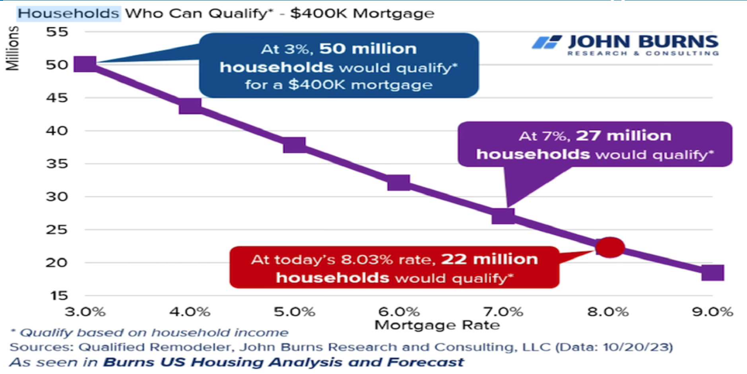
Affordability

Slide 11
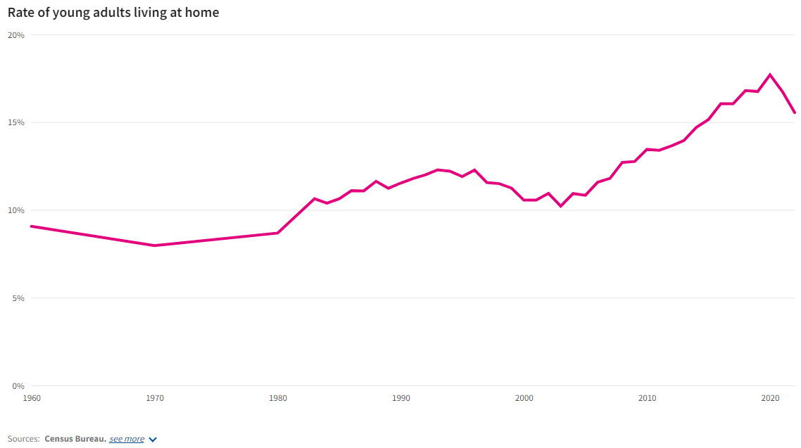
Rate of Young Adults Living at Home
Lack of Affordable Housing
Do Not See Relief in Sight!
Seniors want to Age In Place
Is Opportunity Knocking?
Why Not Multi-Generational Housing?

Slide 12

Reverse Mortgages the Answer to the Housing Shortage
Severe Lack of Housing
Generational Housing Expansion
Age In Place
Lack of Senior Care Facilities
Non-Family Rentals
Housing Bartering

Slide 13

How Do You Decide?
Get to know the Basics
Define The Purpose
Investigate the Process
Understand the Costs
Do we meet the Guidelines
Focus on Spousal & Estate Impact
Alternative Options

Slide 14

The Basics
Home Equity Conversion Mortgage (HECM)
Established – Housing & Community Act of 1987
Buyers/Borrowers = 62 or older
Traditional Mortgage In “Reverse”
“Rising Debt, Falling Equity”
Loan Advance – Financing the Payments
No Principal & Interest Payment
Continue to pay Property Taxes & Insurance*
Remain the Owner as long as you live there*

Slide 15

Purpose
Enable Elderly Homeowners to convert equity in their homes to monthly streams of income, lines of credit and or payment deferral.
Utilized in both a Purchase and Refinance Transaction
No Fixed Maturity or Loan Amount

Slide 16

Cash Proceeds
Can be used for Any Purpose
Non-Taxable Distribution
Does Not Affect Social Security or Medicare Benefits
Watch Liquidity for SSI & Medicaid
Makes Homes Handicap Accessible
Add Generational Living
Generate Monthly Cashflow
Create Equity Line
Credit Repair

Slide 17

Loan Guidelines
First Mortgage
Has Mortgage Insurance (.5% Annually/2% Financed)
No Prepayment Penalties
Interest is Charged as money is received
Fixed & Adjustable Options
Both Monthly & Annually ARMs
ARMs come with an index, margin & caps
3 Days to cancel after closing – Refinance
Non-Recourse Loan

Slide 18

Non-Recourse Loan
Never Owe More Than the Value of the Home.
No One is coming to take the home as long as you live there.
The Estate will not owe more than the home is worth.
The Mortgage Company cannot attach any other assets.
Great Retirement Planning Tool
Put Your Assets to Work

Slide 19
5 Basic Payment Plans
A. Tenure. Under this payment plan, the borrower will receive equal monthly payments from the lender for as long as the borrower lives and continues to occupy the property as a principal residence.
B. Term. Under this payment plan, the borrower will receive equal monthly payments from the lender for a fixed period of months selected by the borrower.
C. Line of Credit. Under this payment plan, the borrower will receive the mortgage proceeds in unscheduled payments or in installments, at times and in amounts of the borrower's choosing, until the line of credit is exhausted.
D. Modified Tenure. Under this payment plan, the borrower may combine a line of credit with monthly payments for life, or for as long as the borrower continues to live in the home as a principal residence. In exchange for reduced monthly payments, the borrower will set aside a specified amount of money for a line of credit, on which he or she can draw until the line of credit is exhausted.
E. Modified Term. Under this payment plan, the borrower may combine a line of credit with monthly payments for a fixed period of months selected by the borrower. In exchange for reduced monthly payments, the borrower will set aside a specified amount of money for a line of credit, on which he or she can draw until the line of credit is exhausted.

Slide 20
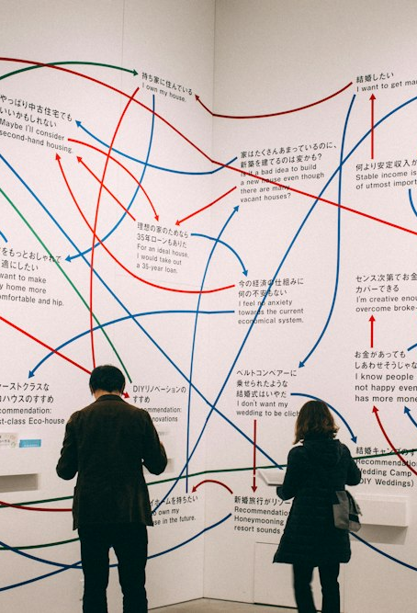
Plan Options?
Anticipated Needs?
Monthly Cashflow?
Emergency Cash?
House Renovation? – ADA Flex
Timeline?
Health
Combination of the Above
Always Modify the Plan

Slide 21

Changing Payment Plans
Can Be Changed at Anytime
Throughout the Life of the Loan
Change to Term
Change to Payout
Change to Line of Credit
Lump Sum Distribution
Watch Your Value!

Slide 22

Qualifying?
Not Income Dependent
Equity – Value of the House
Age of the Borrowers
Interest Rates
Outstanding Liens
Clear Title
Social Security Number

Slide 23

How Much Can You Borrow?
Depends on Age of the Youngest Borrower, Home Value & Interest Rate
Older you are, the more cash you can receive.
Greater the Value, the more cash you can receive.
The Lower the Rate, the more cash you can receive.
Personally Customized to the Borrower’s Needs

Slide 24

Reverse Mortgage Costs
Origination Fees
Closing & 3rd Party Fees
Servicing Fees
Mortgage Insurance Premium
Can be financed
Total Annual Loan Cost Disclosure (TALC)

Slide 25

Upfront Costs
Appraisal
Inspections (Purchase)
Credit Report
Title Commitment
Survey
May All be Financed

Slide 26

Credit Issues
Why Do We Need to Pull Your Credit Report?
Not Score Driven
Delinquent Federal Debts
Outstanding Tax Liens
Can Have a Tax Repayment Plan
CAIVRS Claim (3 Year Wait) – No Defaulted Fed Debt Resolution for 3 Yrs

Slide 27

Counseling
HECM Counseling Roster
Informed Decisions concerning their mortgage options
Whether or Not to pursue a HECM Loan
Use of a POA or Conservator
Involve Family Members

Slide 28

Reverse Mortgage Process
Needs Analysis
Initial Financial Snapshot
Income & Review
Loan Application
Counseling
Appraisal
Loan Approval
Closing

Slide 29

Types of Housing
Follows HUD Requirements
Single Family
Townhouses
FHA Approved Condos
Manufactured Homes (Real Property)
Primary Residence
Meet Minimum Safety & Health Requirements
Leaseholds with a minimum of 50 Years

Slide 30

Property Repairs
Follow HUD Required Guidelines
Based upon Appraisal
Hold Back 150% of the costs + Inspection Fee
Can be disbursed from the Line of Credit
Maximum 15% of the Claim
Greater than 15% must be repaired prior to closing

Slide 31

Condo & HOA Covenants
Ban Protective Covenants based on familial Status
Exemption for Retirement Communities
55+ Communities

Slide 32

Payments
Fixed or Adjustable
Depends on Payment Plan
ARMS – Adjust Annually with 2% Annual Cap & 5% Lifetime Cap
May Also Offer a Monthly Adjustment
Interest Accrued Daily
Can arrange disbursement of Property Taxes & Insurance

Slide 33

Title Requirements
Commitment = Maximum Claim Amount
Can be Held in a Living Trust
Can be transferred into a Living Trust without causing the loan to become Due In Full
POA is allowed – Confirm Legal Competence
Court Appointed Conservator or Guardian can also sign
Picture Identification – Driver’s License, Passport or ID Card

Slide 34
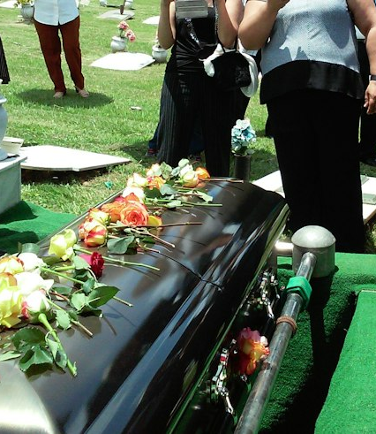
When Its Time
Surviving Borrower unable to Occupy for more than 12 Consecutive Months
The Home is no longer a Primary Residence
Last Surviving Borrower passes away
Fail to Perform a Mortgage Obligation
We have Three Options:
Estate Sells the Home, Satisfy the debt.
Refinance the Home, Satisfy the debt.
Short Sale or Foreclosure
No Further Action Needed

Slide 35

Non-Borrowing Spouses
Why would they by Non-Borrowing?
Good & Marketable Title
Legal Right to Remain in the Home
Borrower in Health Care Facility when exceeding 12 months
Due & Payable Status Deferment
Ceases upon no longer Principal Residence or fails to meet requirements.

Slide 36

Pros
Answer to Increased Health, Housing & Subsistence Cost
No Repayment – Live in the House
Multiple Plans
Non-Taxable Distribution
No impact Social Security or Medicare
Continued Homeownership
Keep Cash on Hand

Slide 37

Cons
Deletes Equity
12 Month Rule
Property Maintenance
Taxes & Insurance Payments*
Higher Fees & Costs
Higher Interest Rates
Time Frame

Slide 38

Financial Oversight
Significant Change to the Lending Structure since Initiation
Costs are contained in HOEPA (High-Cost Mortgages Rules)
Guidelines & Rules Enforcement
Government & Private Sector Loans
What if it’s the only Choice?

Slide 39

Scams, Fraud & Elder Abuse
Interview the Provider
Local Lender & References
Involve Family Members
Make sure it makes Cents
You are the First Line of Defense

Slide 40

Alternative Solutions
Cash Out Refinance
Debt Consolidation
Loan Restructure – Longer Term
Downsize – Sale of Home
House Hacking or Rental
Purchase of Rentals – To Supplement Income
Financial Planner Redistribution
May not be the answer, Must qualify & Meet Credit/DTI guidelines

Slide 41

Case Studies
The Boppers – Self Employment
Uncle Fred - Bachelor
Grandma & Grandpa – Age In Place
Bob & Mary – Credit Repair
Stanley & Sue – House in Dis-Repair

Slide 42

Your Recommendation
What If:
Elderly Parents
Financial Investments
Disabled Children
Housing Concerns
2nd Home Purchase
Moral Dilemma

Slide 43
Circle Back to the Ethical Dilemma?
Reverse Mortgages are Bad
Reverse Mortgages are Good
Take Advantage of the Elderly
Robs the Children’s Inheritance
Have High Fees & Interest Rates
Not the Best Financing Option
Limitations on Loan Amts & Choices
Penalty for Younger Spouses
Home Maintenance & Escrows
Seniors can remain in their home indefinitely
Infinite Loan Term not defined by their Equity
No Tax Liability on Disbursements
Keep Retirement Secure
Multiple Loan Options
Cash for Maintenance & Escrows
Non-Course Loan & Affordable

Slide 44

Your Strategy
Offer the A Class to:
Senior Centers
Community Organizations
Church Groups
55+ Communities
FaceBook Live Events
Open the Dialogue

Slide 45

Team Up With:
Financial Planners
Tax Advisers
Estate Planners
Medicare Advisors
Family

Slide 46

Property Tax Waiver
Age & Income Based
Contact County Treasurer’s Office
Also 100% Disabled Veteran’s Tax Waiver

Slide 47

Lion or Gazelle?
Who will you be?
What you do today determines your Future!
Be Bold, Take these Strategies and make them your own!
You are either a Lion or a Gazelle, its your choice!

Slide 48

Questions or More Ideas
tmurphy@annie-mac.com
Cell Phone # 301-752-8152
Demonstrate what you know!
Get the Word Out that you are a Pro!
Knowledge is Power!
Ultimately Knowledge is Power!

