Slide 1
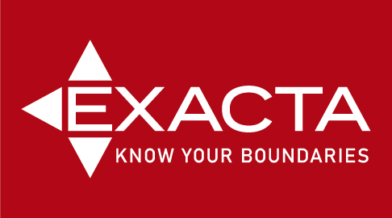

Slide 2
2004 Exacta Land Surveyors started in Miami, FL
2006 Implemented Survey Stars which is survey tracking and retrieval system. Customer database but also tracks jobs and accounting records
2009 moved customer service support, drafting and accounting service center to Cleveland, OH
2010 Exacta MD, OH, IL & TX were created
Bought out by investment company Summit Park in 2019

Slide 3
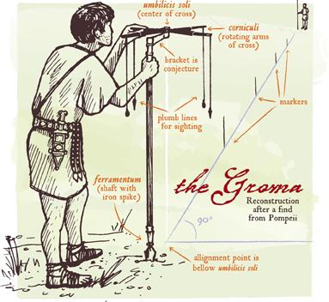
History of Surveying
Egypt
3000 BC: First documented land ownership records are that of the Egyptian Land Register. They show records and declarations of land ownership with boundary details. Surveyors were known as rope stretchers because the measuring device they used was a knotted rope.
Great Pyramid of Giza. Built around 2700 BC, the pyramid exhibits nearly perfect squareness and a north-south orientation
Babylon (Early Iraq)
1600 to 1200 BC in ancient Babylon, Kudurrus were stone tablets that served as boundary stones upon which details of the property, the surveyor, the owner and property history were all inscribed.
Greece & Rome
Land surveyors were held in high esteem in both Greece and Rome. They were crucial in the creation of the straight angles and perfect lines that shaped those amazing buildings and coliseums that still stand today.

Slide 4
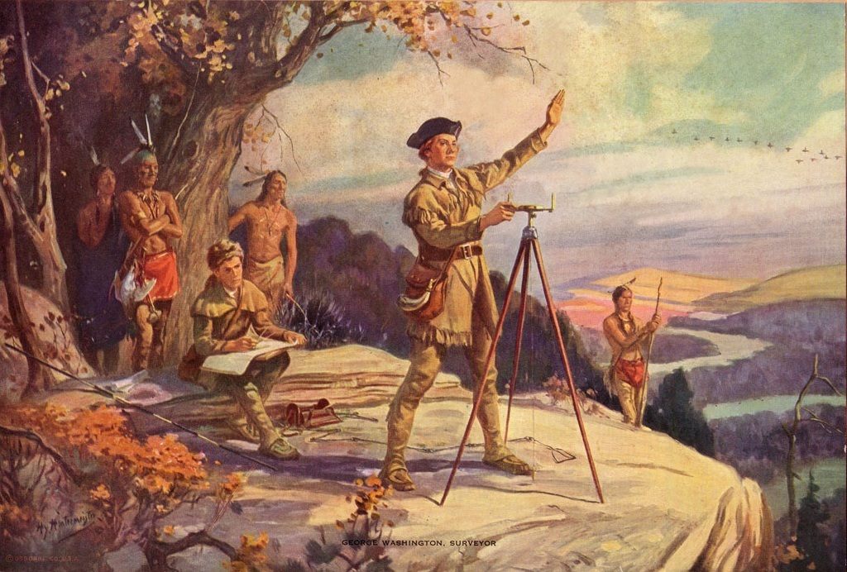
Most famous surveyors:
George Washington-started at age 17 and later appointed Surveyor General of VA. Essential role with expansion to the West
Thomas Jefferson
Abraham Lincoln
Lewis & Clark

Slide 5
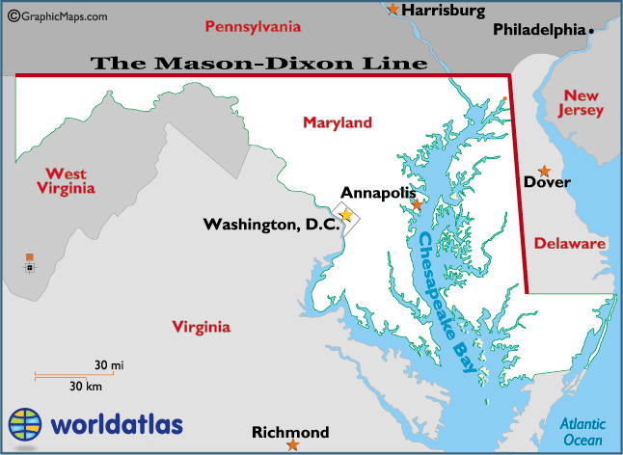
MASON DIXON A SURVEY LINE FROM 1767
Charles Mason, assistant astronomer and Jeremiah Dixon, astronomer, mathematician and surveyor were hired to survey the agreed-upon line, 233 miles, marked by stones every mile and every 5 miles. Cost $75,000

Slide 6
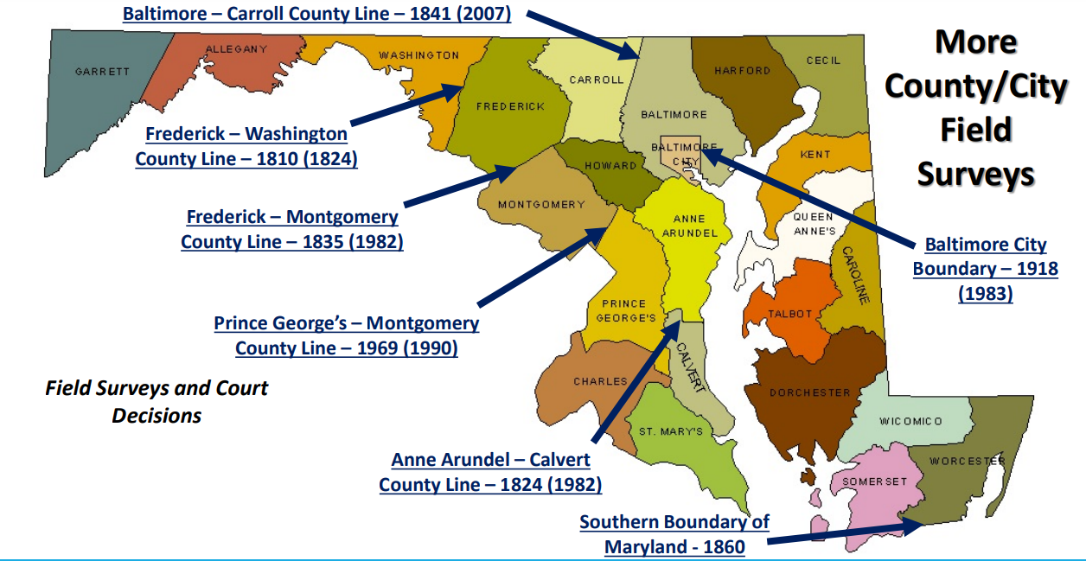

Slide 7
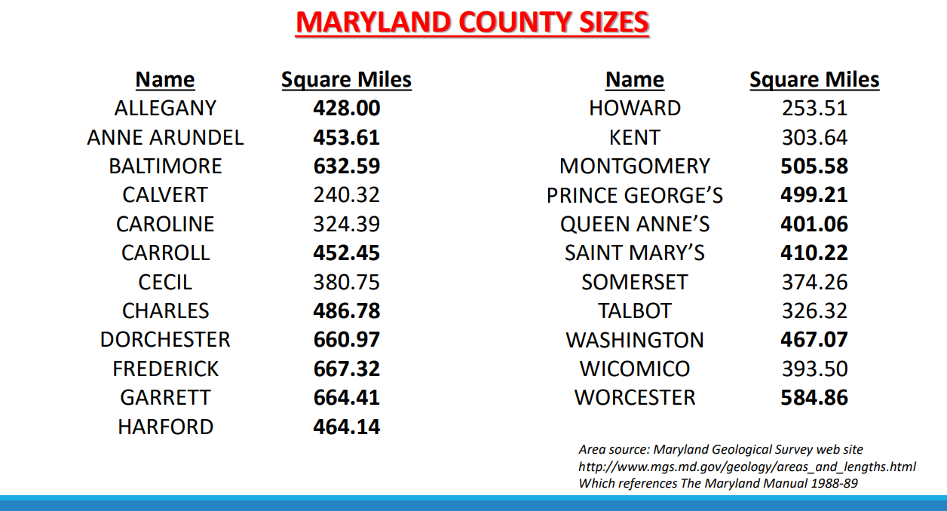

Slide 8
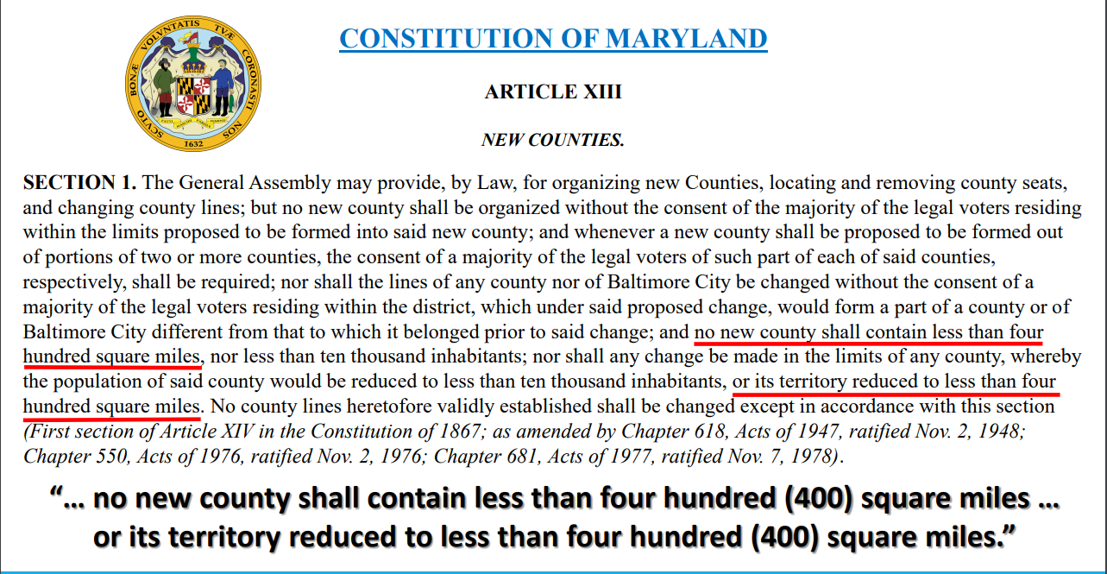

Slide 9
LICENSED SURVEYOR
The process of becoming a land surveyor:
Earn a bachelor's degree in land surveying or a closely related field
Take and pass the Fundamentals of Surveying exam
Obtain hands-on experience working for a licensed surveyor (usually 4 years)
Take and pass the Principles and Practice of Surveying exams
Key Skills
Excellent oral and written communication, attention to detail, physical endurance, problem-solving, technological competence, time management, visual creativity

Slide 10
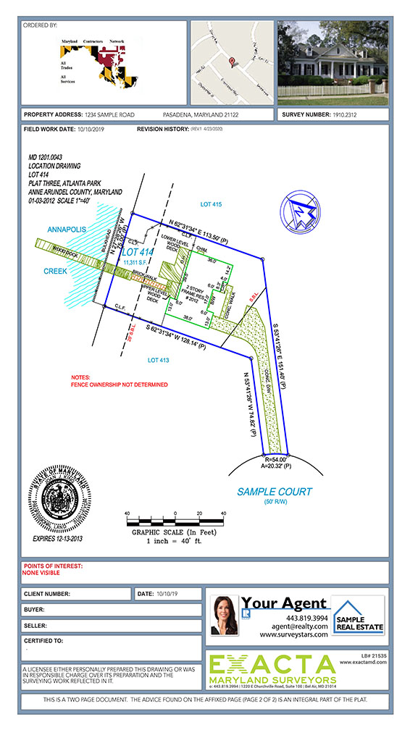
Types of Surveys:
House Location Drawings: plat usually within +/- 1 ft of property lines
Boundary Surveys: Marking exact property lines with stakes or flags
ALTA: for commercial properties with more details like parking spaces, lamp post, underground utility

Slide 11
Items not always on location drawings
Easements of any kind. If not stated on the deed or plat, we will not place on drawings
Plastic sheds Not considered real property and can be easily removed, will not be drawn.
Septic & Well: If the well or septic company flags the placement, we can put on the house location drawing. We need to know ahead of time or an extra cost to go back to the property.

Slide 12
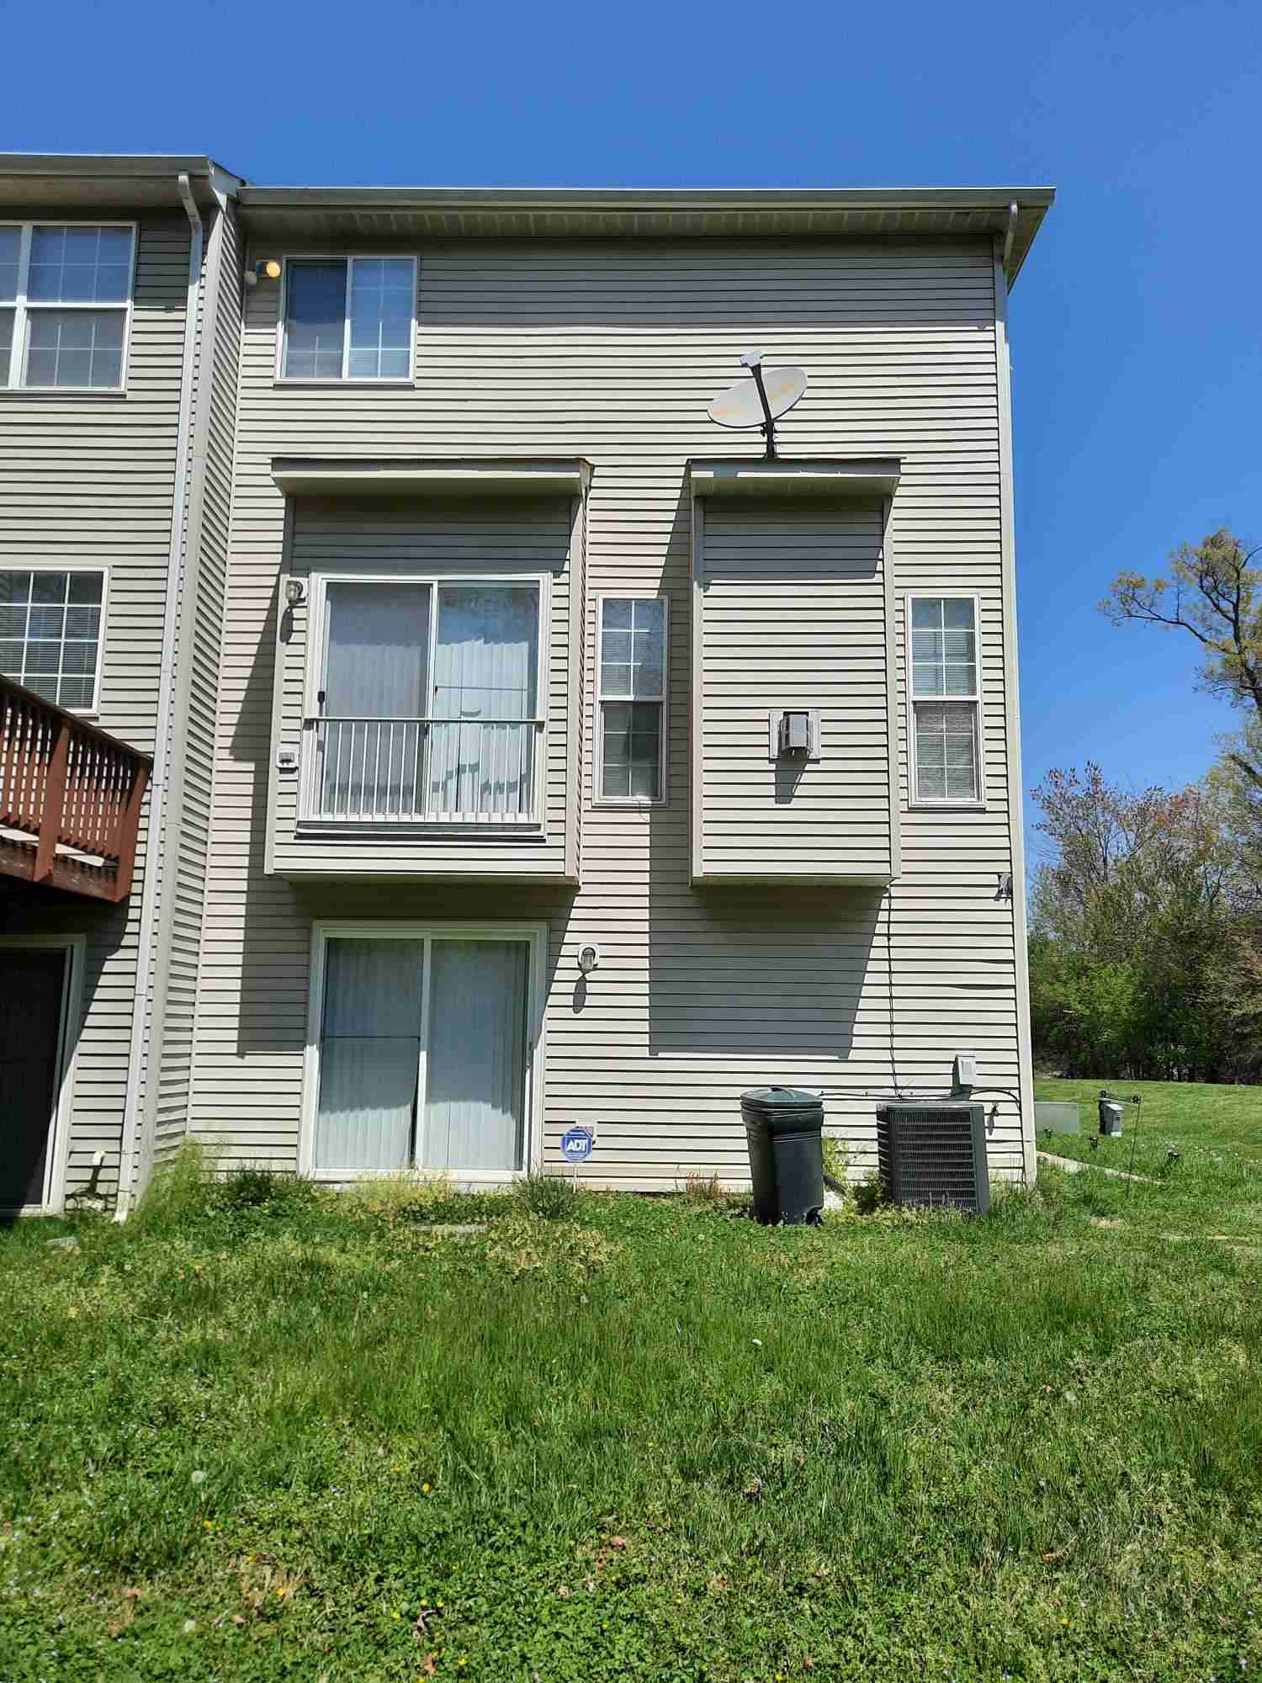
If the structure doesn’t reach ground level, we won’t draw it.

Slide 13
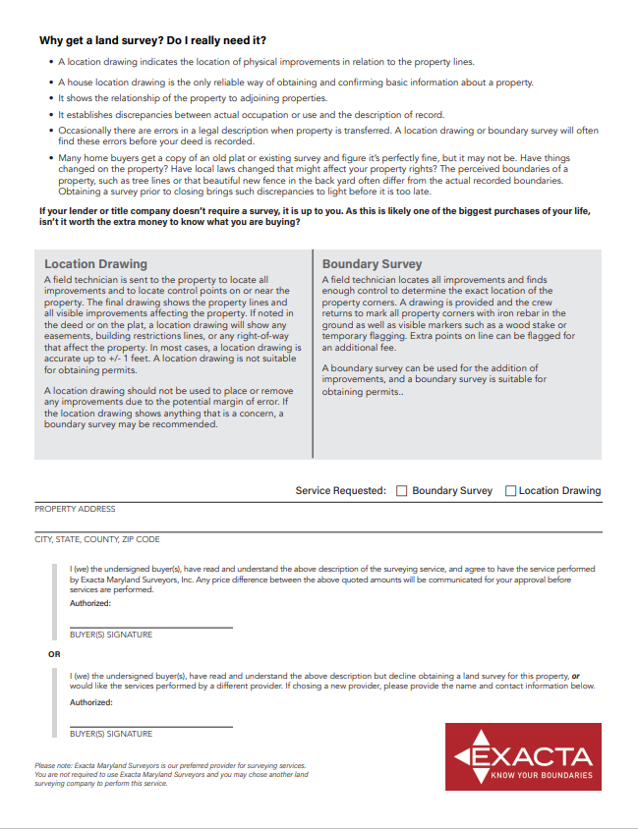
Educating buyers

Slide 14
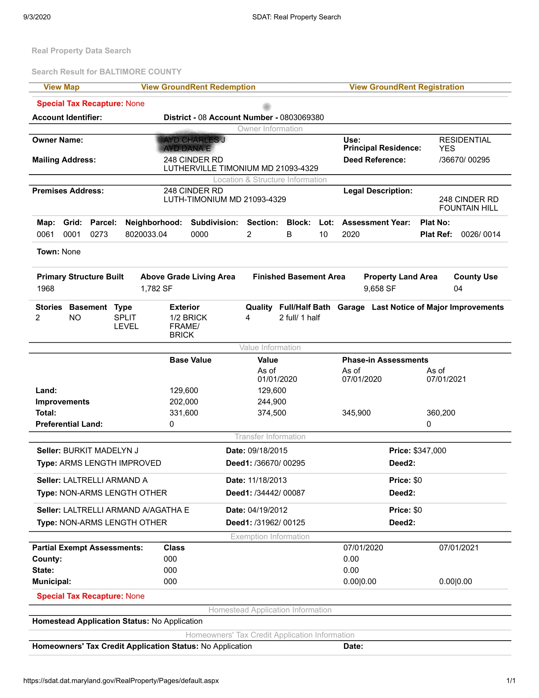

Slide 15
Legal Description From Deed
BEING known and designated as Lot No.10, in Block “B”, as shown on the amended Plat of Section Two, “Fountain Hill”, which Plat is recorded among the Land Records of Baltimore County in Plat Book W.J.R. No. 26, folio 14
For Informational Purposes Only: The improvements thereon as known as No. 248 Cinder Road

Slide 16
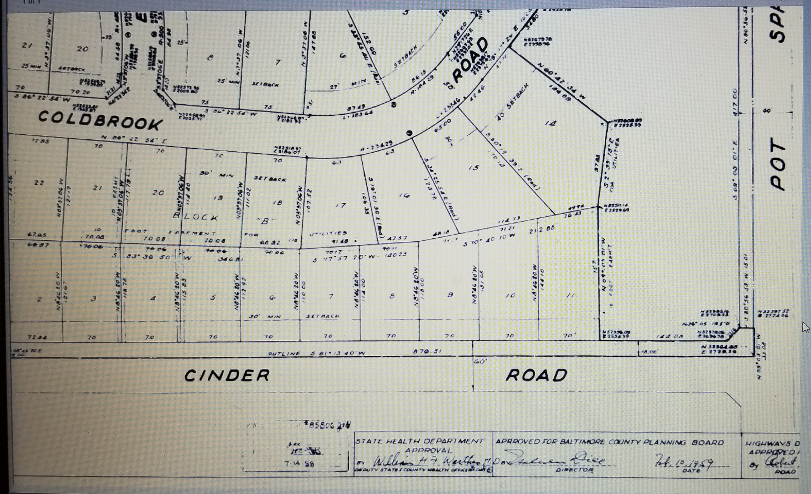

Slide 17
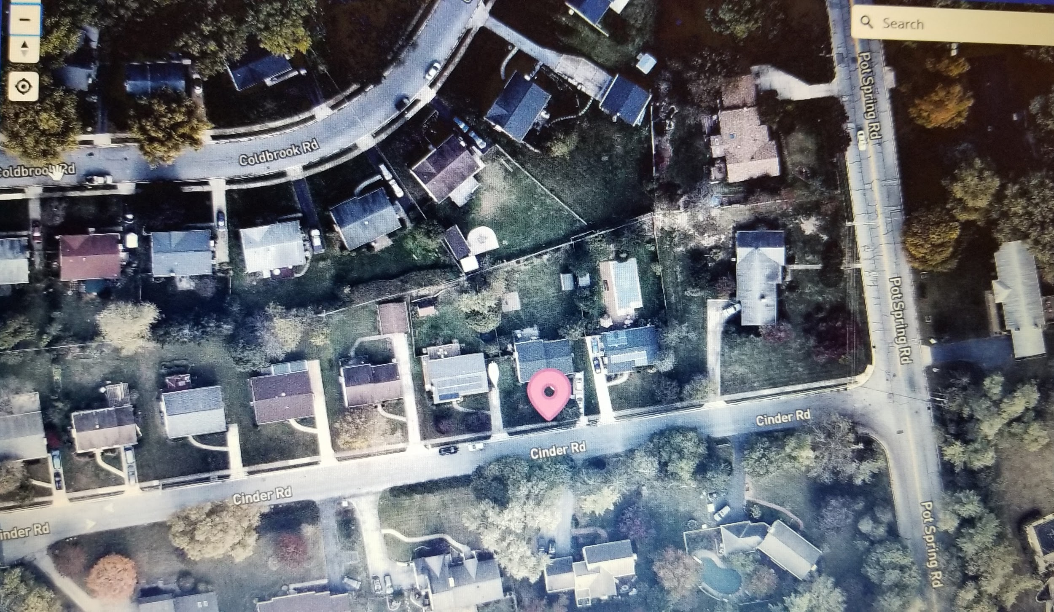

Slide 18
Examples of Legal Descriptions
Metes and Bounds
Rectangular government survey
(or fractional survey)
Lot and Block Number on Plat Map

Slide 19
Metes and Bounds Legal Description
This system was imported to the original colonies that formed the United States. It is also used in some states that were previously part of one of the Thirteen Colonies, or where land was allocated before 1785 using landmarks or compass bearings

Slide 20
Old Surveying Measurements

Slide 21
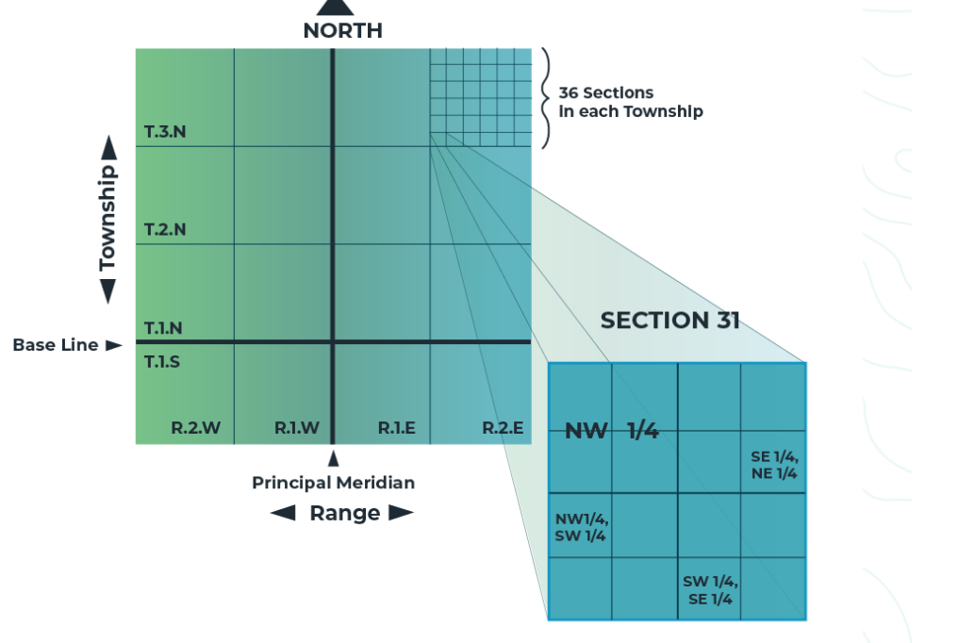
Example of Rectangular Gov’t Survey
SW 1/2, NW ¼,S9, T4N
R5W
OR
The southwest half of
The northwest quarter
Of section nine
Township four North
Range five West

Slide 22
RECTANGULAR GOVERNMENT SURVEY
Also called Public Land Survey system created in 1785 to plat or divide real property into squares or rectangles
System was primarily used in US with exception to thirteen colonies which surveyed by metes and bounds
This system was a costly investment, but more reliable legal descriptions

Slide 23
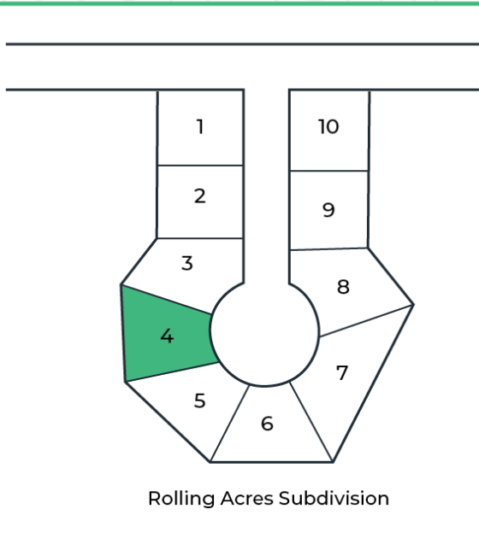
LOT AND BLOCK
Newest method used in US and Canada. Introduced in 19th century to identify parcels of planned urban and suburban developments

Slide 24
Conditions that Affect Turn Times
Property Condition​
Property Type (platted, townhomes)​
Legibility / availability of plats​
Ability to locate rods​
Inclement Weather​

Slide 25
Notes:
Surveyor will text 1 hour before arrival.

Slide 26
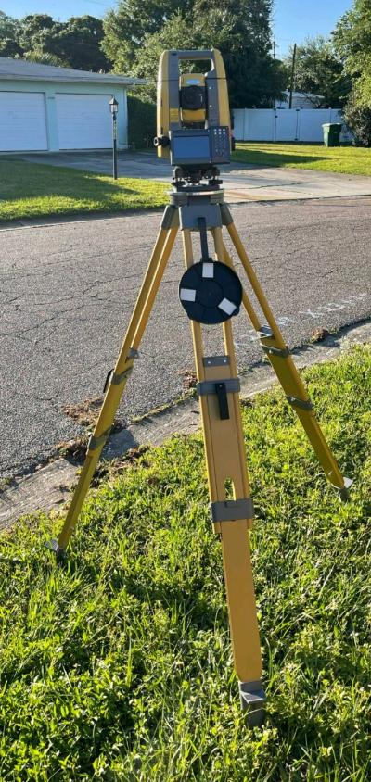
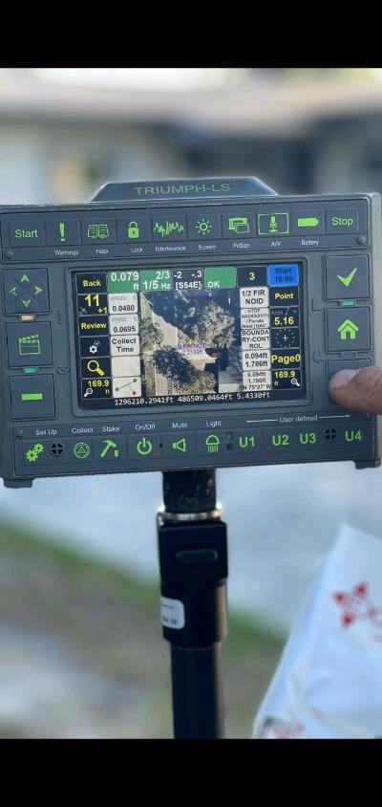
Robotic Stations
Optoelectronic device measures angles, distances and coordinates to provide the surveyor precise description of the land and its features
Reduces human error and can measure different angles without turning the instrument
Allows one-person crew to work as efficiently as a 2-person crew

Slide 27
Monuments
Land surveying monuments used corners of the property are marked with a 12” rebar driven vertically into the ground.
***If we are putting rebar in, we cap it with our MD License

Slide 28
Notes:
CAD drafter (Computer Aided Design) takes all of the data and field measurements, plays a complicated version of connect the dots, gives each line meaning by assigning it a color and thickness, and adds symbols and notes to help tell the whole story in an easy way to read.

Slide 30
Notes:
Then, the cad drafter takes that information, all of the data and the map to a PLS professional land surveyor to review the entire process. Here, the PLS will determine if the team followed his instructions all of the way through the process. PLS will determine if there is indeed enough measurements and information to confirm the boundary location as it was presented.

Slide 31
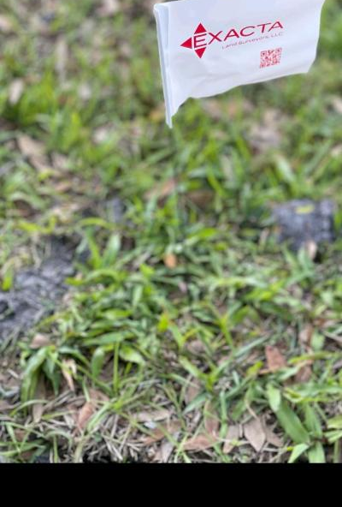
Boundary Surveys
4 flags are marking corners of the property
Time to be completed depends on complexity
Boundary surveys are precise

Slide 32
Conflicting Information
Legal documents don’t match findings
Monumentation doesn’t match description
(was it moved or put in the wrong place?)
Surveyor will use “Dignity of Calls”based on:
Existing surveys
Adjoiner Deeds
Monumentation

Slide 36
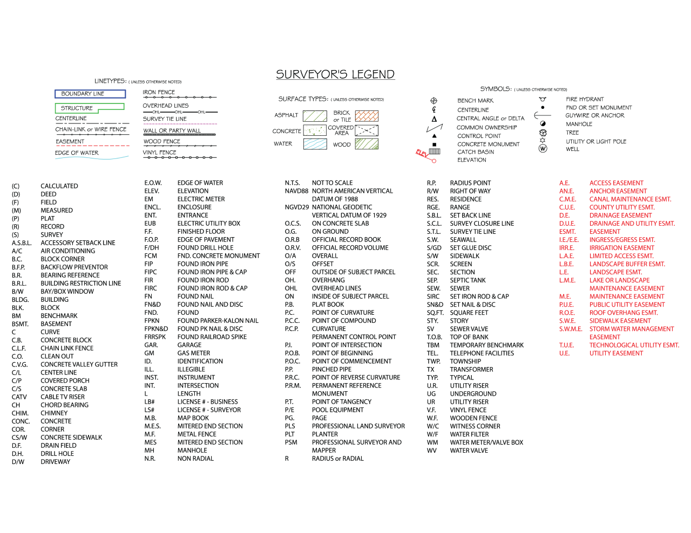

Slide 38
State Requirements for Surveys
Maryland: Survey is optional
Florida & Texas: Survey is required unless it is a cash deal
OH: Survey is required unless it is a cash deal. Although some title companies have seller sign an affidavit that states no improvements have been made since the last deed transfer.
IL: Not required by the state, but a lot of Chicago municipalities need survey for the transfer stamp. There are some real estate contracts that do require their buyers to get a survey for settlement.

Slide 39
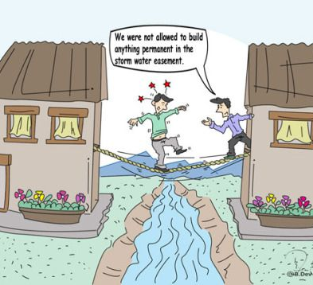
EASEMENTS
The right others have to use real property belonging to you. Common real property easements include rights to access your backyard or others' rights to cross over your land to access their property.
Right-of-ways is another term for easements
Common Easements:
Utility Drainage Driveway Sidewalk

Slide 40
Setbacks and Easements

Slide 42
House Location Drawing for Building Permits?
Some permits require more than a location drawing

Slide 43
ENCROACHMENTS
In property law, an encroachment is an intrusion on the land or property owned by another. Real estate encroachments commonly occur when one property owner violates the property rights of an adjacent property owner by building on that neighbor's land.

Slide 44
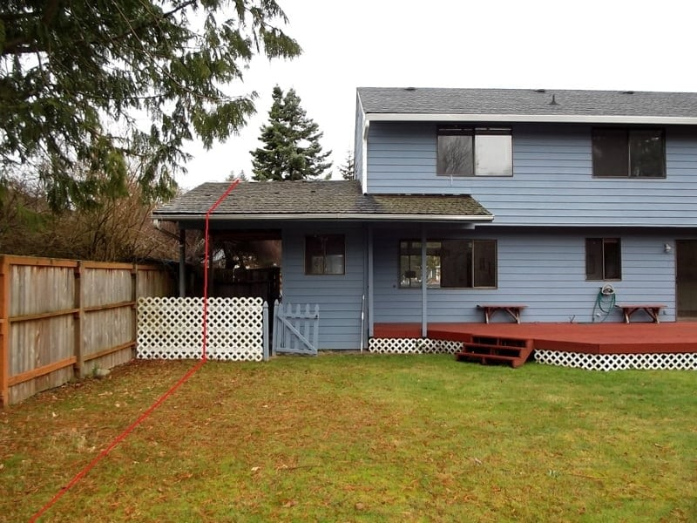
3 Most Common Encroachments
Driveways
Sheds
Fences
Other Encroachments:
Trees, pools, gardens

Slide 45
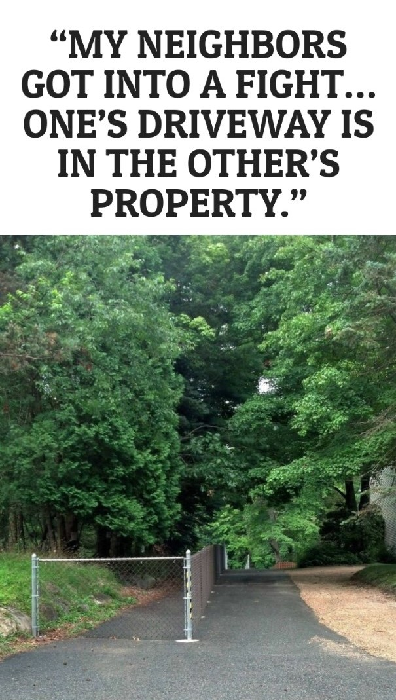
No survey before putting driveway in

Slide 46
Ferris Wheel Encroachment: Ocean City orders it off Boardwalk (6/7/21)
Trimper’s Ride must move Ferris wheel for violating Ocean City’s zoning code
Encroaching 10 ft over park’s property line
Deconstructing, moving and rebuilding the Big Wheel would cost more than $70,000

Slide 47
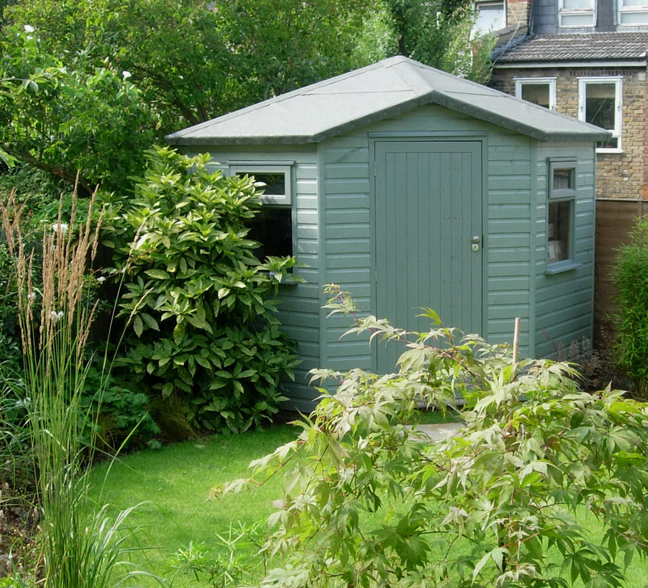
Senick v. Lucas
Inexpensive tool shed encroached onto a neighbor’s property. In that case, the court held that the purchaser was not entitled to rescind the contract based on the tool shed’s encroachment, but that he was entitled to an abatement of the purchase price in the amount of the value of that portion of the tool shed used as a tool shed..
The court looked at the value of the tool shed at issue compared with value of the entire property and the fact that the tool shed was still usable even after the seller had taken matters into his own hands and resolved the encroachment by having the offending portion sawed.

Slide 48
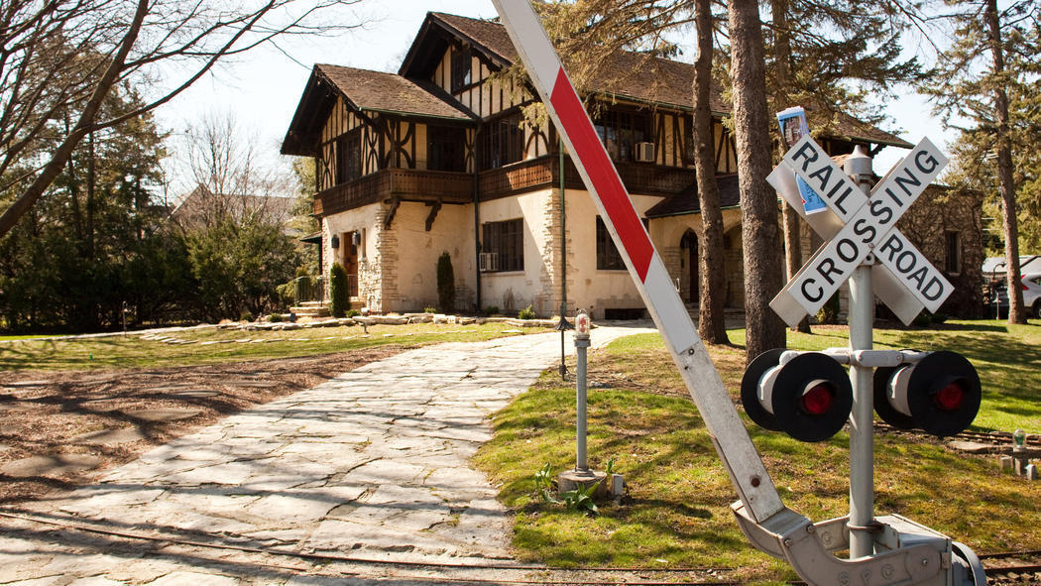
Risky Encroachments Title Co will not insure:
railroad rights of way
bike and walking paths
conservation area
lake or river
townhome common areas

Slide 49
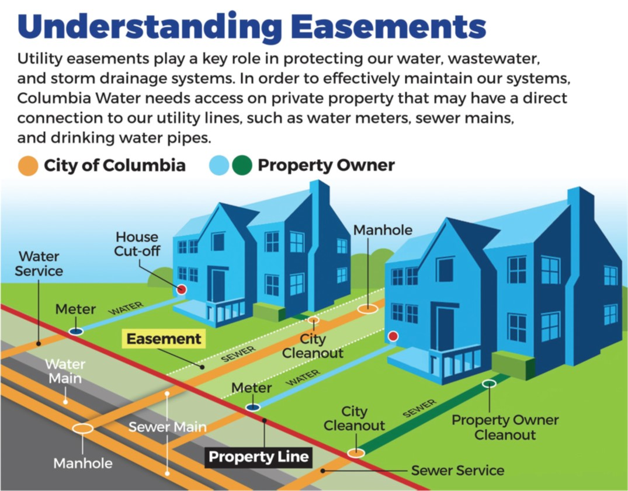
Utility Easements
One of the most common types of easements for private property, which generally allow public utility companies access to the property for the purpose of installing, repairing and maintaining utility lines.

Slide 50
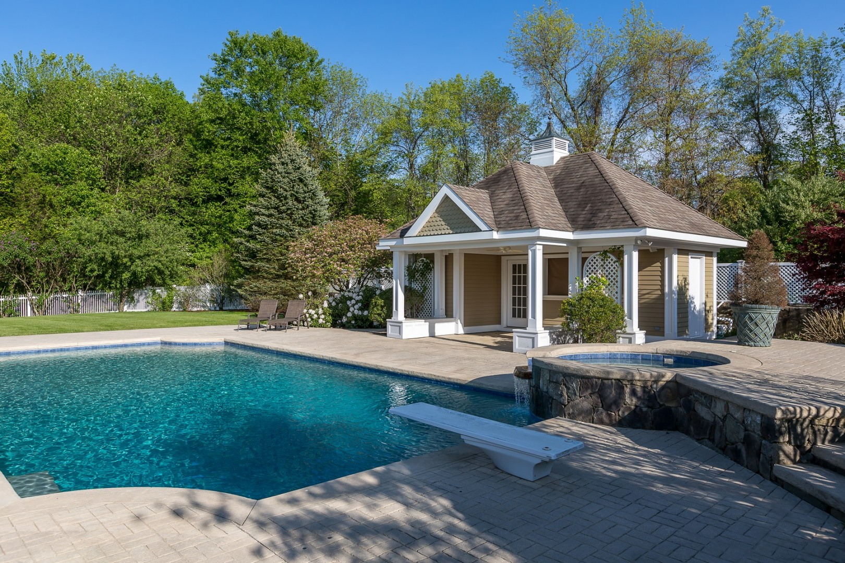
Case Study: Baltimore County
Utility Easement

Slide 51
Conservation Buffers/Easements
A conservation easement is a voluntary, legal agreement that permanently limits uses of the land in order to protect its conservation values. Also known as a conservation restriction or conservation agreement, a conservation easement is one option to protect a property for future generations.
The conservation easement must remain in a natural state and not be used or altered in any way. This includes the building of structures, placing of fences, and mowing of grass. The easement area is intended to remain undisturbed and forever wild.
The easement must be held by a qualified easement holder, i.e., a government entity or a land trust.
The goal of devising a conservation easement is the landowner's voluntary agreement to give up one or more of these rights in order to protect certain natural resources. Prohibitions could include such matters as limitations on roads, structures, drilling, or excavating. The landowner could retain certain rights as long as those rights did not interfere with the conservation goals of the easement.

Slide 52
Tax Benefits

Slide 53
Baltimore County: Preserve Green Space (Baltimore Sun: June 3, 2021)
Baltimore County has acquired more than 24 acres of land in Lutherville-Timonium for $2.2 million, leaving the green space open for recreation and sinking a developer’s plans to build residential housing there.
Acquiring the 24.5 acres also preserves green space near the Loch Raven Reservoir watershed, including 1,100 feet of the Kelly Branch and its shoreline.
Also: First Public Park Plan in Sparrows Point. The county plans to spend $7 million to build a park on an 8-acre plot of land near on Greens Lane near the Randallstown Community Center near neighborhoods that currently lack recreation space.

Slide 54
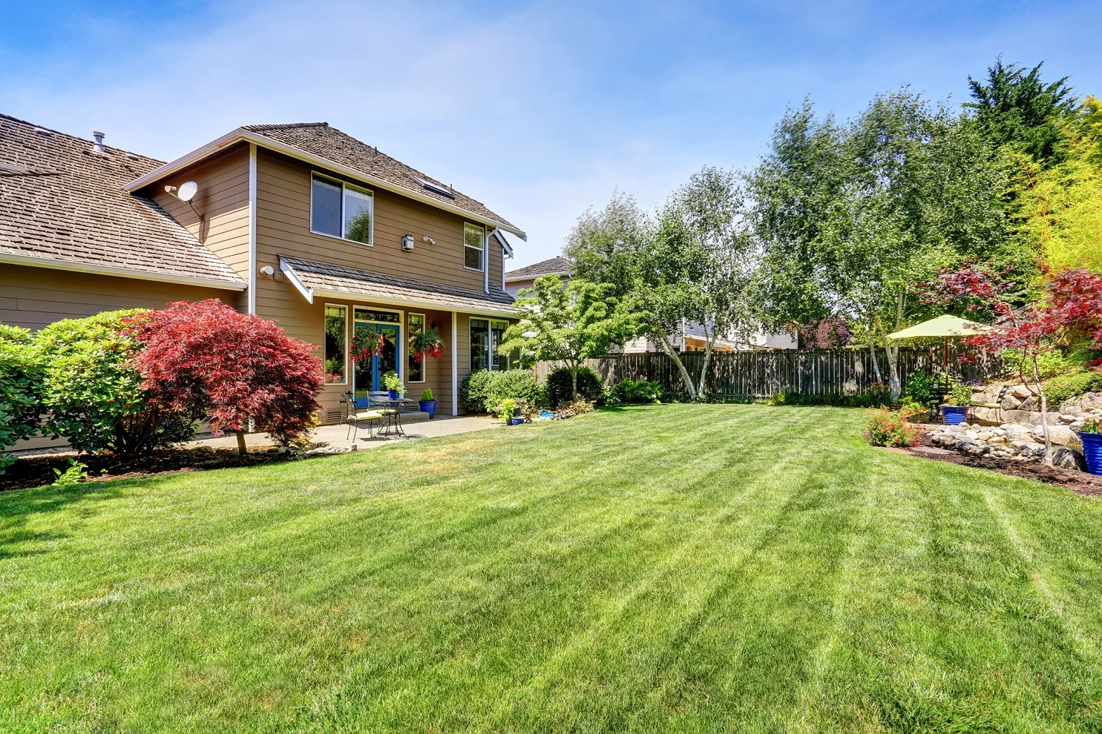
Case Study: Potomac

Slide 55
Harford County Department of Planning & Zoning
FENCES IN EASEMENTS While the Harford County Zoning Code allows property owners to erect fences, at their own risk, in recorded easements, there are caveats attached to permitting this use.
1. Excavation may not cause damage to existing pipes located in the easement.
2. The fence must not cause a drainage or sediment control problem.
3. Harford County may enter the property and make use of the easement area for grading and/or the installation or repair of utilities.
4. Harford County may either remove the fence as part of the work being done or require that you remove the fence prior to the work.
5. Harford County may enter the property and remove the fence if the fence violates one of the above provisions.
THE COST OF REPAIR RESULTING FROM ANY DAMAGE TO PIPES LOCATED IN THE EASEMENT OR THE COST FOR REMOVAL OF THE FENCE BY HARFORD COUNTY WILL BE THE RESPONSIBILITY OF THE PROPERTY OWNER.

Slide 56
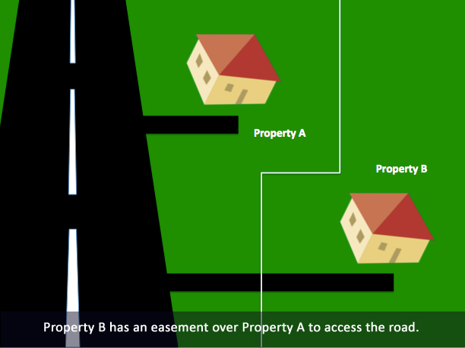
Prescriptive Easement:
An easement by prescription is created after a party uses someone else's land continuously (as if they had an easement) for a certain amount of time. The party would have to use the land without the owner's permission, openly. The amount of time needed to pass for an easement by prescription depends on state law. Prescriptive easements often arise on rural land when landowners fail to realize part of their land is being used, perhaps by a neighbor.

Slide 57
ADVERSE POSSESSION VS PRESCRIPTIVE EASEMENT
Prescription
Obtains easement
Does not require openness, notoriety or claim of right
20 years required
User does not depend on the rights of others
Adverse Possession
Obtains fee title
Period of time maybe shorter or longer than 20 years depending on state
HOWEVER: persons with legal disabilities or persons after a tax sale may have different requirements
User is the ONLY use of that area

Slide 58
MARYLAND LAW ON ADVERSE POSSESSION
hostile (against the right of the true owner and without permission; it doesn't require actual arguments or bad relations between the parties, however)
actual (exercising control over the property)
exclusive (in the possession of the trespasser alone)
open and notorious (using the property as the real owner would, without hiding the occupancy), and
continuous for the whole of the statutory period, which is 20 years
For example, Billy and Jamie live next to one another in Bethesda. There is no dividing fence or boundary between their yards. Billy builds a shed that is actually on Jamie's side of the property, covering about 13 square feet of earth. Jamie doesn't say anything. Billy uses the shed as if it were on his own land. He does this for 21 years. Under Maryland Law, Billy can probably establish that he “owns” the land on which he was encroaching. Jamie could have stopped Billy by demanding over those 21 years that he remove his shed, or sign a rental agreement indicating that the arrangement was by mutual consent. But Maryland courts will not allow Jamie to kick out Billy after sitting on those rights for over two decades.
Credit: Brian Farka , Esq.

Slide 59
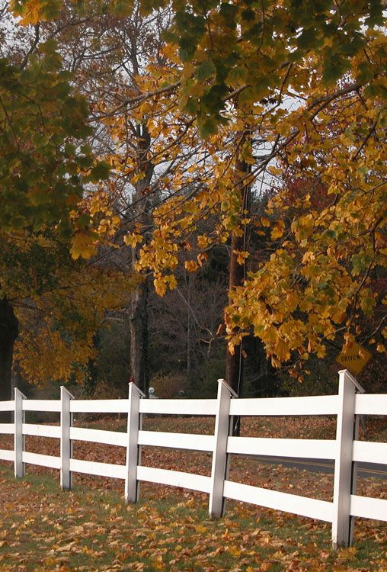
Case Study: Webb v. Nowak
The case arose because the Nowak’s cut down and sold timber on a parcel of land that the Webb’s believed they owned – this led to accusations of trespass and claims of adverse possession.
The original 1928 deed set the mutual property line at an “existing fence” and then ran from the fence “340 feet more or less” to a road. The Nowak’s surveyor concluded that there were remnants of a fence and other evidence of its location when he surveyed almost 80 years later in 2007
His testimony included pictures of a fence post, the borings of a tree that had grown around a fence post and a description of a swale that he concluded indicated the edge of a formerly tilled field. He therefore concluded that the 340 foot measurement was a mistake, and the distance should only be about 200 feet.
Webb v. Nowak, 83 SEPTTERM 2012, 2013 WL 4417573 (Md. Aug. 20, 2013). The Court went on to conclude that the 340 foot measurement was a mistake

Slide 60
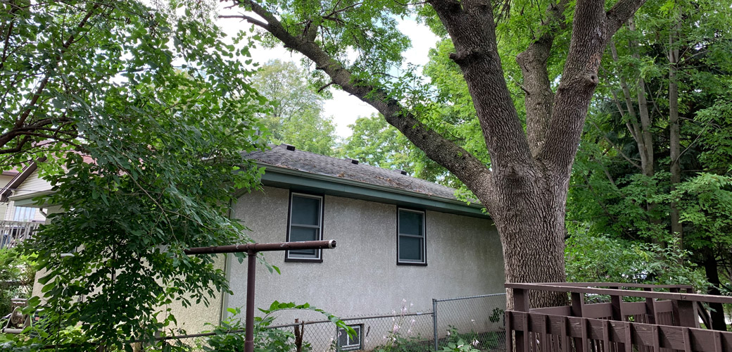
Maryland Law: Trees on Property Lines
Overhanging branches, invasive root systems, and falling debris can all cause tensions between neighbors. Under Maryland law, you are responsible for the proper care and maintenance of your trees and, if they become a nuisance, you may be liable for damages. Here are some other basic tree laws observed in Maryland:
maintain your trees in such manner that they do not damage the property of another;
if branches or roots belonging to a neighbor's tree extend over your property, you have a right to trim them back to the property line;
you may be liable damages if you injure or kill a neighbor's tree;
ownership of a tree is determined by the location of the trunk; and
trees located on a boundary line are considered joint property, and no single neighbor can decide to remove the trees.

Slide 61
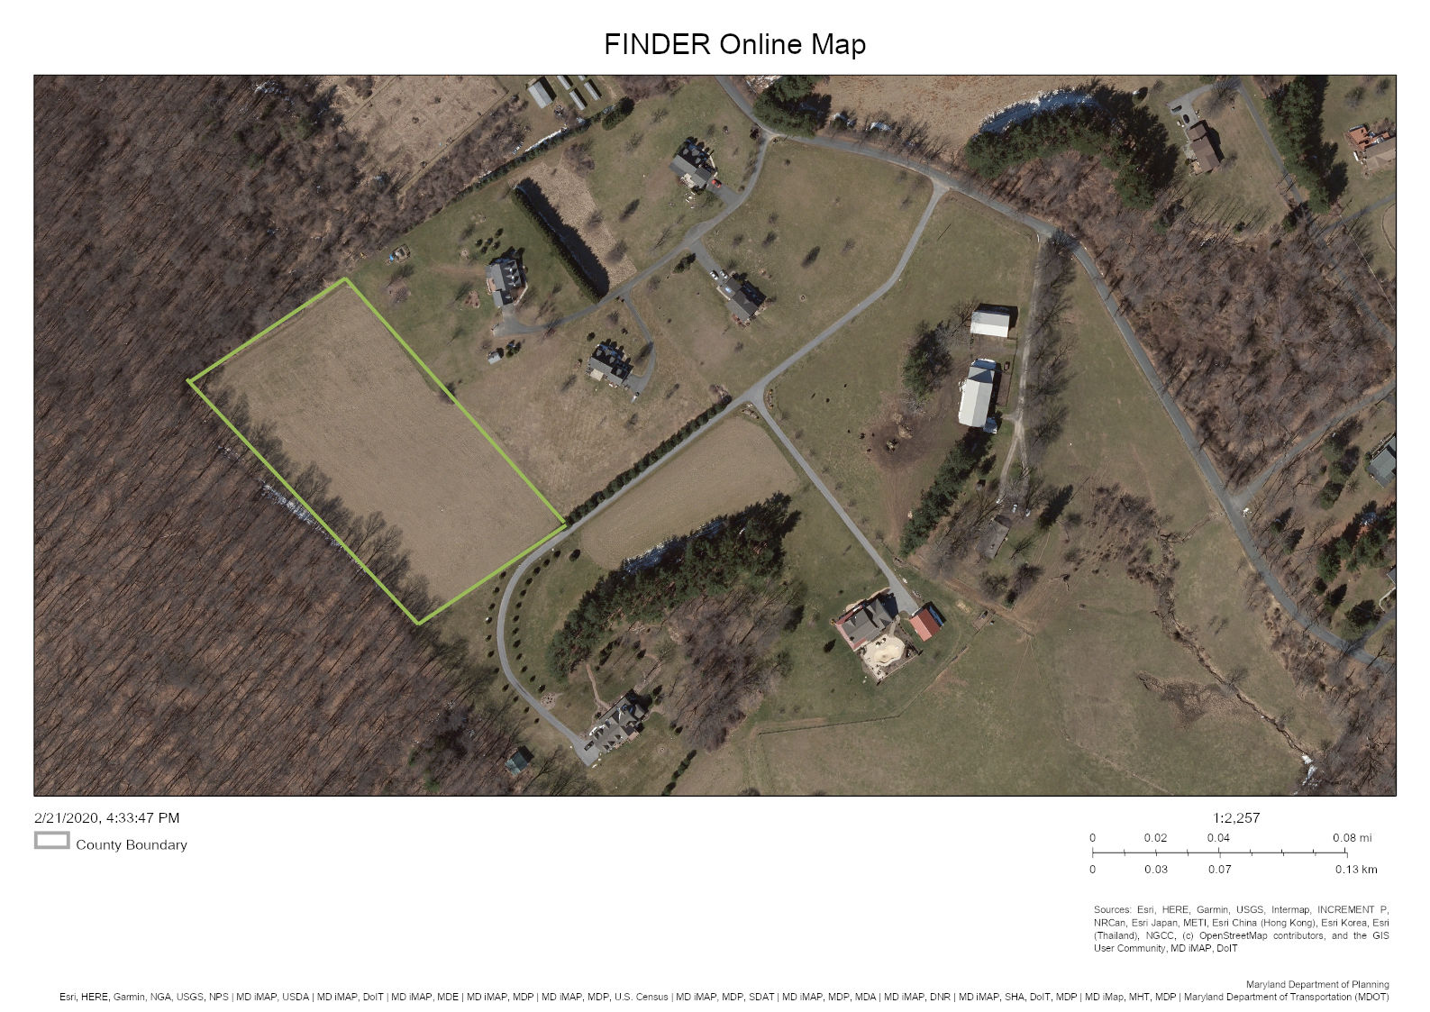
Case Study: Harford County

Slide 63
Requirements for Survey to be accepted by Title Co.
Confirm surveyor surveyed actual property being insured
Include correct legal description and common property address
If legal description does NOT match legal of title commitment,
it needs to be determined if the 2 different legal describes the same parcel
(If they do, then title co. could issue an equivalency endorsement)
Survey should be certified to the name the parties who have right to rely on the said survey
Title company checks the date that the survey has been completed within 6 months of the closing

Slide 64
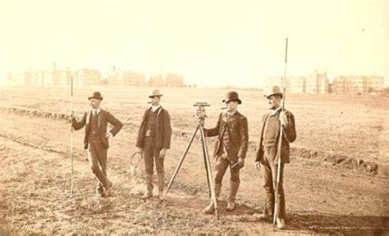
OLD SURVEY VS NEW SURVEY?
If an older survey is used, the current parties are not named and certified to the older survey.
Some title companies accept older surveys, along with an Affidavit of No Change (which simply states no physical improvements were added to the land since the date of the old survey
***************************************************************************************
Title companies are reluctant to use old surveys:
there is a question of liability to 3rd parties and subsequent purchasers
Affidavit also does not attest if adjoining landowners have made any changes to their property such as encroachments, additions and fences
A current survey with all the requirements mentioned above is the best course of action to avoid potential future problems.

Slide 65
Exceptions to the Title Policy Without a Survey
Without a current survey done, there will be an exclusion in the policy such that the policy will not cover situations that would have been revealed by a current survey.
Encroachments over the property line,
Adverse possession by adjacent owners
Errors in acreage calculations in older surveys,
Undocumented driveways over the property
If the buyer purchases an enhanced owner’s policy, the blanket survey exception is removed from the owner’s policy even if the buyer only gets a house location survey.

Slide 66
Considerations for waterfront properties
Does the property actually physically abut (i.e. touch) the waterway in question? Although it may appear to do so, this requires a survey that accurately depicts the proper margin of the waterway (many waterfront surveys do not), and a legal analysis to confirm that there are no gaps, margins, or hiatuses between the property and the margin of the waterway. Even a one inch gap precludes waterfront access.
If there is a dock or related facilities, were they properly permitted? And no, do not assume that because a dock (or any improvement exists), that it must have been properly permitted.
Can you replace the dock if it is damaged or destroyed?
Do third parties have the right to the use or enjoyment of your dock?
If there is no dock, can you place one there? Do not fall into the common trap of assuming that because your neighbor has one that you too can have one. The determination is extremely site specific.
What restrictions might you have with regard to the placement of a new dock?
Does the parcel indeed have riparian rights for use of the applicable waterway?
If your waterfront access is over another parcel, does such access actually get you to the waterfront, do you have the legal right to use it and, most importantly, does it specifically confer the right to also locate a dock?
Conversely, do third parties have the right to enjoy the riparian rights associated with your parcel?
If there is a seawall, is it properly located on the property’s waterfront boundary, and does the face of the seawall match the property’s waterfront boundary? An inspection can also determine if the seawall is structurally sound, which if poorly constructed could lead to costly repairs.
In the likely event that the waterfront parcel is located within a flood prone area, was the home constructed to satisfy FEMA requirements?
If there is no home on the property, are you familiar with FEMA requirements for the subject parcel (and the most recently revised flood map for such parcel)?
Does the parcel have unique setback/construction requirements due to the water it abuts and how do they apply? Do the improvements satisfy those requirements?
If the home is ever damaged or destroyed, is it important for you to know what requirements you might need to satisfy to replace it.
Credit: Berlin, Patten, Ebling Attorneys

Slide 67
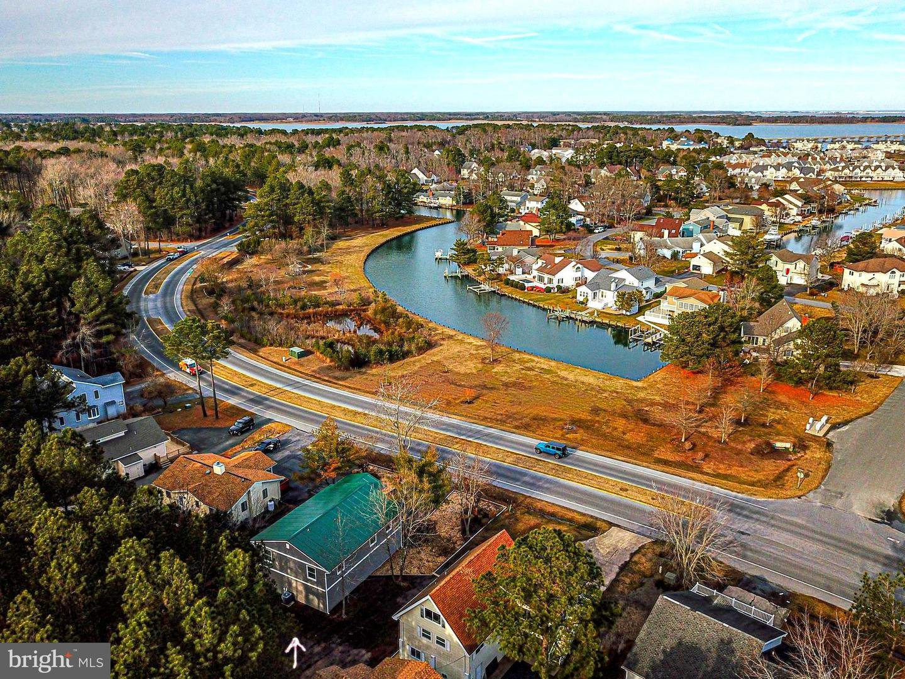
Ocean Pines: Obligation to Maintain Waterfront
The Obligation and Ability to Maintain the Waterfront
For any property that faces significant wave action or is on a bluff, there will be erosion concerns. For all waterfront properties, there are significant legal restrictions on the owners’ ability to clear growth and trees, to fill eroded areas, and to construct shoreline protection. The cost and ability to obtain permits for waterfront repairs and maintenance should be considered. For example, in many waterfront communities, there are existing bulkheads or revetments. Depending on the particular community, the cost to maintain these structures may lie with the nearest individual landowner or with the community. In Ocean Pines, Maryland, for example, all properties in the community must pay an annual HOA assessment toward the upkeep of common area facilities, but in the instance of waterfront properties, the assessment may also cover the cost of maintenance to the property’s bulkhead. “MAY” because this is true in some sections of Ocean Pines, whereas in other sections, waterfront property owners, although they still pay an annual assessment that is higher than a land locked property, have the cost and burden of bulkhead maintenance placed squarely upon the homeowner.
**** In Anne Arundel County, Maryland, there have been news reports of criminal charges being filed because a waterfront property owner hired a landscaper to clear trees and bushes along the waterfront.
Just like piers, it is wise to consult with knowledgeable professionals and zoning departments before becoming set on plans for improvements.
(Credit: Dirk Schwenk and Mike Piasecki III)

Slide 68
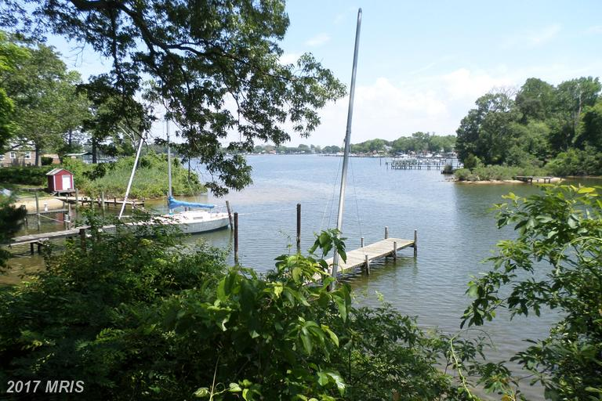
Case Study: Pasadena Maryland
First time home buyer
Water property with small backyard
Family of 5
House location drawing “optional”/ Lender deemed unnecessary

Slide 69
Elevation Certificates
For Flood Zone clients who need certificates to determine insurance rates.

Slide 70
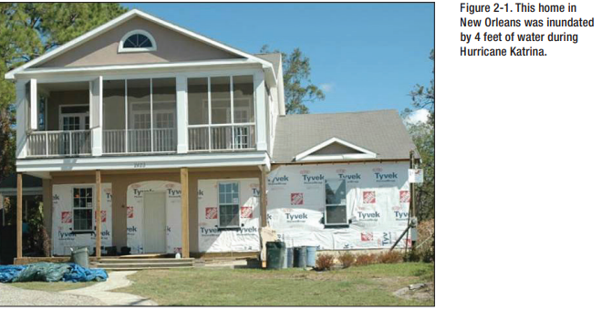
FEMA: Retrofitting Homes to Reduce Flood Insurance Costs

Slide 71
Home Inspection + Land Survey= Happy Homeowners Inside and Out!

Slide 72
Thank you MLTA!
Patty Aiken
pattyaiken@exactaland.com
orders@exactaland.com
Cell: 301-904-0153

