Slide 2
2004 Exacta Land Surveyors started in Miami, FL
2006 Implemented Survey Stars which is survey tracking and retrieval system. Customer database but also tracks jobs and accounting records
2009 moved customer service support, drafting and accounting service center to Cleveland, OH
2010 Exacta MD, VA, IL & TX were created
Bought out by investment company Summit Park in 2019

Slide 3
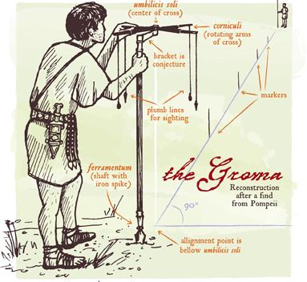
History of Surveying
Egypt
3000 BC: First documented land ownership records are that of the Egyptian Land Register. They show records and declarations of land ownership with boundary details. Surveyors were known as rope stretchers because the measuring device they used was a knotted rope.
Great Pyramid of Giza. Built around 2700 BC, the pyramid exhibits nearly perfect squareness and a north-south orientation
Babylon (Early Iraq)
1600 to 1200 BC in ancient Babylon, Kudurrus were stone tablets that served as boundary stones upon which details of the property, the surveyor, the owner and property history were all inscribed.
Greece & Rome
Land surveyors were held in high esteem in both Greece and Rome. They were crucial in the creation of the straight angles and perfect lines that shaped those amazing buildings and coliseums that still stand today.

Slide 4
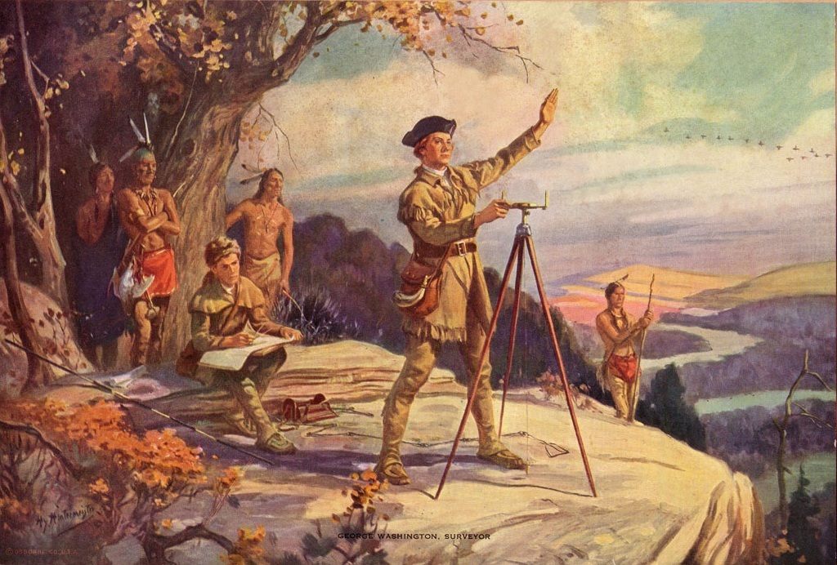
Most famous surveyors:
George Washington-started at age 17 and later appointed Surveyor General of VA. Essential role with expansion to the West
Thomas Jefferson
Abraham Lincoln
Lewis & Clark

Slide 5
MASON DIXON A SURVEY LINE FROM 1767
Charles Mason, assistant astronomer and Jeremiah Dixon, astronomer, mathematician and surveyor were hired to survey the agreed-upon line, 233 miles, marked by stones every mile and every 5 miles. Cost $75,000

Slide 6
LICENSED SURVEYOR
The process of becoming a land surveyor can be broken down into four steps:
Earn a bachelor's degree in land surveying or a closely related field (or whatever education your state requires)
Take and pass the Fundamentals of Surveying exam
Obtain hands-on experience working for a licensed surveyor (usually 4 years)
Take and pass the Principles and Practice of Surveying exams
Key Skills
Excellent oral and written communication, attention to detail, physical endurance, problem-solving, technological competence, time management, visual creativity

Slide 7
Types of Surveys:
House Location Drawings: plat usually within +/- 1 ft of property lines
Boundary Surveys: Marking exact property lines with stakes or flags
ALTA: for commercial properties with more details like parking spaces, lamp post, underground utility

Slide 8
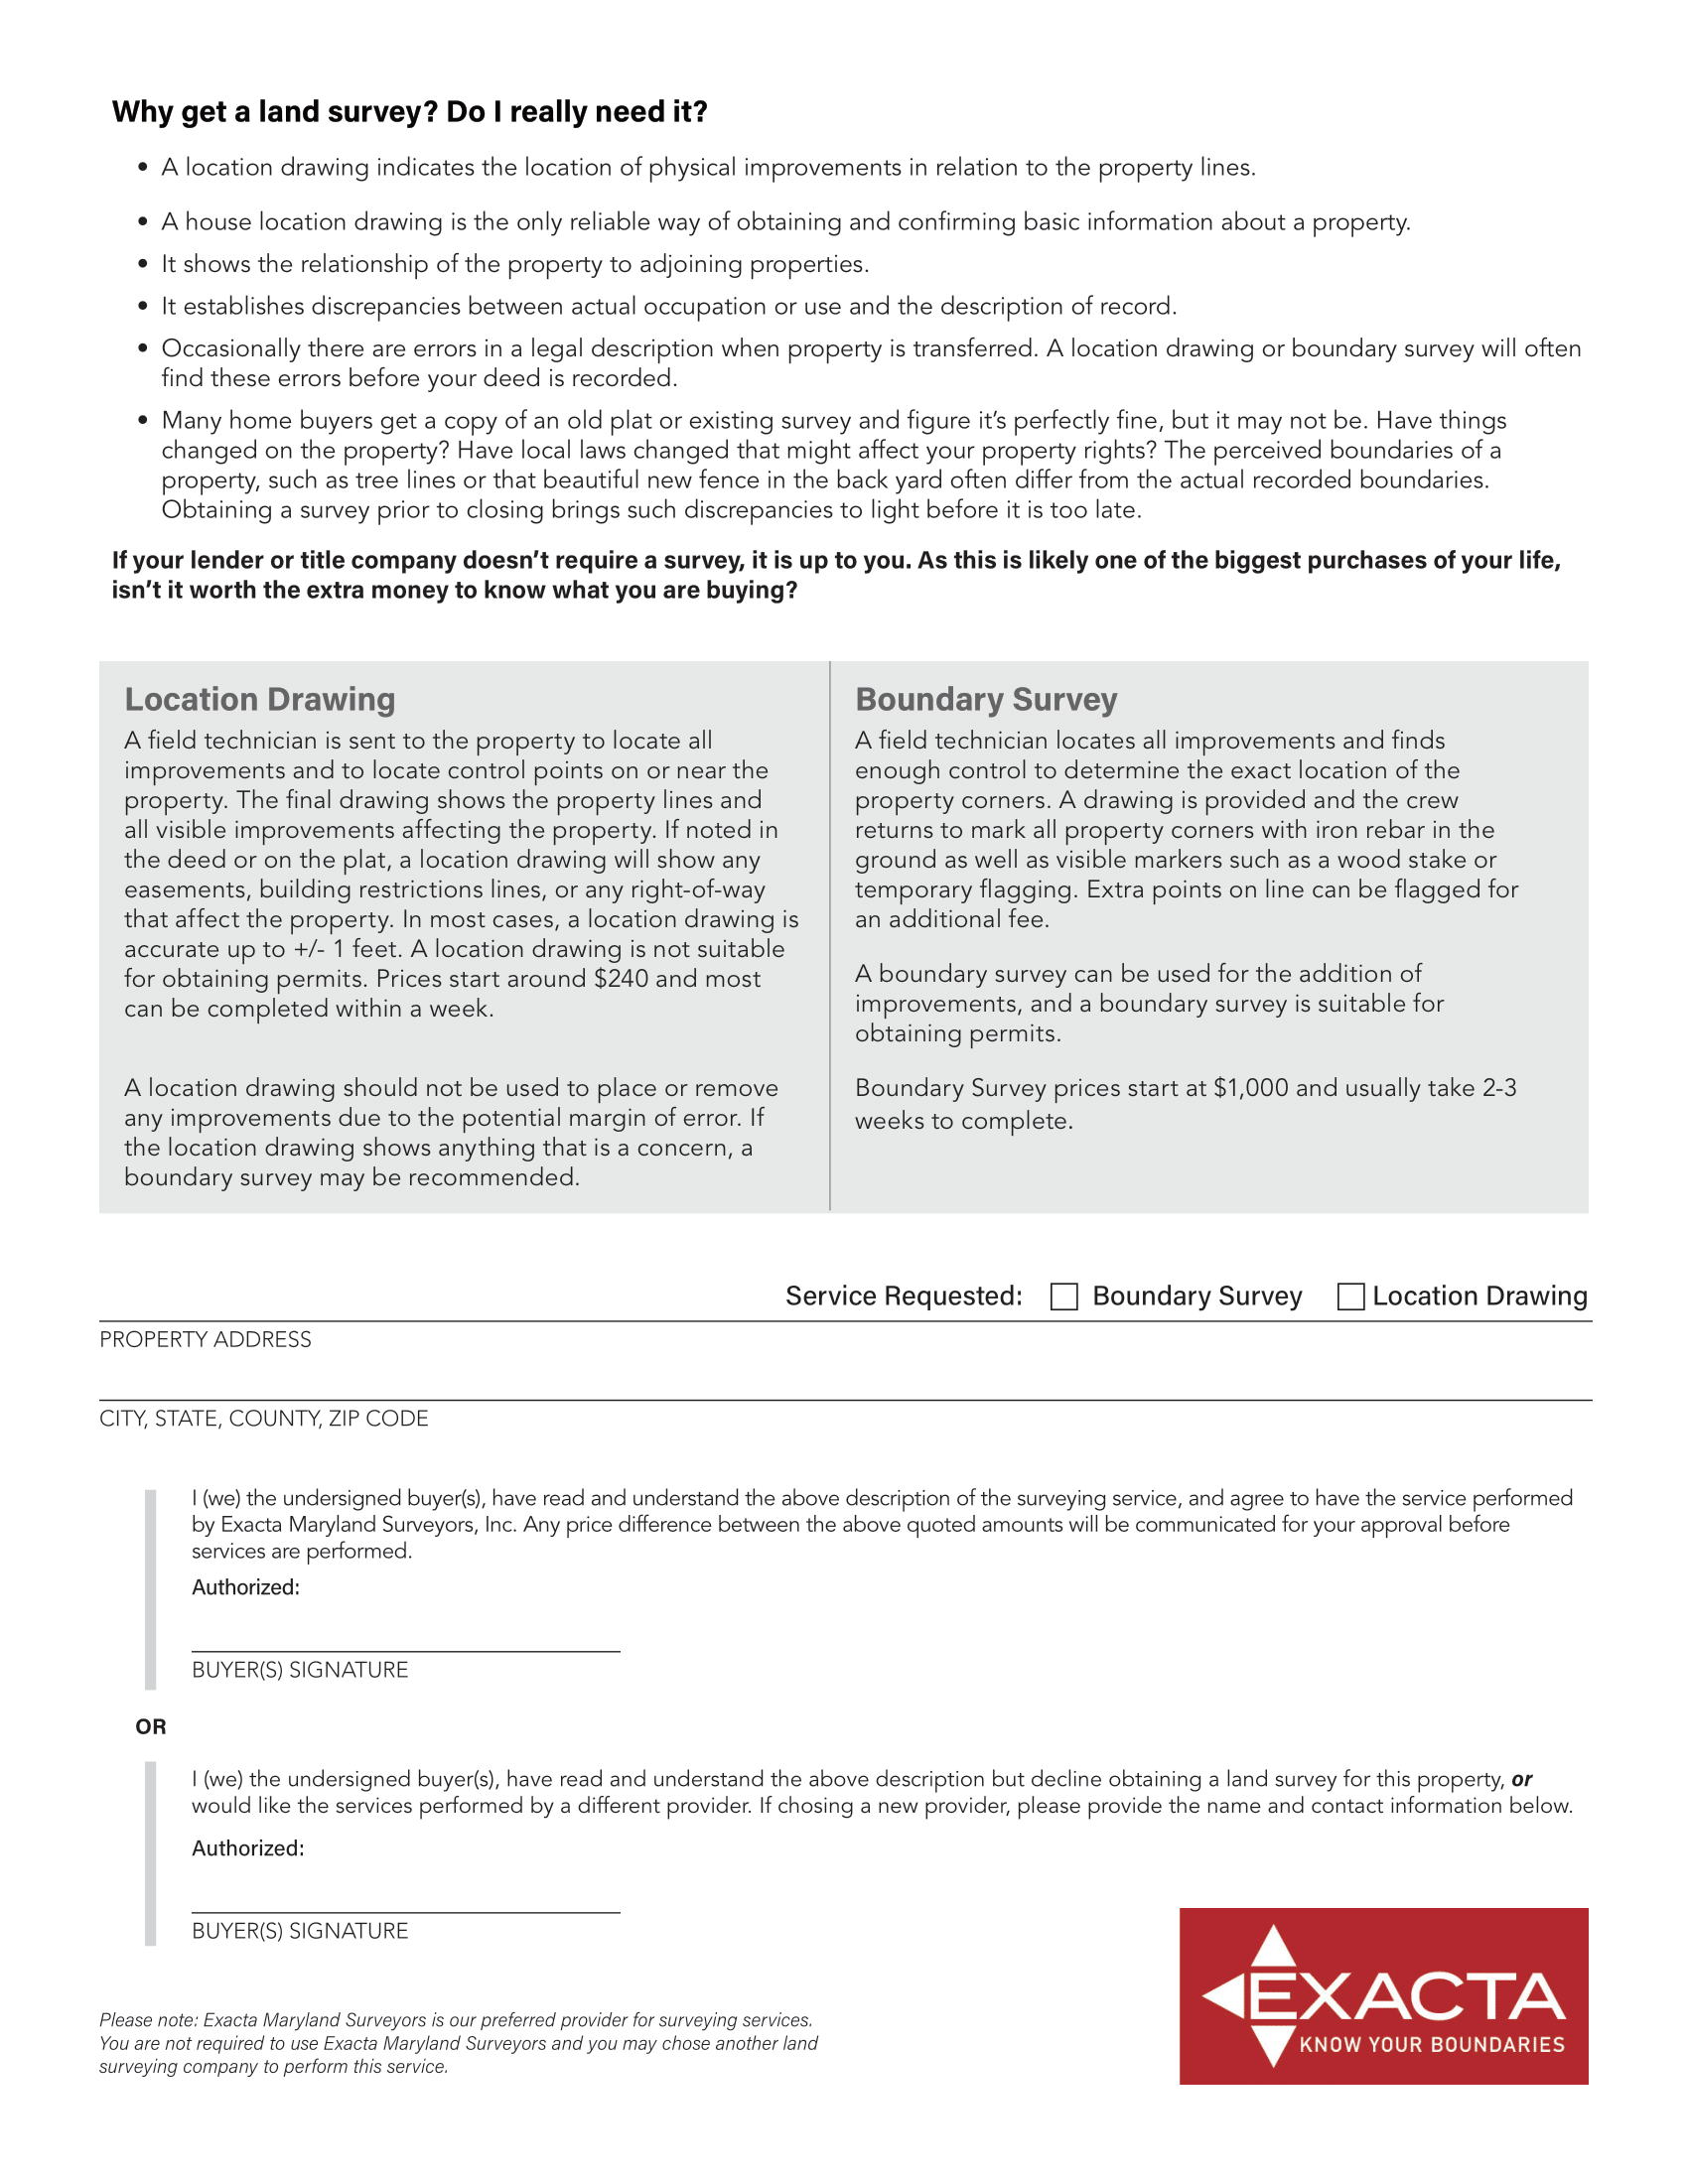

Slide 9
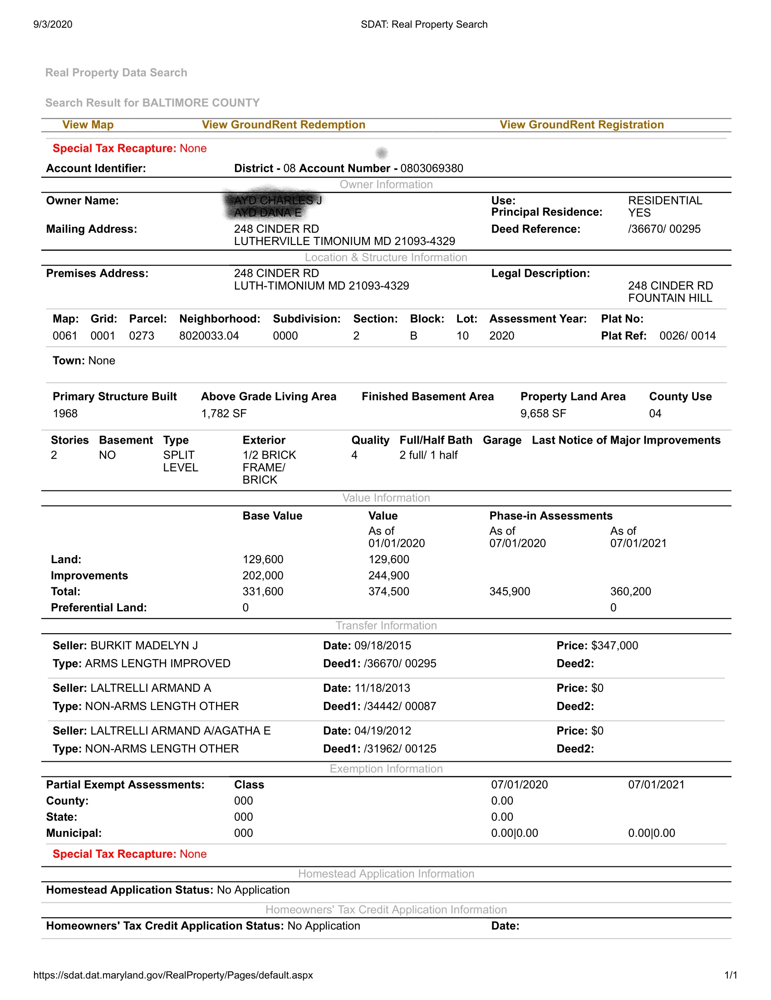

Slide 10
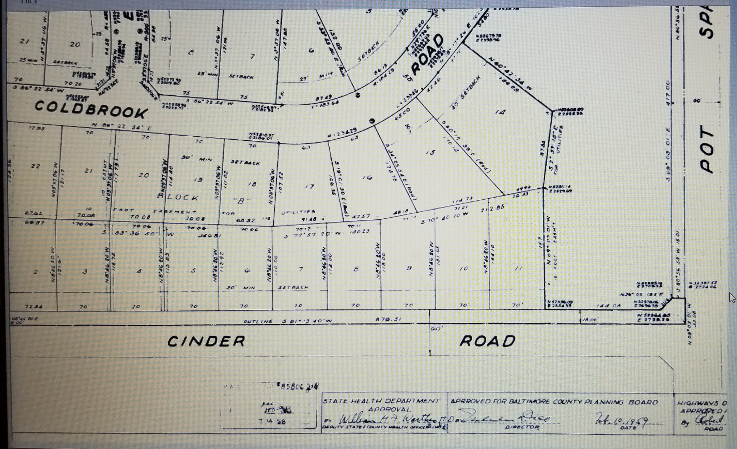

Slide 11
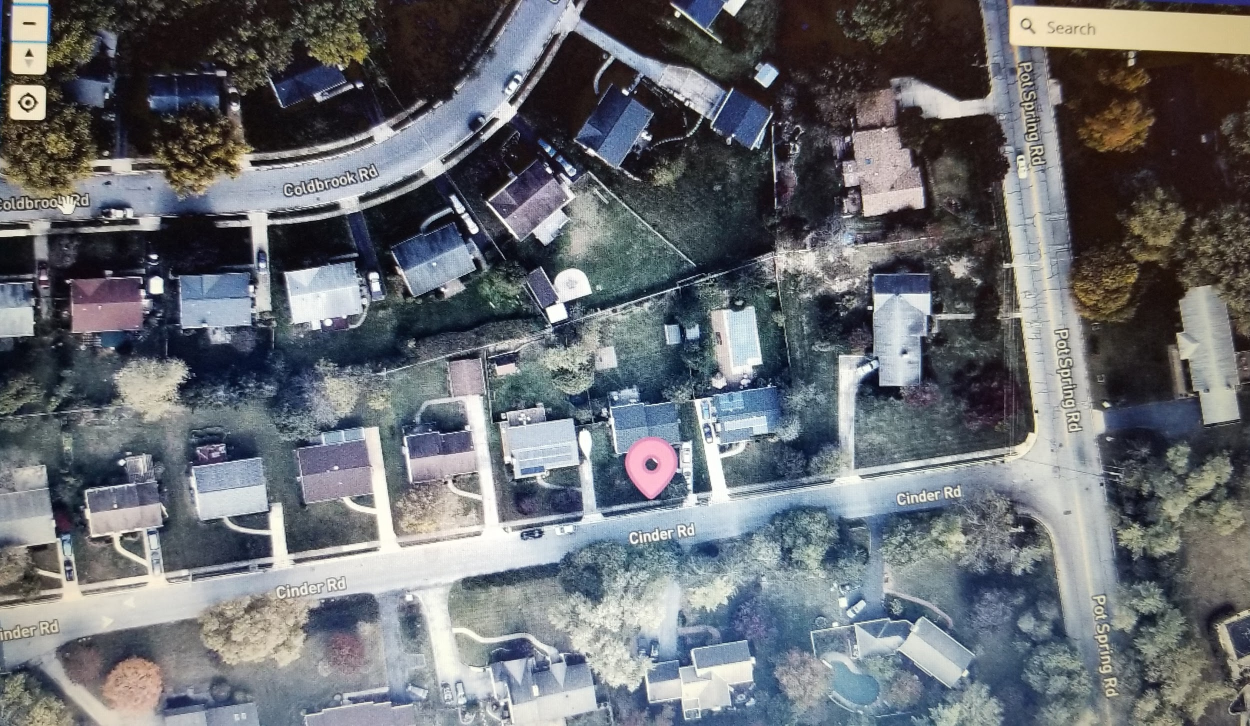

Slide 12
Legal description from Deed

Slide 13
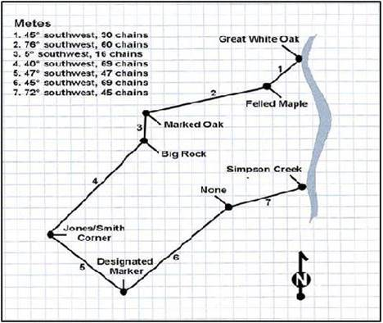
Metes and Bounds Legal Description
This system was imported to the original colonies that formed the United States. It is also used in some states that were previously part of one of the Thirteen Colonies, or where land was allocated before 1785.

Slide 14
Notes:
Surveyor will text 1 hour before arrival.

Slide 15
Tech crew will text before arrival
No one needs to be home for location drawing or boundary survey
Note if there are gated communities or dog doors!
1-2 acres typically take 1-1.5 hours to complete measurements for house location
Boundary surveys take 2-3 hours depending on property size
Boundary surveys crew may take a 2nd trip to stake property
We now have the latest robotic equipment that improves accurancy when measuring an aligning the property lines.

Slide 16
Notes:
Most location drawings under 2 acres takes about an hour.

Slide 17
Monuments
Land surveying monuments used corners of the property are marked with a 12” rebar driven vertically into the ground.
***If we are putting rebar in, we cap it with our MD License

Slide 19
Notes:
CAD drafter (Computer Aided Design) takes all of the data and field measurements, plays a complicated version of connect the dots, gives each line meaning by assigning it a color and thickness, and adds symbols and notes to help tell the whole story in an easy way to read.

Slide 21
Notes:
Then, the cad drafter takes that information, all of the data and the map to a PLS professional land surveyor to review the entire process. Here, the PLS will determine if the team followed his instructions all of the way through the process. PLS will determine if there is indeed enough measurements and information to confirm the boundary location as it was presented.

Slide 22
Notes:
.

Slide 25
Encroachments vs. Easements
Encroachments:
In property law, an encroachment is an intrusion on the land or property owned by another. Real estate encroachments commonly occur when one property owner violates the property rights of an adjacent property owner by building on that neighbor's land.
Tip
Ordering a property survey when purchasing a property reveals any encroachments and they can be dealt with before closing escrow.
What a great idea!! :-)
Easements:
An easement is the right others have to use real property belonging to you. Common real property easements include rights to access your backyard or others' rights to cross over your land to access their property.
Right-of-ways is another term for easements
Common Easements:
Utility Drainage Driveway Sidewalk

Slide 26
3 Most Common Encroachments
Driveways
Sheds
Fences
Other Encroachments:
Trees, pools, gardens

Slide 27
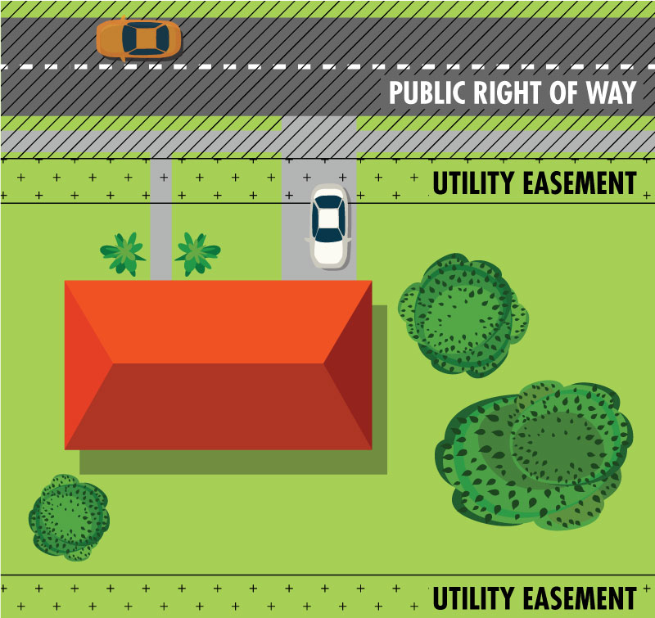
Utility Easement:
Having an easement gives the utility the right to use the land, but the utility does not own it.
The property owner may encounter certain restrictions on land use: restricting planting trees or putting in a swimming pool

Slide 28
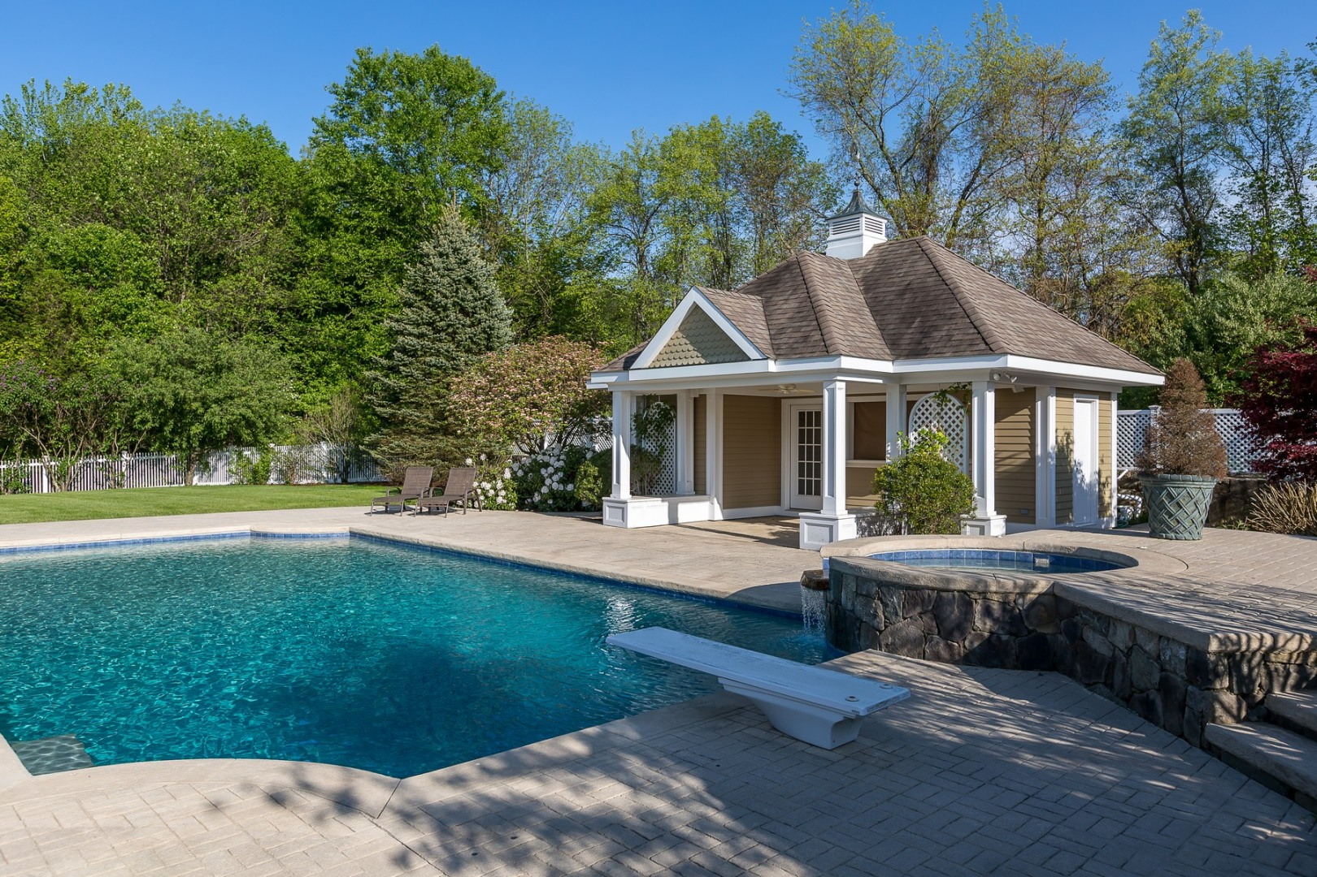
Case Study: Baltimore County
Utility Easement

Slide 29
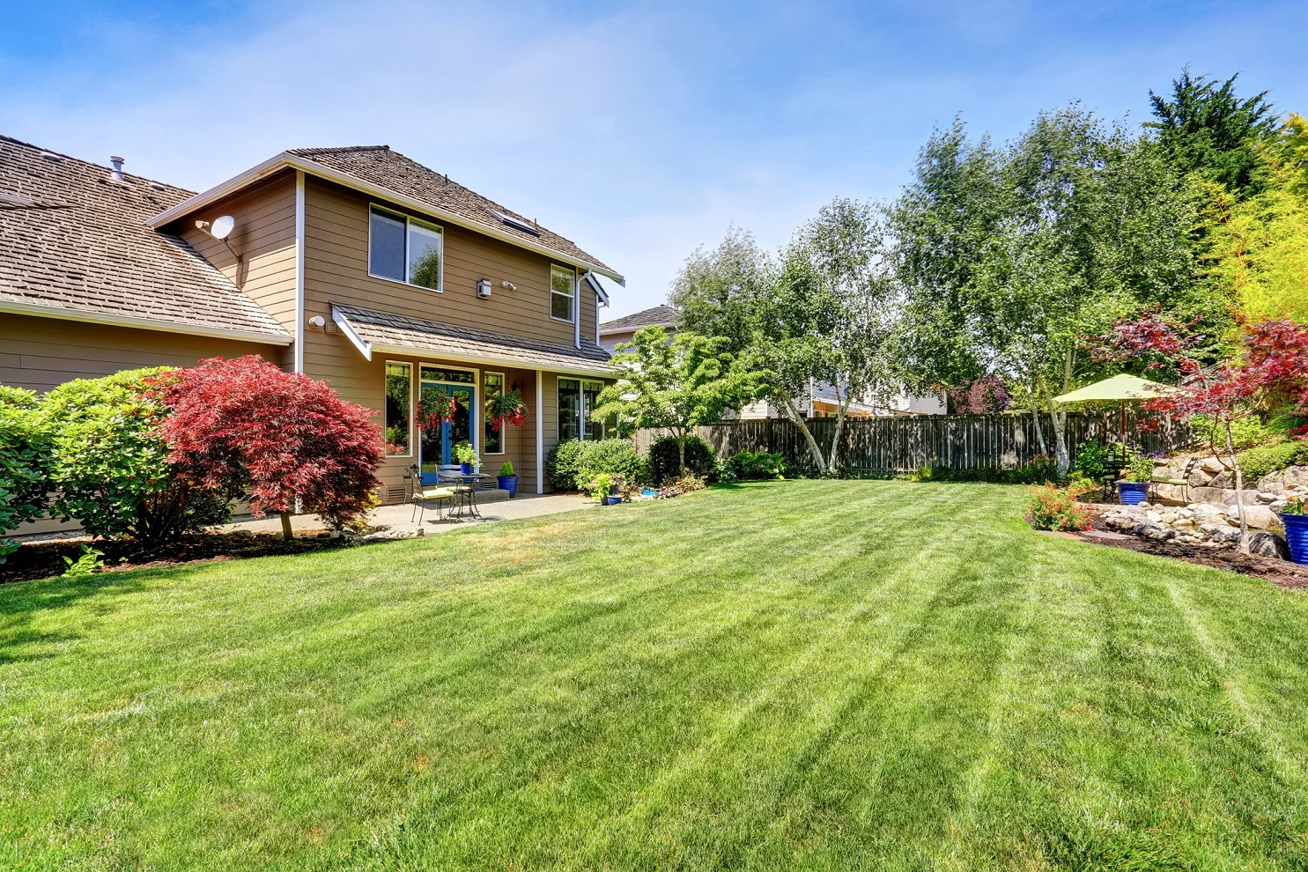
Case Study: Potomac

Slide 30
Conservation Buffers/Easements
A conservation easement is a voluntary, legal agreement that permanently limits uses of the land in order to protect its conservation values. Also known as a conservation restriction or conservation agreement, a conservation easement is one option to protect a property for future generations.
The conservation easement must remain in a natural state and not be used or altered in any way. This includes the building of structures, placing of fences, and mowing of grass. The easement area is intended to remain undisturbed and forever wild.
The easement must be held by a qualified easement holder, i.e., a government entity or a land trust.
The goal of devising a conservation easement is the landowner's voluntary agreement to give up one or more of these rights in order to protect certain natural resources. Prohibitions could include such matters as limitations on roads, structures, drilling, or excavating. The landowner could retain certain rights as long as those rights did not interfere with the conservation goals of the easement.

Slide 31
Harford County Department of Planning & Zoning
FENCES IN EASEMENTS While the Harford County Zoning Code allows property owners to erect fences, at their own risk, in recorded easements, there are caveats attached to permitting this use.
1. Excavation may not cause damage to existing pipes located in the easement.
2. The fence must not cause a drainage or sediment control problem.
3. Harford County may enter the property and make use of the easement area for grading and/or the installation or repair of utilities.
4. Harford County may either remove the fence as part of the work being done or require that you remove the fence prior to the work.
5. Harford County may enter the property and remove the fence if the fence violates one of the above provisions.
THE COST OF REPAIR RESULTING FROM ANY DAMAGE TO PIPES LOCATED IN THE EASEMENT OR THE COST FOR REMOVAL OF THE FENCE BY HARFORD COUNTY WILL BE THE RESPONSIBILITY OF THE PROPERTY OWNER.

Slide 32
Tax Benefits

Slide 33
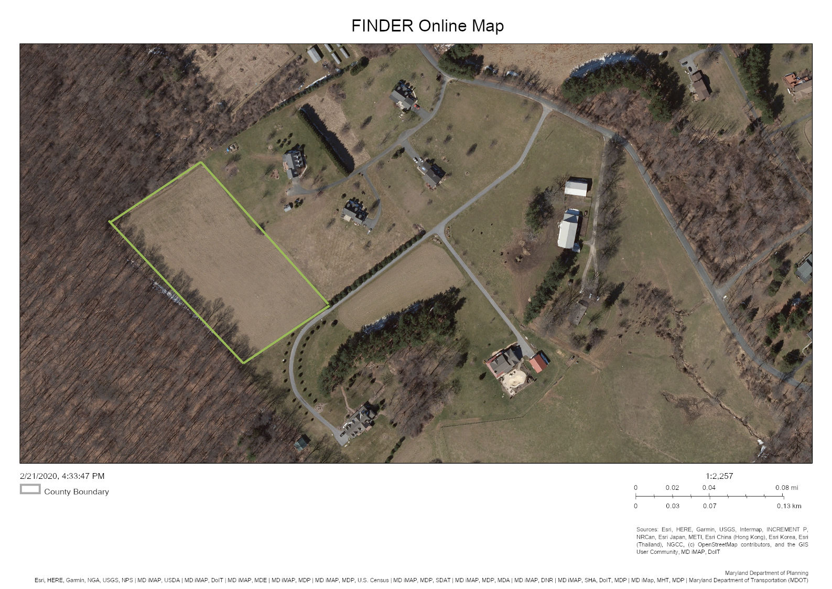
Case Study: White Hall, MD

Slide 34
****Items not always on location drawings****
Easements of any kind. If not stated on the deed or plat, we will not place on drawings
Plastic sheds Not considered real property and can be easily removed, will not be drawn.
Septic & Well: If the well or septic company flags the placement, we can put on the house location drawing. We need to know ahead of time or an extra cost to go back to the property.

Slide 38
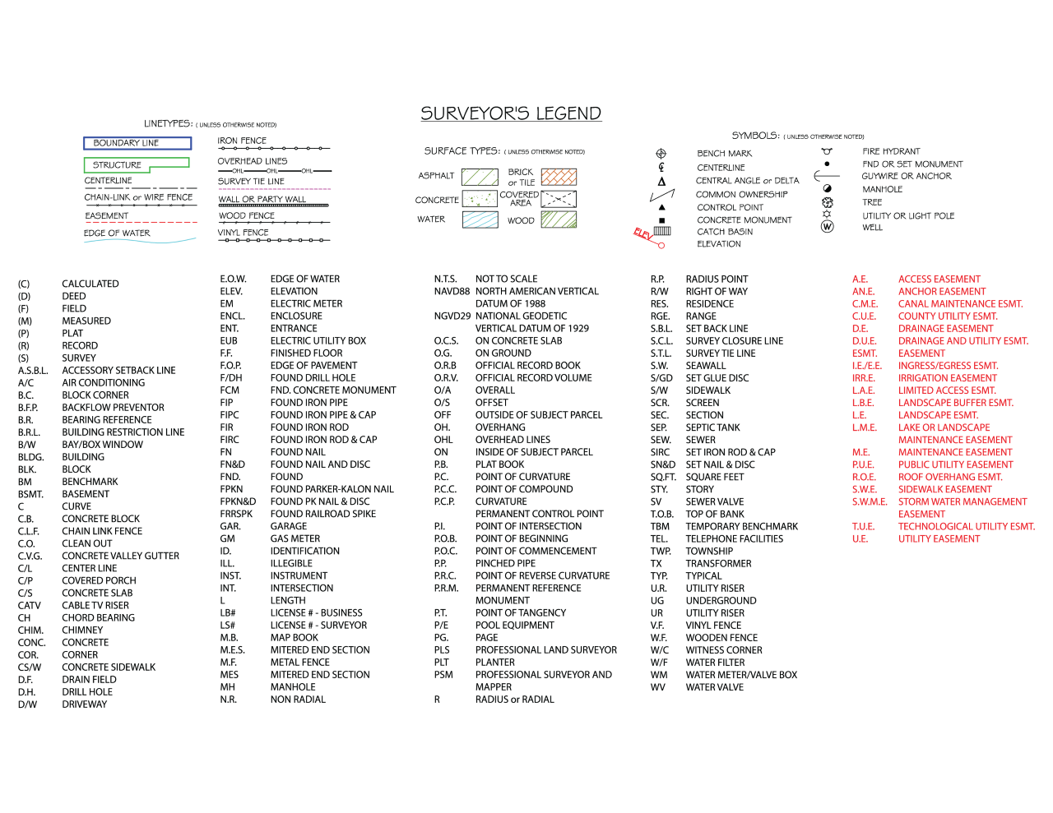

Slide 40
Exceptions to the Title Policy Without a Survey
Without a current survey done, there will be an exclusion in the policy such that the policy will not cover situations that would have been revealed by a current survey.
Encroachments over the property line,
Adverse possession by adjacent owners
Errors in acreage calculations in older surveys,
Undocumented driveways over the property
If the buyer purchases an enhanced owner’s policy, the blanket survey exception is removed from the owner’s policy even if the buyer only gets a house location survey.

Slide 41
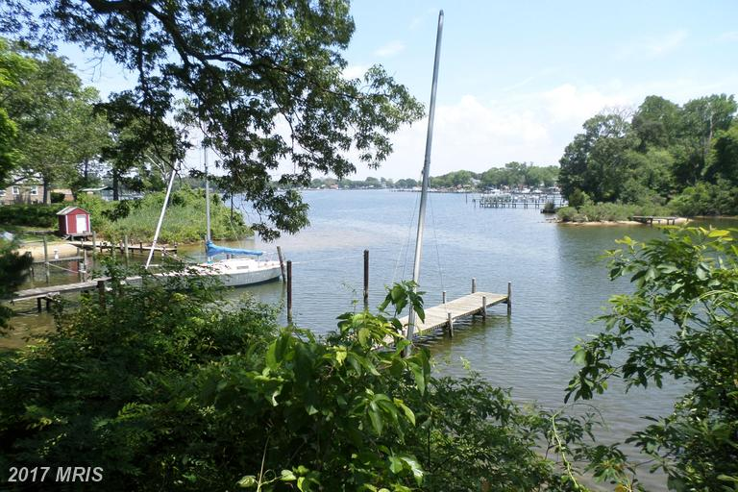
Case Study: Pasadena Maryland
First time home buyer
Water property with small backyard
Family of 5
House location drawing “optional”/ Lender deemed unnecessary

Slide 42
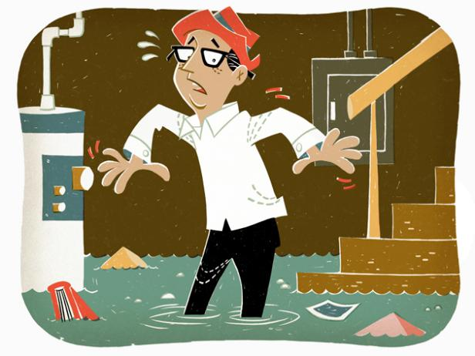
Elevation Certificates
For Flood Zone clients who need certificates to determine insurance rates.

Slide 43
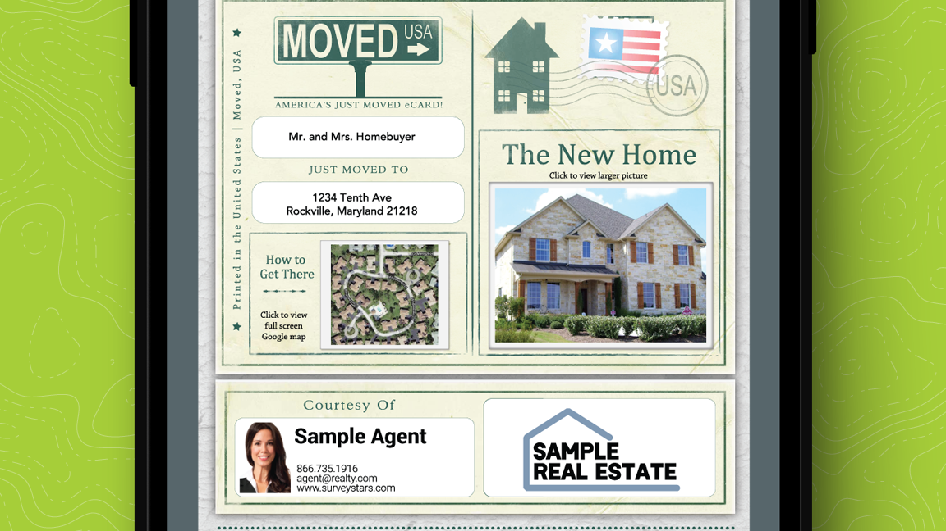
Notes:
MOVED USA. MORE Marketing! Buyers LOVE THIS.

Slide 44
Home Inspection + Land survey =
Happy Homeowners Inside and out!

Slide 45
INTEGRATIONS:
We are integrated with RamQuest and Resware
Coming soon are Soft Pro and Qualia (currently can order through Qualia email)
SurveyStars another way to order through Exacta or orders@exactaland.com
Questions or need any additional information:
Patty Aiken : pattyaiken@exactaland.com
Direct: 301-904-0153

