Slide 1
Real Estate Fraud: A Growing Problem
September 14, 2022
Notes:
Perla

Slide 2
Matt Reass, NTP
EVP Strategic Partner Relationships
RynohLive
matthew.reass@rynoh.com
757.333.3772
Perla Aparicio
VP of Strategic Partnerships
paymints.io
perla.aparicio@paymints.io
281.468.7019
Notes:
Perla

Slide 3
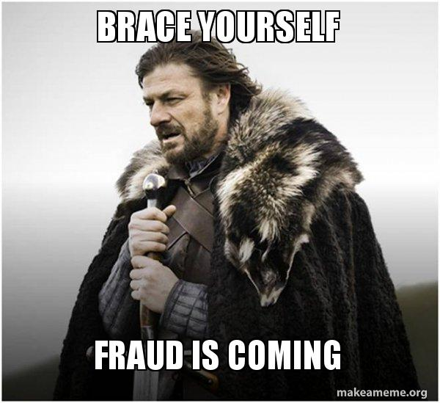
Notes:
Perla

Slide 4
Welcome
Fraud – A Growing Problem
Closer Look – Common Scams & Headlines
Technology & COVID-19
Prevention Techniques
Paymints.io
Rynoh
Q & A
Notes:
Perla

Slide 5
Rynoh & paymints.io Partnership
Rynoh is the leader in our industry for reconciliation automation software
Paymints.io is a leader in the electronic payment space
Collaboration across financial vendors is a critical initiative
Working together with like - minded companies
Same goals
Notes:
Perla

Slide 6
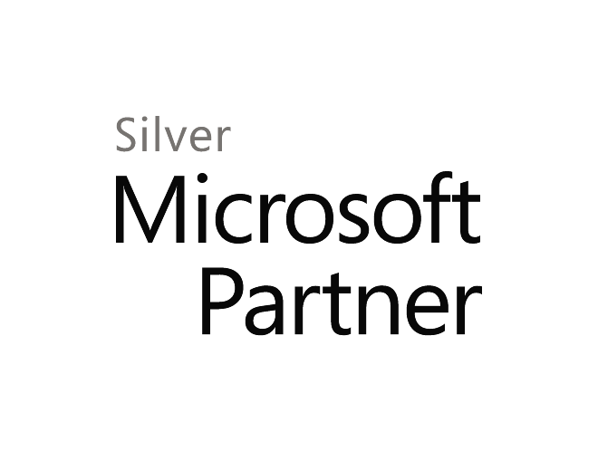
RynohLive®
Founded in 2007
>2,500 settlement agents
>21 Million Closings monitored
Protected in excess of $7.0 Trillion
Patented, cloud-based financial management and fraud prevention system
Independent and platform-neutral
Integrations with 20 closing software and counting
Notes:
Matt

Slide 7
Paymints.io Mission
Transforming how real estate payments are made with the goal of eliminating wire fraud and paper checks.
Our Vision
Allow consumers and organizations to send and receive payments securely and effortlessly.
Our Holistic Approach
Eliminate wire fraud for every part of the real estate
transaction!
Notes:
Perla

Slide 8
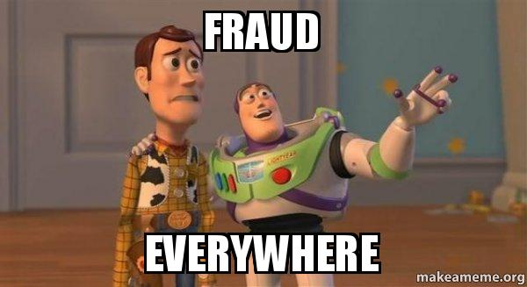
Why fraud happens in Real Estate?
Notes:
https://www.certifid.com/article/why-fraud-happens-in-real-estate Perla

Slide 9
Why fraud happens in Real Estate?
The median price of homes that have sold exceeds $439,400
There are multiple parties in every transaction, and only ONE needs to be compromised
All the information a scammer needs can be found online
Time is of the essence
Inexperienced buyers
Notes:
Perla https://www.certifid.com/article/why-fraud-happens-in-real-estate https://www.census.gov/construction/nrs/pdf/newressales.pdf

Slide 10
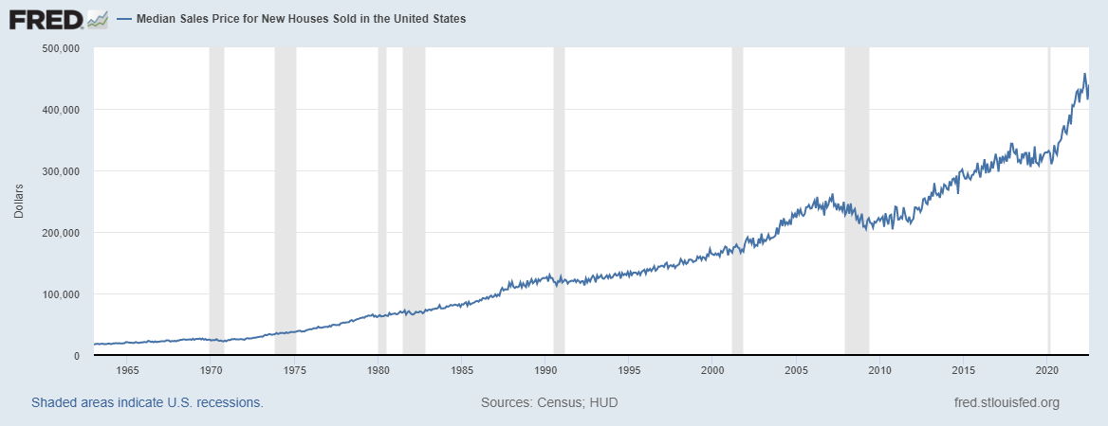
Notes:
Perla

Slide 11
Financial Fraud
Attacks/Attempts Declining:
2018 & 2019: 74% of organizations reported fraud activity
2021: 71% reported payments fraud attacks
Checks & ACH Debits most susceptible: 2021: 66% and 37%, respectively
Accounts Payable (AP) Departments most targeted: 58% reported being susceptible to BEC (2020: 61% reported)
Real estate transactions are an easy target for cyber criminals as they involve multiple parties, long transaction cycles, readily-available public information, and large buckets of money.
Title agents are sustaining crippling losses and recent revisions to the Closing Protection Letter (CPL) specifically exclude underwriter liability for losses due to wire fraud.
Notes:
Perla

Slide 12
Closer Look: Common Scams
Scenario 1: Fraudster impersonates the borrower/buyer’s trusted counter-party (real estate agent) prompting the buyer’s financial institution to execute an authorized wire transfer.
Scenario 2: Fraudster impersonates a financial institution’s customer prompting the financial institution to execute an unauthorized wire transfer.
Scenario 3: Fraudster impersonates a company executive to mislead a company employee into authorizing a wire transfer to a criminal-controlled account.
Scenario 4: Fraudster impersonates a supplier to mislead a company employee into directing wires transfers to a criminal-controlled account.
Notes:
Perla

Slide 13
Closer Look: Statistics
CEO’s are the most popular “Senders”- (31% of scams).
“Email appeared to come from our owner and money was sent.”
CFO’s are the most popular “Recipients” (40% of scams).
Owners/Executives committed only 20% of occupational fraud (but caused the largest losses):
Owner/Executive: $600,000
Manager: $150,000
Employee: $60,000
Occupational Fraud Schemes (median loss per month):
Financial Statement Fraud: $39,800
Corruption: $11,100
Noncash: $6,000
Check and payment tampering: $4,600
Source: Association of Certified Fraud Examiners (ACFE) “Report To The Nations: 2020 Global Study on Occupational Fraud and Abuse”
Notes:
Perla

Slide 14
Closer Look: Statistics
Source: Association for Financial Professionals (AFP) “Payments Fraud and Control Survey Report” (2022)
Notes:
Perla

Slide 15
Closer Look: Statistics
Source: IC3 Internet Crime Report (2021)
Notes:
Perla

Slide 16
Closer Look: Statistics
Source: IC3 Internet Crime Report (2021)
Notes:
Matt

Slide 17
Closer Look: Statistics
Source: IC3 Internet Crime Report (2021)
Notes:
matt

Slide 18
Closer Look: Statistics
Source: IC3 Internet Crime Report (2021)

Slide 19
Closer Look: Statistics
Source: Association for Financial Professionals (AFP) “Payments Fraud and Control Survey Report” (2022)

Slide 20
Business Email Compromise (BEC)
2020 statistics:
19,369 complaints (approx. $1.8B in losses): continue to be costliest scheme
Average BEC loss: $179k ($43B from 241k incidents)
Bank robbery: approx. $4k
Convenience store: approx. $709

Slide 21
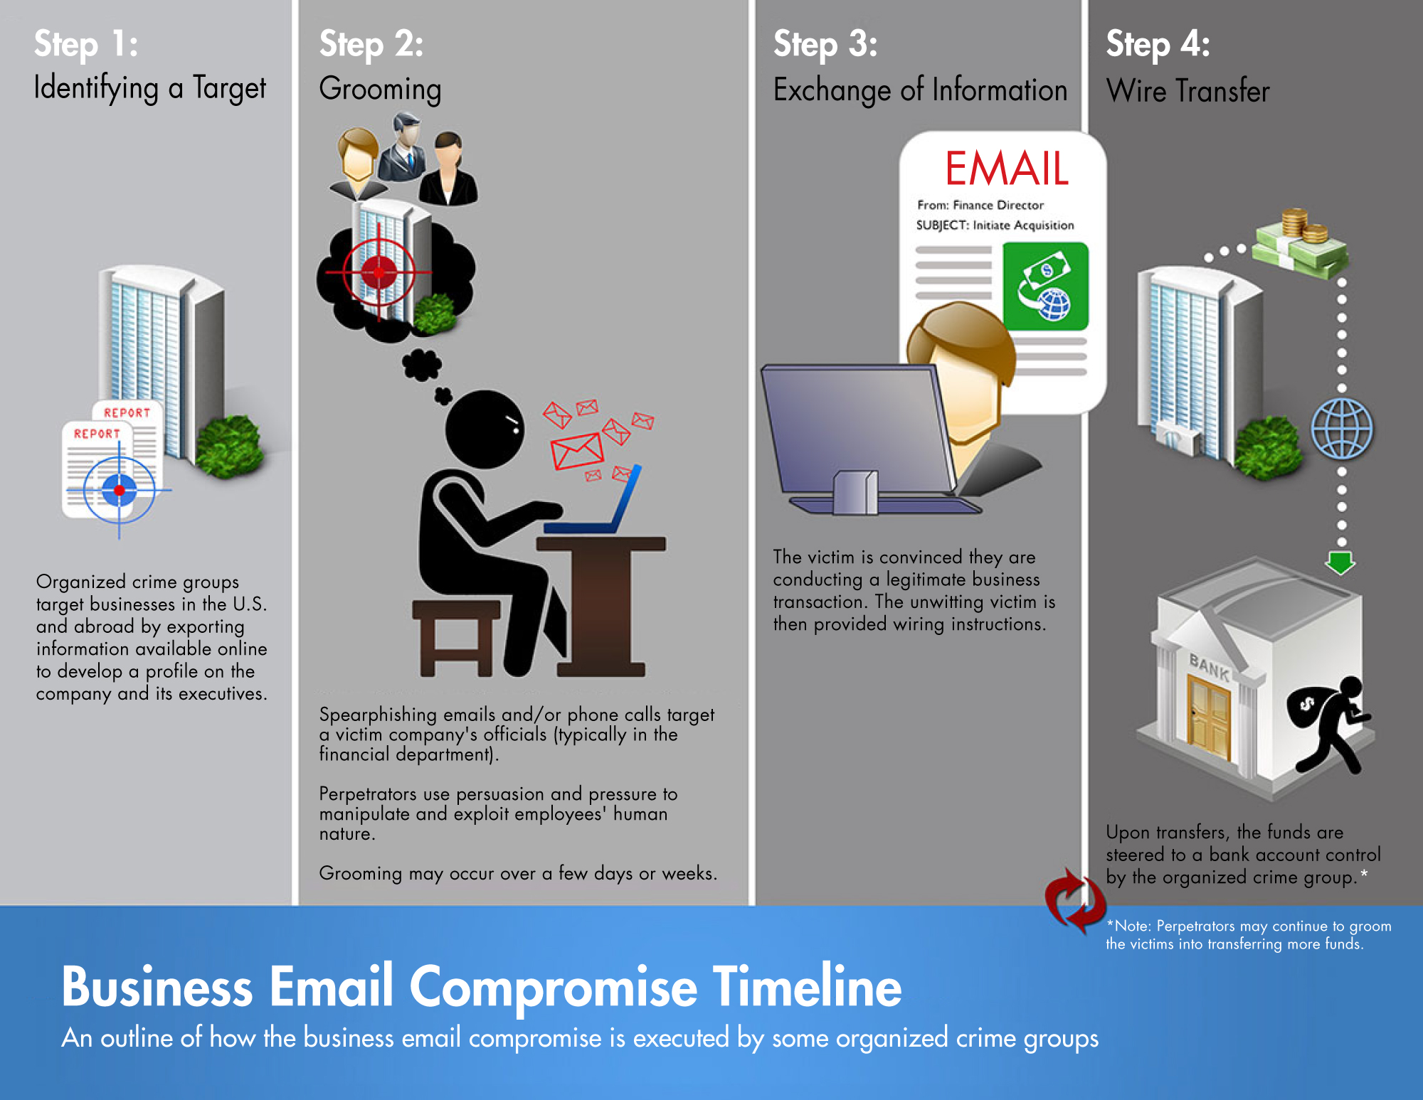
Business Email Compromise (BEC)
Source: www.fbi.gov (https://www.fbi.gov/image-repository/business-email-compromise-timeline-050222.jpg)

Slide 22
Technology & COVID19
Criminals have upped their came in the age of COVID-19.
“There is a digitally historic event occurring in the background of this pandemic, and that is there is a cybercrime pandemic that is occurring,” said VMWare cybersecurity strategist Tom Kellerman.
Technology: More important than ever to help keep business operations up and running in the age of COVID-19.
Wire Fraud, Ransomware and Other Security Threats: The current increase in telework, electronic flow and automation exposes the industry to more security threats and wire fraud. This past March, experts saw a spike of 600% in wire fraud attempts alone.
Workforce Management with COVID-19: Your staff is now remote, what do you do?

Slide 23
Technology & COVID19
Reuters just reported that hacking activity against corporations in the United States and other countries more than doubled by some measures in March as digital thieves took advantage of security weakened by pandemic work-from-home policies.
Zeus Sphinx Banking Trojan is revived under the guise of COVID-19 financial assistance after a three-year hiatus. The intent of the malware is to collect logon credentials as users attempt to access online banking.
Netflix scams! Google searches for Netflix jumped 142% since stay-at-home. Phishing campaigns use fake sites that appear to be Netflix sign-up pages, but they are in fact established simply to steal from those who think they’re registering for the service. The cyber security firm BrandShield told the Express that 639 fraudulent domains that use the word “Netflix” have been registered. 236 of those were established during March alone.

Slide 24
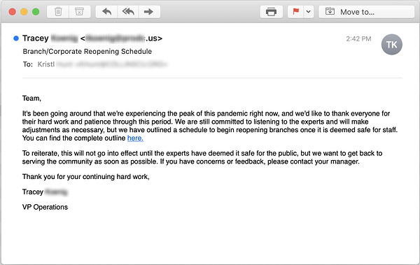
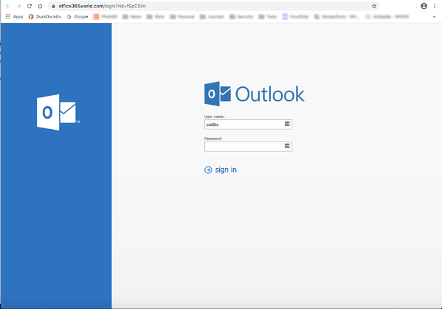
Technology & COVID19
Rapid growth and development of Coronavirus-themed phishing emails
Re-Opening the American Economy: Malicious actors have a plan! Targeting employees with HR announcements to phish for credentials.

Slide 25
Technology & COVID19
A recent quarantine text scam tricked U.K. residents into paying a “fine.”
"GOV.UK CORONAVIRUS ALERT. We would like to inform you that you have been recorded as leaving your home on 3 occasions yesterday. A fine of £35 has been added to your gov.uk account. For further information please visit gov.uk/coronavirus-penalty-payment-tracking. Protect the NHS. Save Lives.”
Malware variants! Some actors aren’t apparently after money or credentials. Their goal? To wipe entire file systems. MalwareHunterTeam has spotted a variant in Italy that also looks to (albeit inefficiently) delete the files on an endpoint. Whether a joke or intended for espionage, these kinds of malware can kill IT and user productivity, hurting the organization.

Slide 26
Technology & COVID19
Phony Form from HR: The phishing email resembles something that your human resources department might send about returning to the office. Attached to the email is an HTML file that includes your name in the file name… what happens when you try to download the file?
Fake Video Calls are a Quick Score for Scammers: With so many organizations still working remotely, bad guys continue to target you by spoofing popular video conferencing software, such as Zoom and Microsoft Teams. Video-conference themed phishing attacks can come in all shapes and sizes. For example, you may receive a phony welcome email that asks you to set up your new account. Or, you could receive an email claiming that you need to reschedule a missed meeting. As a more alarming example, you may receive a fake notice that your account has been suspended and you cannot join a meeting without first clicking the link in the email.
Pfizer’s Vaccine is Fresh Phish Bait: Pfizer announced that long-term trials of their COVID-19 vaccine have been highly successful. This exciting development is a huge step towards ending the pandemic, but experts say we are still far from a publicly available vaccine. Unfortunately, good news like this is often used by cybercriminals to catch your attention and manipulate your emotions. Expect to see mentions of a COVID-19 vaccine in phishing attacks and social media disinformation campaigns.

Slide 27
Technology & COVID19
Smishing Gains Popularity with Bad Guys: Many services, from grocery pickup to credit score updates, offer notifications via text messages or short message service (SMS). Typically, these notifications are short, vague, and include a link—which makes them great for spoofing! Bad guys use fake notification messages for SMS Phishing, or Smishing attacks.
The combination of simplicity and effectiveness have ensured that BEC will continue to be one of the most popular attacks, especially for those who lack special tools and knowledge to pull off more complicated schemes.

Slide 28
Technology
Credit Unions: National Credit Union Administration (NCUA) warned of increasing cyber attacks targeting credit unions
Fake emails appear to be from credit union
Email directing recipient to click a link (big “no no”)
Redirected to login page: username and password forwarded to cybercriminal
Social Media (Meta, Twitter, LinkedIn, etc…):
Cybercriminals can gather information about you (and your organization)
Post responsibly
Think before you post
Avoid sharing too much information with public groups

Slide 29
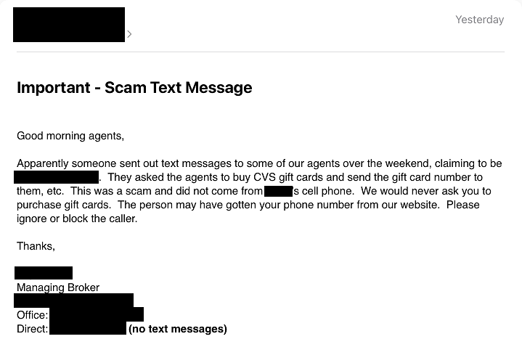
Smishing

Slide 30
Financial Fraud Kill Chain (FFKC)
Contact Bank: reverse wire???
File Complaint: Internet Crime Complaint Center (www.ic3.gov)
Contact Local FBI: reque<72 hours after wire transfer
>$50k wire transfer
Wire sent from business account
st FFKC

Slide 31
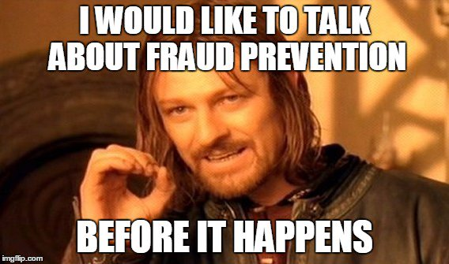
Prevention Techniques: (Action Items)
Notes:
Perla

Slide 32
Prevention Techniques: (Action Items)
2017 AFP Payments Fraud Survey: 60% of companies reconcile accounts daily to identify and return unauthorized debits.
Frequently monitor your Email Exchange server for changes in configuration and custom rules for specific accounts
Two factor authentication (2FA) on all email, social media and other sites/communication platforms
Consider adding an email banner stating when an email comes from outside your organization,
Conduct End User education and training on the threats and how to identify scams and evaluate remote work policies.
Ensure company policies provide for verification of any changes to existing invoices, bank deposit information, and contact information
Contact requestors by phone before complying with e-mail requests for payments or personnel records
Consider requiring two parties sign off on payment transfers
Implement technology that can help detect fraud
Notes:
Perla

Slide 33
Prevention Techniques: (Action Items)
End-user education
2020: 77%
2019: 80%
Implemented company policies
2020: 70%
2019: 70%
Confirm requests for transfer of funds
2020: 67%
2019: 65%
Stronger internal controls
2020: 66%
2019: 61%
Two-factor authentication
2020: 57%
2019: 59%
Source: Association for Financial Professionals (AFP) “Payments Fraud and Control Survey Report” (2021)

Slide 34
What are the solutions to the problem
Keep all software and systems updated
Back-up all your data
Limit access to your technology
Protect your wifi
Give every employee their own credentials
Regularly update your passwords
Agency Fraud Policies
Training Staff and Clients
Electronic Money Transfer Systems
Cyber Security Protections
Notes:
https://www.paymints.io/2021/07/real-estate-fraud-prevention-3/

Slide 35
How to be a resource to your partners and be seen as a leader in cyber security:
Double check everything
Analyze all of the options
Stay informed
Listen to the problems of your customers
Clear communication
Follow your gut

Slide 36
Paymints.io
Electronic Payment Platform
Customized platform to showcase your brand
Eliminate checks & reduce wire fraud
Bi-directional functionality
No sharing of account & routing numbers

Slide 37
Paymints.io Security
Encryption of sensitive data & personal information
No sharing of account or routing information
No sharing of private information you would see on a paper check
Bank level encryption to keep clients’ personal information safe
SMS authentication

Slide 38
RynohLive®
Cloud-based
Ability to grant your underwriter access (easier audits)
Caught: malware (ZeusBot), check fraud, internal embezzlement
Three words: Proactive, Automated, Daily
Frank Abagnale:
“What I did in my youth is hundred of times easier today. Technology breeds crime.”
Notes:
Matt

Slide 39
Rynoh Security
Risk Reduction
"On more than one occasion, Rynoh has Identified items for us that looked odd and we were able to resolve problems before they became major incidents."
Increased Efficiency
"Love the fact that our employees don't spend hours reconciling at the end of the month."
Improved Accuracy
"The idea of dealing with real time transactions and determining the issues that Rynoh provides is invaluable. It has reduced time to research and resolve transactions by 75%. It required a full day to reconcile our accounts, and now it only takes a couple of hours."
Notes:
Matt

Slide 40
Matt Reass, NTP
EVP Strategic Partner Relationships
RynohLive
matthew.reass@rynoh.com
757.333.3772
Perla Aparicio
VP of Strategic Partnerships
paymints.io
perla.aparicio@paymints.io
281.468.7019
Notes:
Matt

Slide 41
Why Digital Funds Now?
People don’t have checkbooks
COVID accelerated digital payments
People are moving to remote areas or don't have access to their banks
Amazon-like experience
Saves time (30-60 min of drive time)
Wire Fraud
Touchless & digital experiences
QR codes are a staple in our society now
Notes:
How the landscape has changed with homebuyers- generational change. People that are now buying home are now used to using digital payment platforms more than checks and wire. How many electronic payment transactions are made per person per day. Homebuyer space and percentage of millenials- FATIC presentation Billtrust payment study: 79% of GenZ reported using a digital payment platform like Venmo or Zelle at least one a month https://www.billtrust.com/resources/blog/billtrusts-generation-z-and-digital-payments-study/

Slide 42
Growing Problems in the Industry
Wire Fraud
Inefficiencies of handling paper checks
Real Estate transactions are an easy target
80% of real estate wire fraud scams target buyers
Notes:
inefficiencies of dealing with checks Real estate transactions are one of the largest transactions someone will make in their lifetime and they don’t know the safeguards to take when sending a wire. People tell them all of the securities behind it, but will they? You have to be very careful when dealing with money in a real estate transaction. In a real estate transaction people are sending their routing and account numbers and someone who gets that info can go to any website and make a purchase. Unless their banking has security safeguards in place it’s very easy to create this fraud. -Make it relatable You have a routingand accounting number on a check

