Slide 1
Seller Impersonation Fraud
Stop it before it happens to you.

Slide 2
Agenda
Introduction
Claims
Red Flags + Triage
Technology to prevent claims
Live demo of ID verification
Q&A

Slide 3
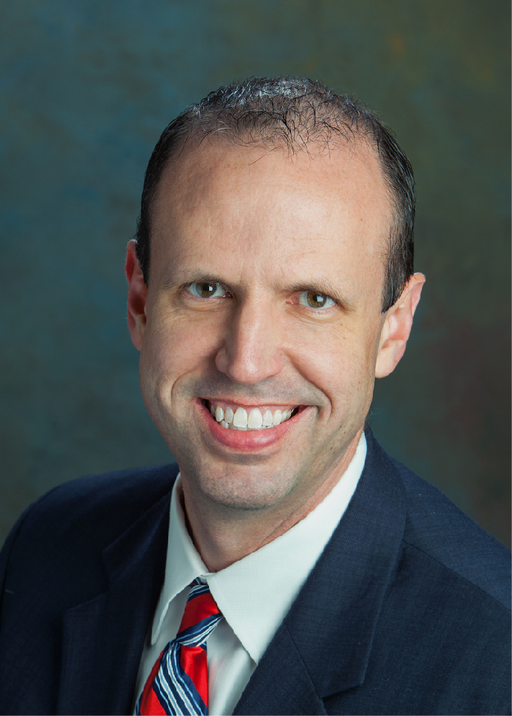
Speaker
Michael Holden
Vice President, Strategic Agency
Doma Title Insurance, Inc.
Ph: 440.725.8973
Email: michael.holden@doma.com

Slide 4
This information is not a substitute for legal advice. It is for your reference only, and is not intended to represent the only approach to any particular issue.
This information should not be construed as legal, financial or business advice, and users should consult legal counsel and subject-matter experts to be sure that the policies adopted and implemented meet the requirements unique to your company.

Slide 5
Seller Impersonation Fraud Introduction

Slide 6
One in Ten Americans targeted for Real Estate Fraud

Slide 7
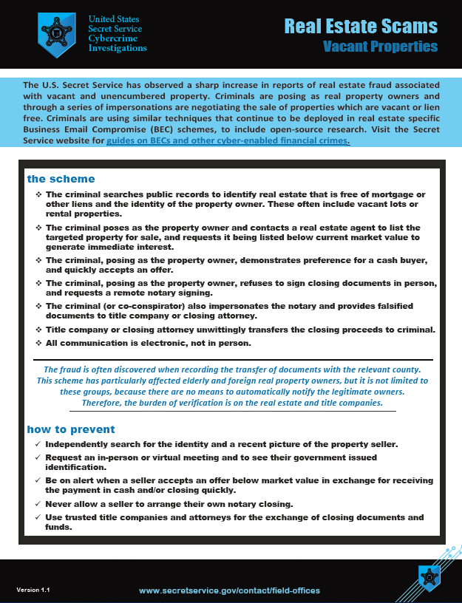
Secret Service Issues Real Estate Fraud Advisory
Fraudsters profile vacant or non-owner occupied property and impersonate the owner in order to steal the proceeds.
Download this recently issued US Secret Service advisory and other advisories on BEC and other fraud schemes:
https://www.secretservice.gov/investigation/Preparing-for-a-Cyber-Incident

Slide 8
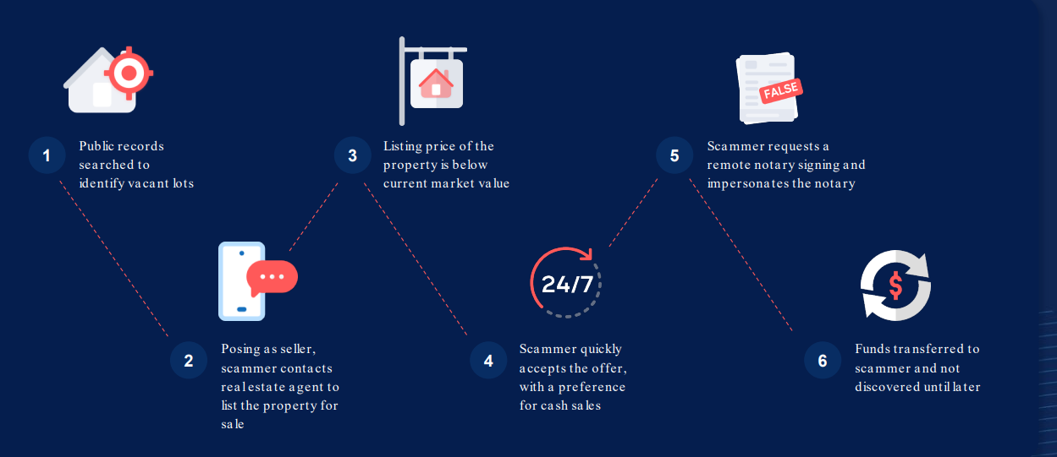
Seller Impersonation Playbook

Slide 9
Effect on Title Insurers – claims have skyrocketed!
In 2023:
9% of claims were for fraud/forgery.
30% of loss payouts
Jumped over 100% from 2022 to 2023

Slide 10
Seller Impersonation Fraud Claims

Slide 11
The Equity Scam

Slide 12
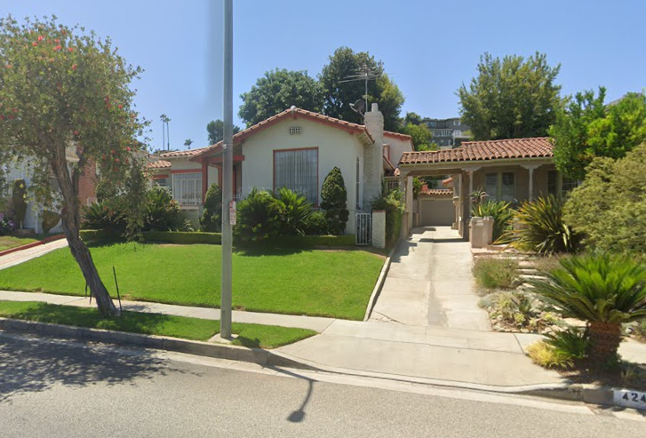
The Equity Scam
Property owner purchased property in 1967.
Widow in her 80’s
Mortgage 2007 to Countrywide $462,000
Transfers to her trust in 2021
2022 Mortgage recorded in favor of “LP Financial” for $225,000
Owner of LP Financial claims this was fraud, and done by former employee.
3 months later – Refinance of the LP Financial loan. New mortgage for $260,000

Slide 13
The Equity Scam
Sub-Escrow – Title agent issuing the policy had no contact with the lender or the borrower.
Mortgage broker was the same former employee of LC Financial (we believe him to be the fraudster)
Hard money lenders funded the new mortgage
No investigation was made as to the identity of the borrower, who at that time was 88 yrs old

Slide 14
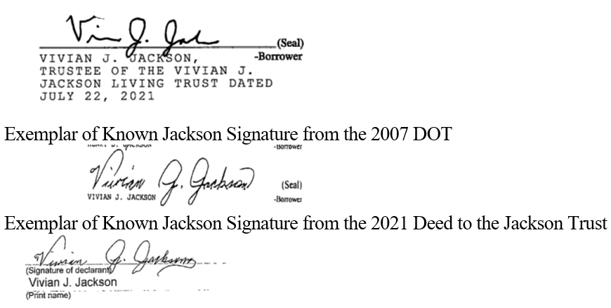
The Equity Scam
Verifying signatures could have prevented fraud

Slide 15
The Equity Scam - Prevention
1. The title agent or independent escrow company must have personal contact with the borrower.
2. Notaries must be employees of the title agent or independent escrow company. Alternatively, notaries that are vetted and approved by a Doma title agent or trusted independent escrow company may be used.
3. Notary must obtain two forms of ID from borrowers at the signing.
4. Notary must provide a copy of the notary journal entry for each signature.
From Doma Underwriting Bulletin 2020-08 California Fraud Prevention

Slide 16
The Equity Scam - Prevention
5. Notaries must provide copies of their E&O policies and/or bonds.
6. Mobile notaries must state in writing where the signing took place.
7. When available, the title agent must compare signatures in recorded documents with the signature(s) on the deed of trust that is to be insured.
9. Provide a copy of the unrecorded, executed, notarized deed of trust to be insured.
From Doma Underwriting Bulletin 2020-08 California Fraud Prevention

Slide 17
Stolen Title Deed

Slide 18
Stolen Title Deed
Feb 2022 – QCD recorded from the true owner to individual person for apartment building
May 2022 – the individual sells this property for significantly less than retail value… however the individual takes no proceeds as they go to pay liens and mortgages. Buyer is an LLC.

Slide 19
Stolen Title Deed
The LLC then finds a cash buyer for 3x the price it purchased for. Sale is conducted and (we believe) that the individual was actually part of the LLC and received approximately $400,000 in sales proceeds.
New buyer discovers that they are not the real owner – the QCD is fraudulent, commences suit to enforce deed.

Slide 20
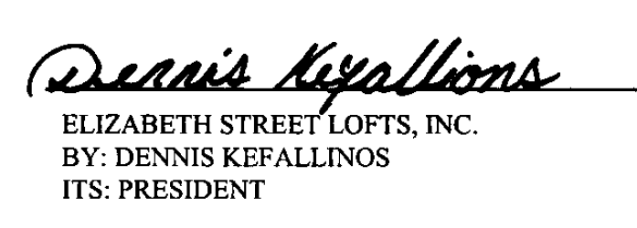
Stolen Title Deed
What could the agent do?
When the first order came in, the order looked legit, the seller came to closing and presented real identification. *Remember the fraud had already occurred when they filed the fake QCD.
The title agent attempted to contact the original (real) owner to confirm they did sign the QCD and intended to sell this property to the individual.
Signature on QCD:

Slide 21
Stolen Title Deed
What more could the agent have done?
If the seller/borrower in the current transaction holds title pursuant to an insured transactions that is less than 1 year old, assume that such prior transaction may have been fraudulent, and confirm the veracity of that prior transaction before proceeding anew. Obtain and carefully scrutinize, with underwriting assistance if possible, evidence of that prior closing, including the closing statement and title policy. Contact the former owner to confirm that they did, in fact, convey to the current seller/borrower.
From Doma Underwriting Bulletin 2024-01

Slide 22
Red Flags & how to triage your orders

Slide 23
Red Flags and Tips to Help Prevent Seller Impersonation in Real Estate
May 9, 2023
Real estate transactions have been a prime target of cybercrime over the past decade. There is little sign of this slowing even as the housing market continues to slow. Instead, fraudsters continue to evolve their scam and money laundering tactics to avoid detection.
This latest trend involves vacant lots or unencumbered properties. Fraudsters impersonate property owners to illegally sell commercial or residential property. Sophisticated fraudsters use the real property owner’s Social Security and driver’s license numbers in the transaction, as well as legitimate notary credentials, which may be applied without the notary’s knowledge. ALTA created a handout that highlights red flags and provides precautions to take to help prevent these scams.

Slide 24
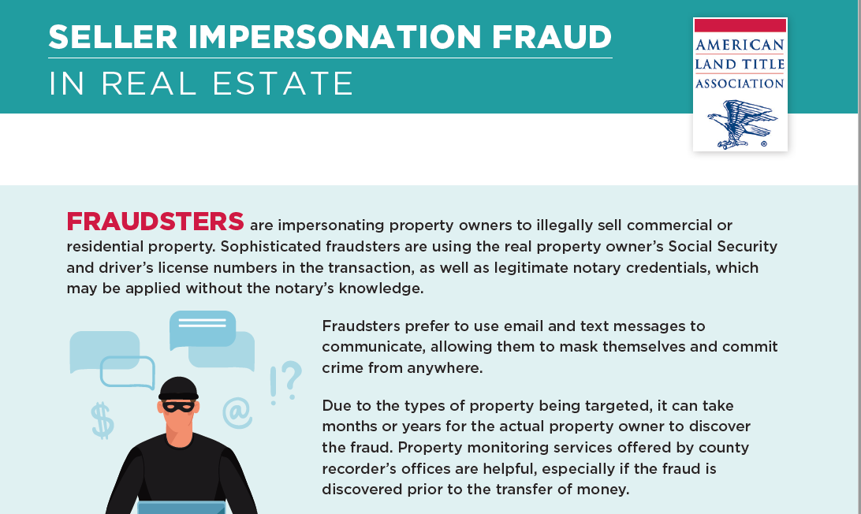

Slide 25
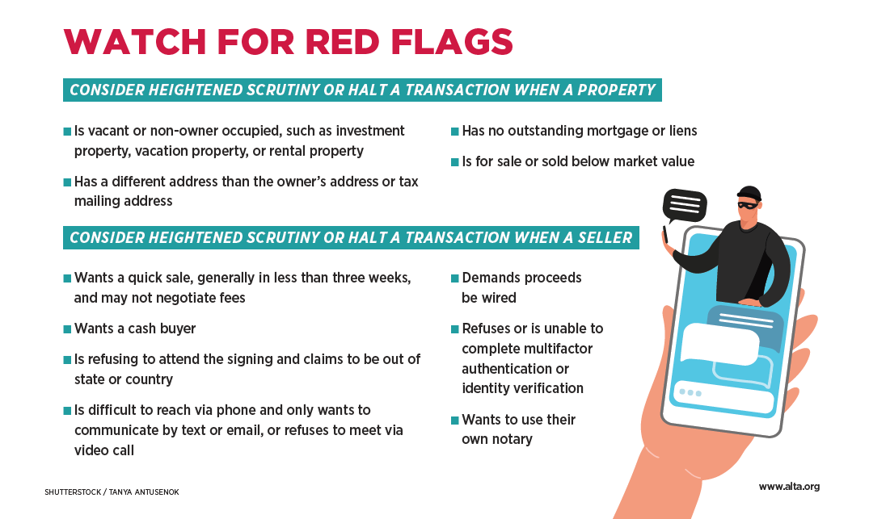

Slide 26
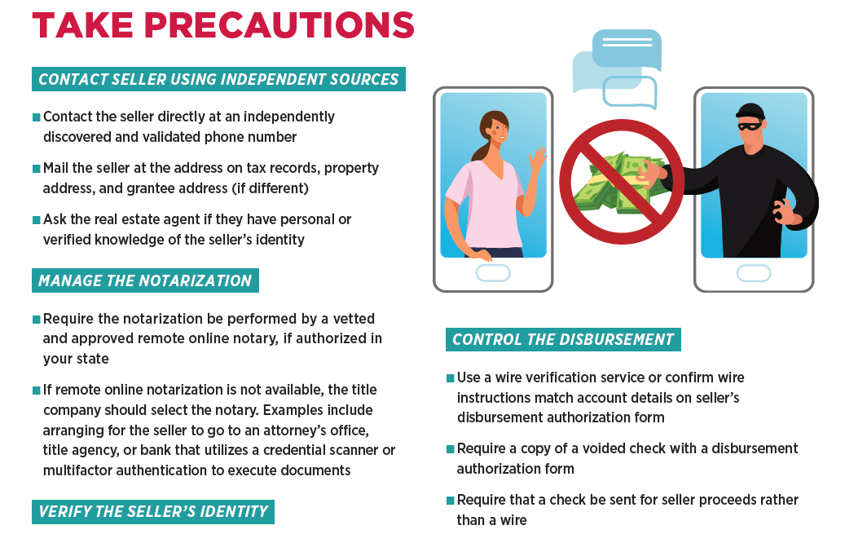

Slide 27
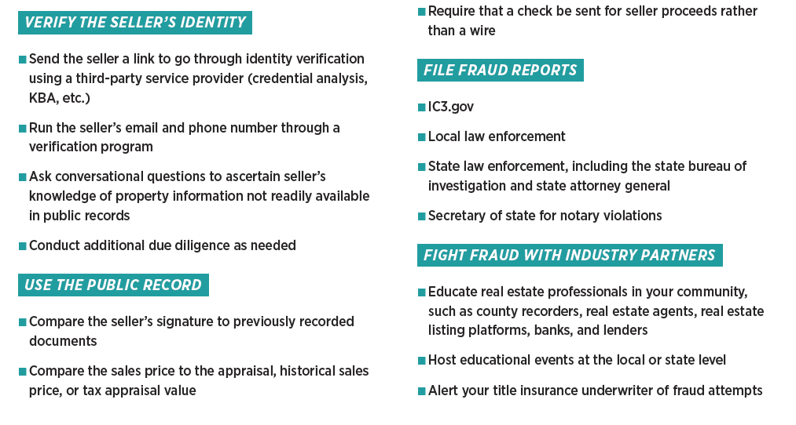

Slide 28
Seller Impersonation Fraud Prevention
Low tech is the best tech?
Unless the agent has a pre-existing relationship with the record title holder, a letter should be mailed to the record title holder, as reflected in the current tax rolls, thanking them for the title order and confirming that the order was initiated at their request. You should use the address on record for the property owner to which real property tax bills are mailed. For a business entity, you should use the record title holder’s address appearing on the current rolls of the Secretary of State or other state corporate records registry. If such representative was recently changed, less than a year, contact the address of the prior entity representatives as fraudsters are getting more savvy to this process.
This letter to the titleholder should provide a summary of the proposed transaction and include the following statement:
Thank you for your recent order with ABC Title Agency regarding your real property located at ______________________(Insert Legal Description/Address). We look forward to handling the sale/refinance of the property on your behalf. If it was not your intention to initiate this order, please contact our office immediately at _________(Phone) or email
__________________.

Slide 29
Triage orders – how?
Triage comes from the French word “trier” meaning to sort. It is a term often used in the Emergency Room where the Intake Nurse will survey all the patients, identify who has the most critical or urgent condition, and then go through a sorting process that will determine who will be seen in what order.

Slide 30
Triage Orders – first the assessment:
Is the property vacant, unencumbered or rental?
Does the Realtor/Title Agent/Mortgage Lender personally know the parties?
Has their been a recent transfer of title or change of corporation officers?
Are the parties only communicating via text or email?
Is there urgency – must close quickly?
Do the parties want to use their own Notary?

Slide 31
Triage Orders – second take steps to prevent fraud:
Require ID Verification to begin this transaction.
Use RON to require parties to verify their identity.
Send letter to owner address shown in tax records – us mail.
Verify signatures on prior deeds.
Use technology where available to thwart fraud.

Slide 32
Technology solutions to prevent fraud

Slide 33
Identity Verification Systems

Slide 34
Knowledge Based Authentication

Slide 35
Payment and Wire verification systems

Slide 36
Remote Online Notary Services

Slide 37
Live demo of ID verification service

Slide 39
Question and Answer time

Slide 40
Speaker
Michael Holden
Vice President, Strategic Agency
Doma Title Insurance, Inc.
Ph: 440.725.8973
Email: michael.holden@doma.com

